Slide 1
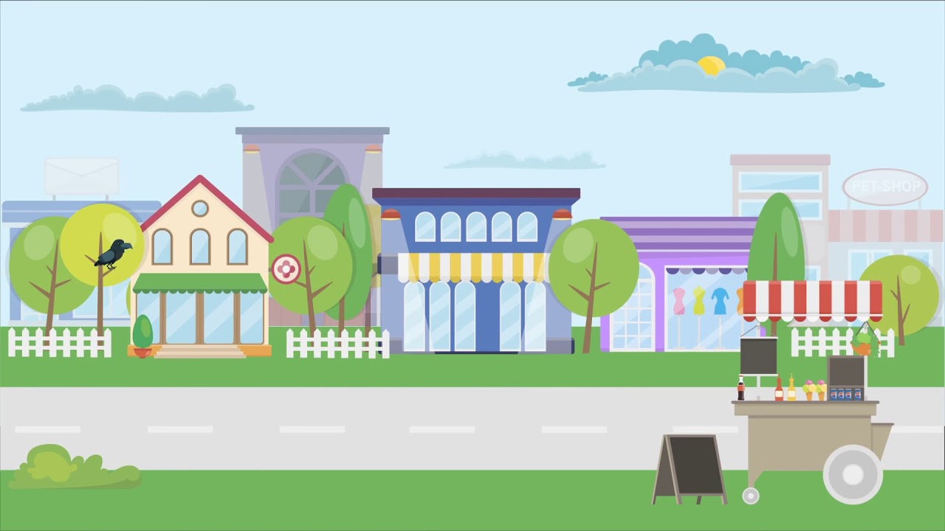
UNIT 1
LESSON 2
It’s Nine Thirty
START

Slide 2

This lesson will learn about :
How to read clock.
Give responds about time.

Slide 3
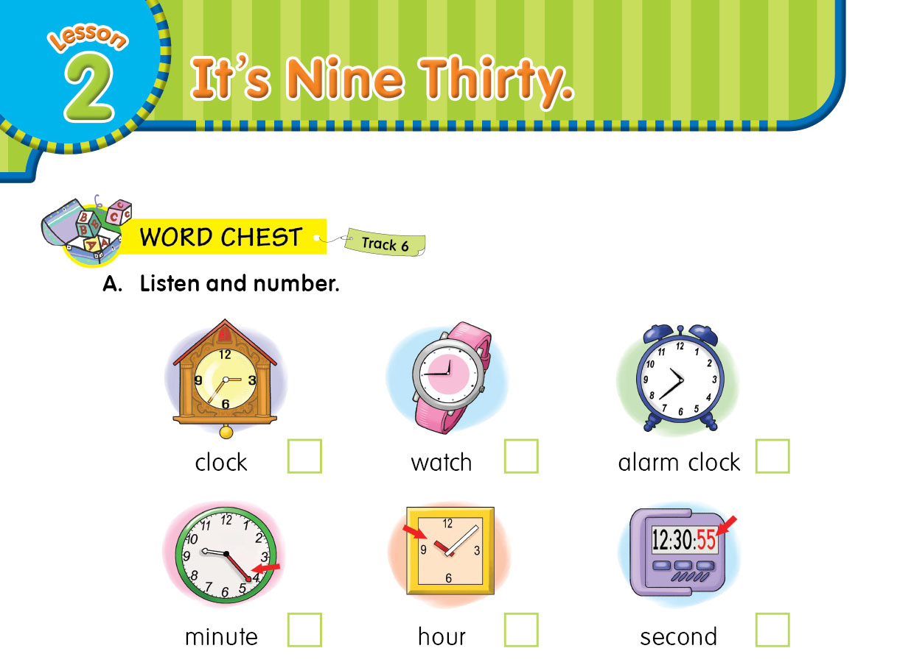

4
1
5
3
6
2

Slide 4

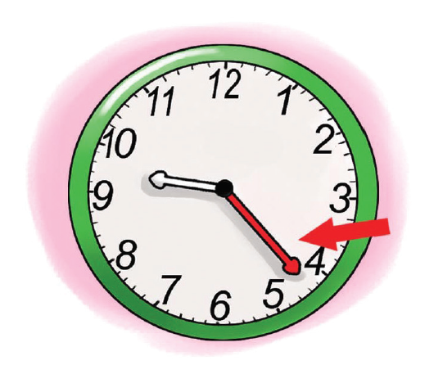

Slide 5

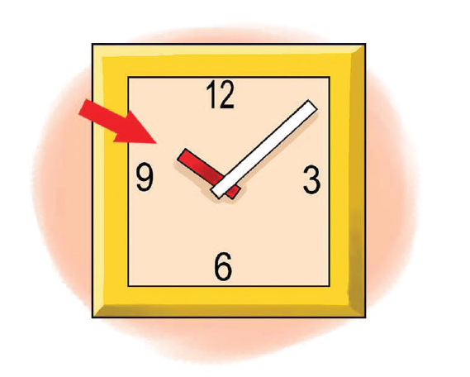

Slide 6

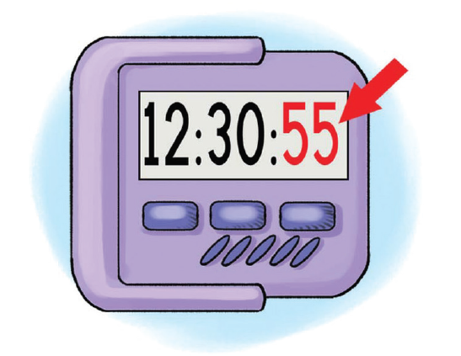

Slide 7

How to Read Clock?

Slide 8
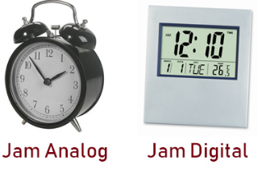

Slide 9
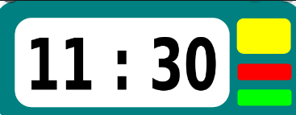
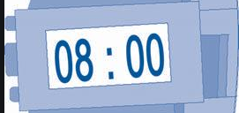
What time is it?
What time is it?
It is eleven thirty
It is eight o’clock

Slide 10
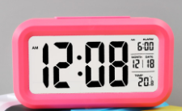

What time is it?
What time is it?
It is twelve fourty five
It is twelve oh eight

Slide 11
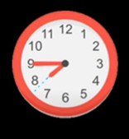

What time is it?
It is seven fourty five

Slide 12
Periods of Time
A.m (Ante Meridiem) = 24.00 – 12.00
09 : 00 a.m. : It’s nine o’clock in the morning.
09 : 45 a.m. : It’s a quarter to ten in the morning.
P.m (Post Meridiem) = 12.00 – 24.00
09 : 00 p.m. : It’s nine o’clock in the evening.
02 : 15 p.m. : It’s a quarter past two in the afternoon.

Slide 13


Expressions of time
Great! We have plenty of time
Uh, oh! Hurry up!

Slide 14



Example
Great! We have plenty of time

Slide 15


Example
Uh, oh! Hurry up!

Slide 16
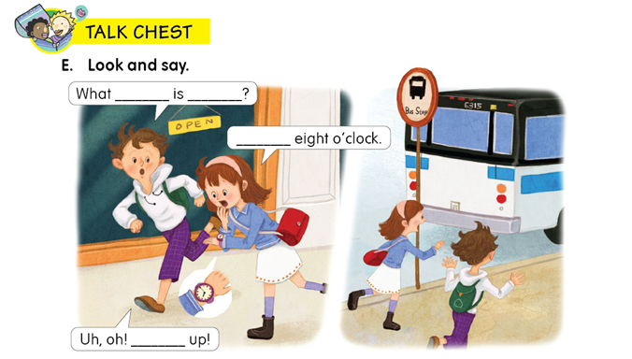
time
it
It’s
Hurry

Slide 17

THANK YOU ☺

