Slide 1
Unit 2 Lesson 1
Be Quiet!
Start!

Slide 3
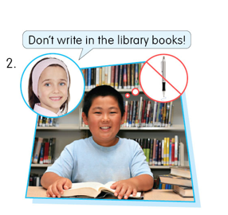

Slide 4
In this lesson, You will learn about:
1. Identifying rules at home and in public place. 2. Commands
Start!

Slide 5
4
2
3
1
5
6

Slide 6
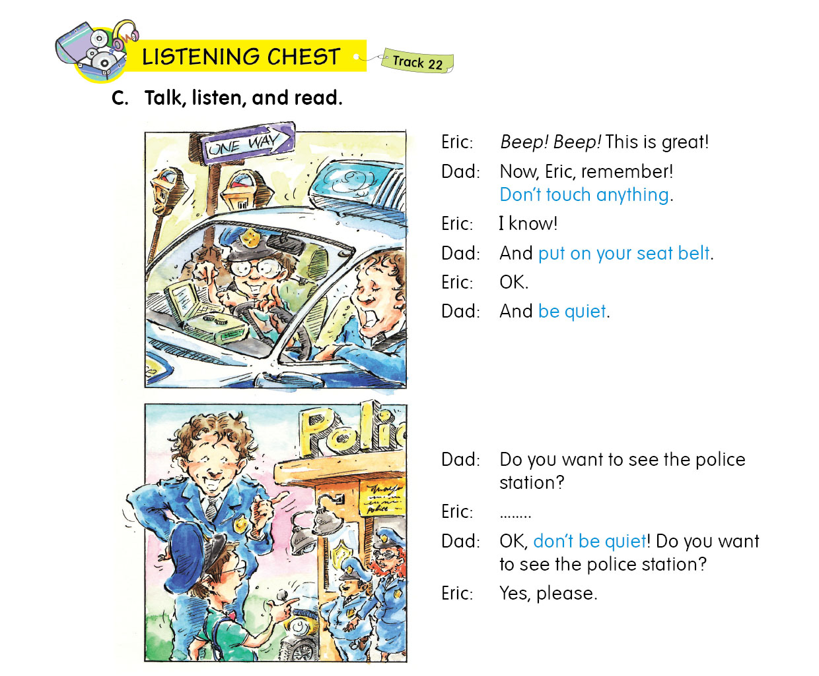

Slide 7
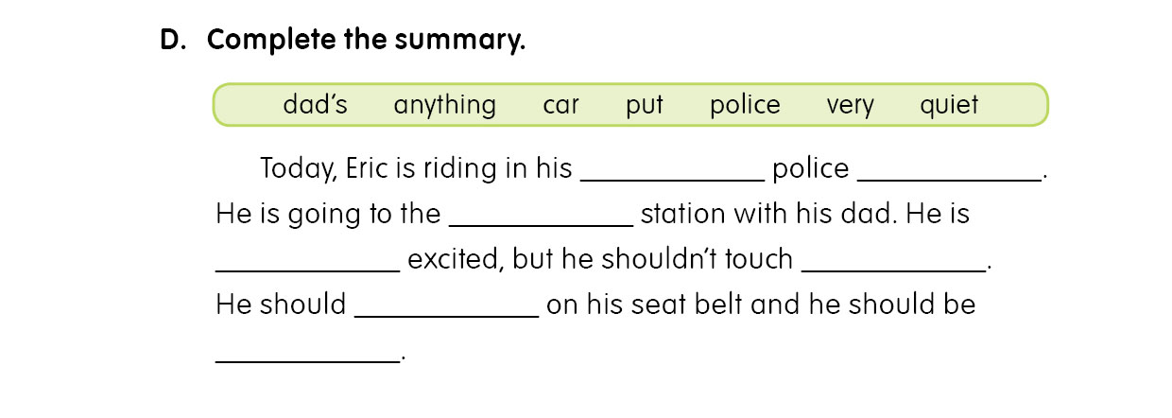
dad’s
car
police
very
anything
put
quiet

Slide 8
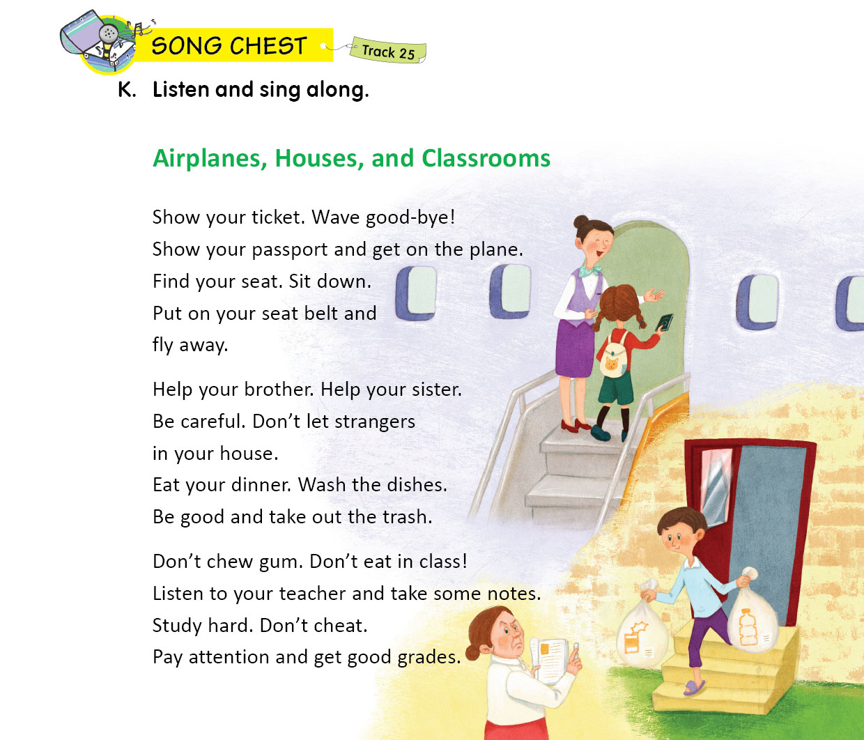

Slide 9
We find some rules
Airplane
At school
1.Show your ticket.
2.Find your seat.
3. Sit down
4.Put on your seat belt.
At home
1.Shouldn’t chew gum.
2.Shouldn’t eat in class.
3. Listen to teacher.
4.Study hard.
5. Shouldn’t cheat.
1.Help your brother or sister
2.Don’t let strangers in house.
3. Wash the dishes.
4.Take out the trash.

Slide 10
Do your homework!
Go to bed early!
Don’t play computer games!
Brush your teeth after breakfast!
Don’t sleep in class!

Slide 11
Can you mention some school rules that should or shouldn’t do?
1
2
3

Slide 12
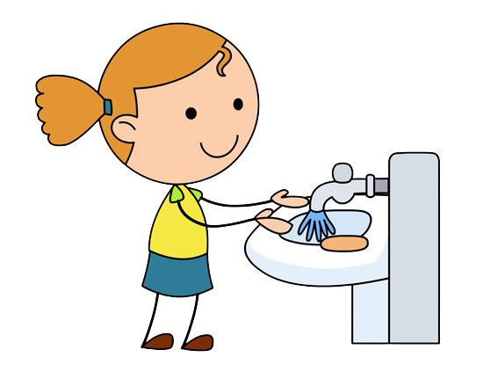
Some rules that should and shouldn’t do.
1. Wash your hands before dinner.
2. Don’t walk in the grass.
3. Go to bed early.

Slide 13
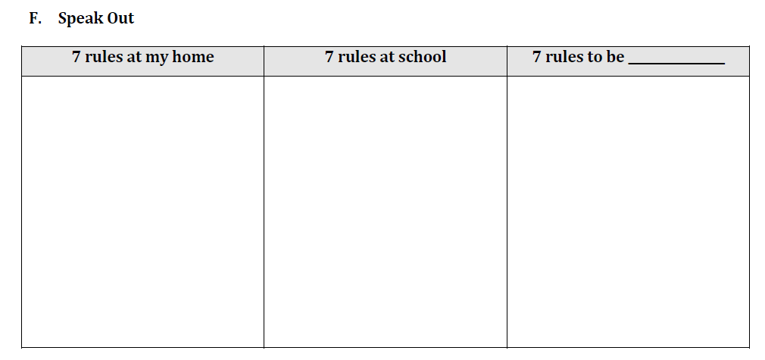

Slide 14
Thanks!!

Slide 15
don’t

Slide 16
