Slide 1
UNIT 1
LESSON 3
Do You Have
Any Hobbies ?

Slide 2
In this lesson, you will learn about:
1. Express hobbies and share some personal information”,
2. Simple Present Tense (like + to (infinitive).

Slide 3
In this lesson, you will learn about:
1. Express hobbies and share some personal information”,
2. Simple Present Tense (like + to (infinitive).

Slide 4
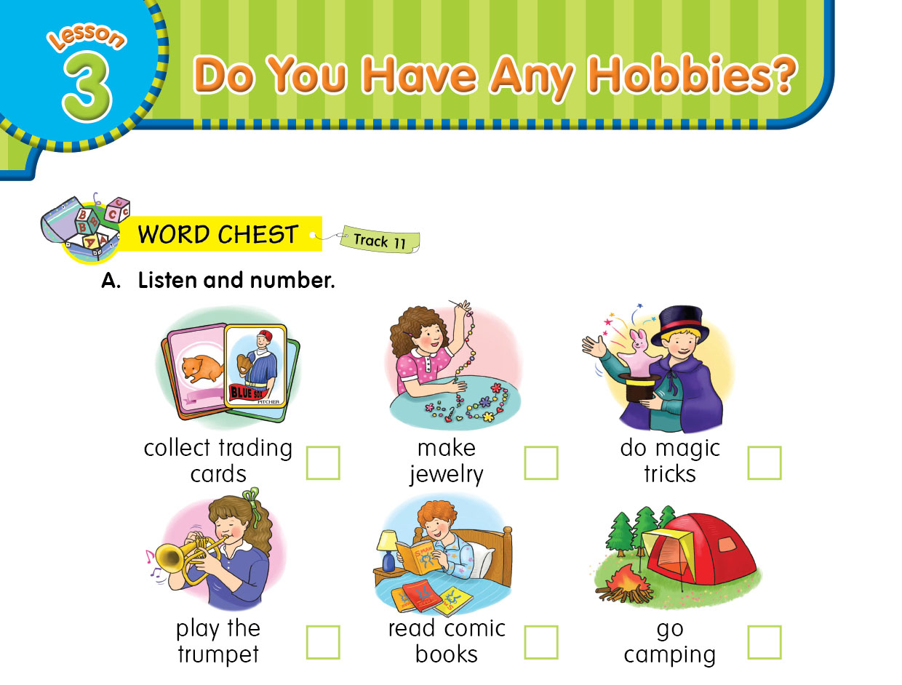

4
1
6
2
5
3

Slide 5

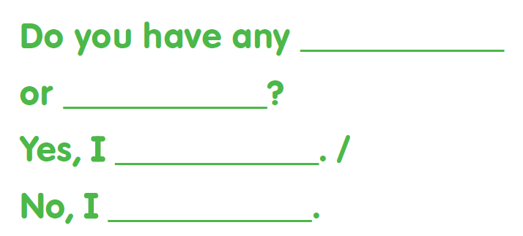

Sentence Pattern

Slide 6
Simple Present Tense
The simple present is a verb tense which is used to express habits, general truths, repeated actions
Definiton
01
02
Structures
04
03
Assignment

Slide 7
1. Positive/ Affirmative
2. Negative form
3. Interrogative form
Do I like coffee?
Do You like coffee ?
Do We like coffee ?
Do They like coffee ?
I like coffee.
You like coffee.
We like coffee.
They like coffee.
I do not like coffee.
You don’t like coffee.
We don’t like coffee.
They don’t like coffee.
She likes coffee.
He likes coffee.
It likes coffee.
She does not like coffee.
He doesn’t like coffee.
It doesn’t like coffee.
Does she like coffee ?
Does he like coffee ?
Does it like coffee ?

Slide 8
1. Positive/ Affirmative
2. Negative form
3. Interrogative form
I drink milk.
I do not drink milk.
Do I drink milk?
You work in the morning.
You don’t work in the morning.
Do you work in the morning?
Jason studies English.
Jason doesn’t study English.
Does Jason study English?
My mother likes singing
My doesn’t mother like singing
Does my mother like singing?

Slide 9
I like to sing.
I like singing.
How to tell Hobbies in English?

Slide 10
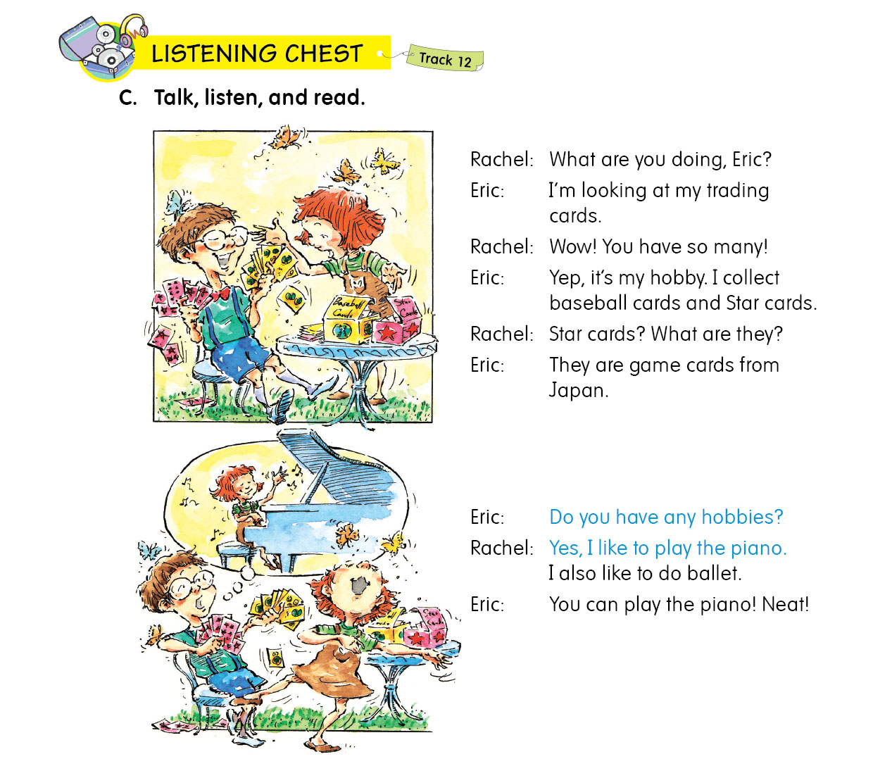

Slide 11
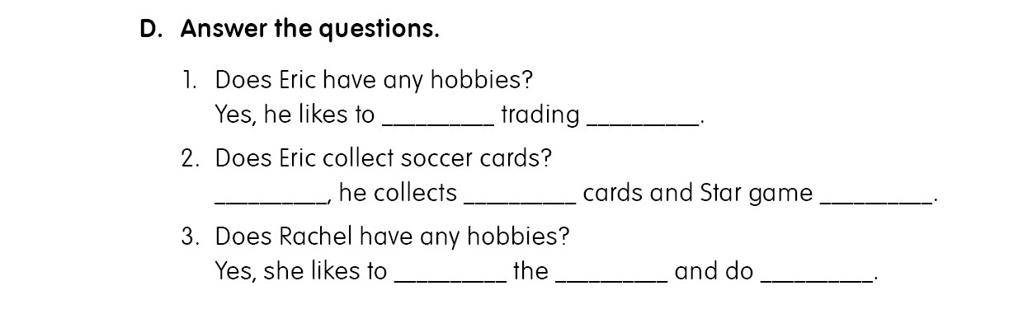
collect
cards
No
baseball
cards
play
piano
ballet

Slide 12
ASSIGNMENT
THANKS!

