Slide 3
What do your parents do?
Unit 2
Lesson 2

Slide 4
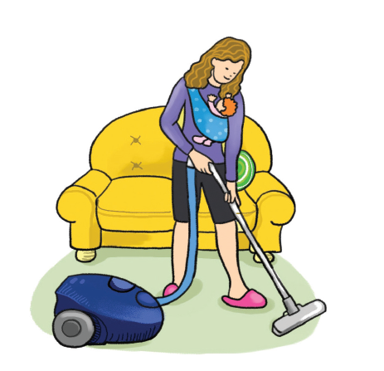
What can you see?

Slide 5
In this lesson, we will learn about:
Talking about
Occupations.

Slide 6
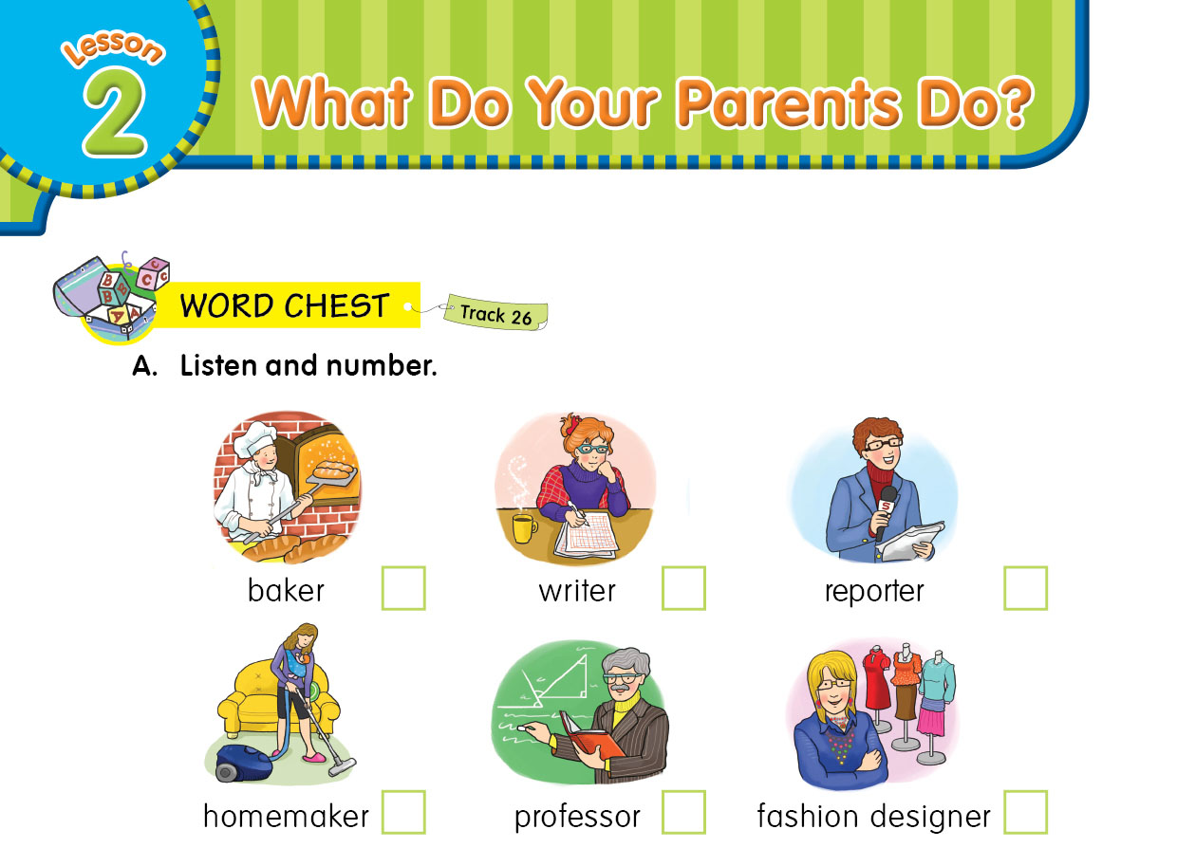
4
6
2
3
1
5

Slide 7
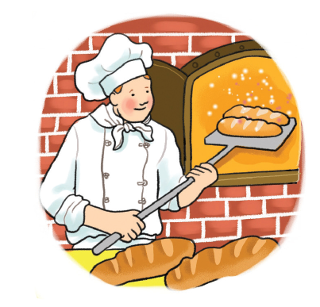
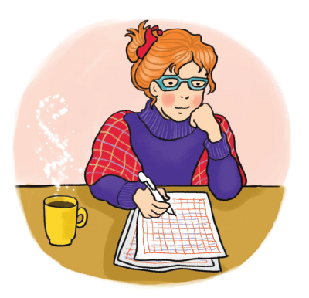
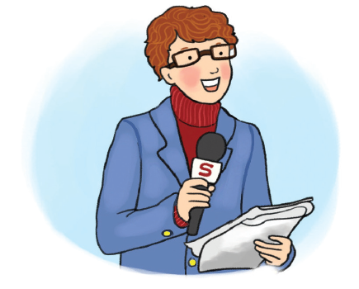
a person whose job is to make bread, cakes and cookies.
a person whose job is to write books.
a person whose job is to find out and report the news.

Slide 8
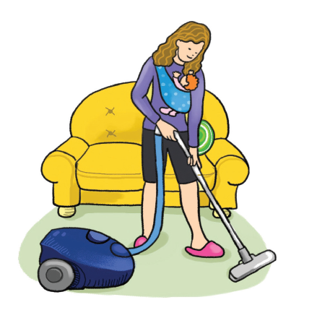
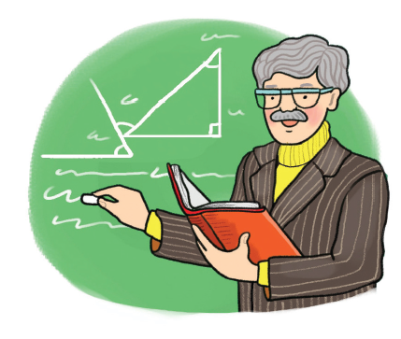
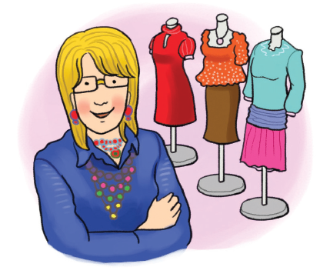
a person who takes care of their own house and family, often a mother.
a teacher at a university.
a person whose job is to create clothes.

Slide 9
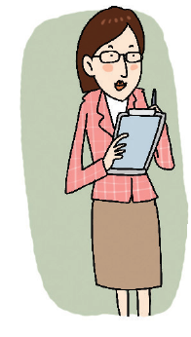
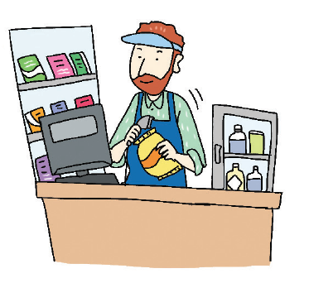
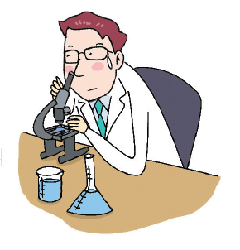
a person who works in an office and answers phones and types documents
a person who owns and works in a shop.
a person who does experiments and research.

Slide 10
a woman who works in movies and plays

Slide 11
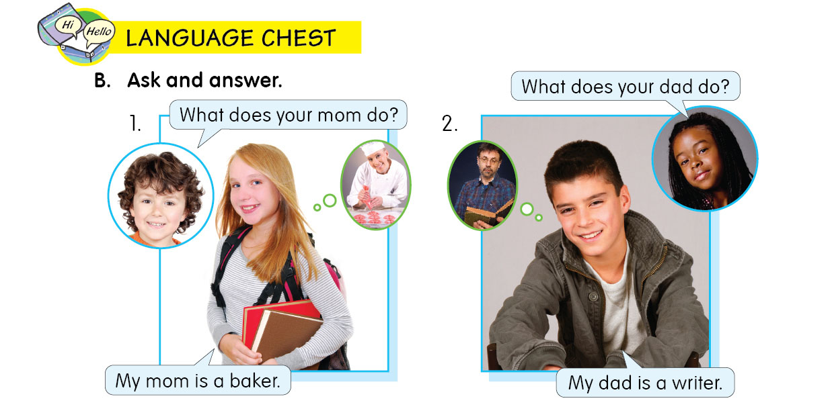

Slide 12
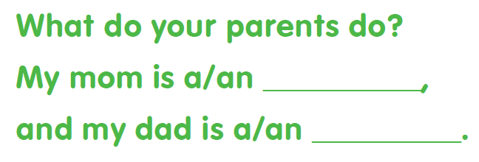

Slide 14
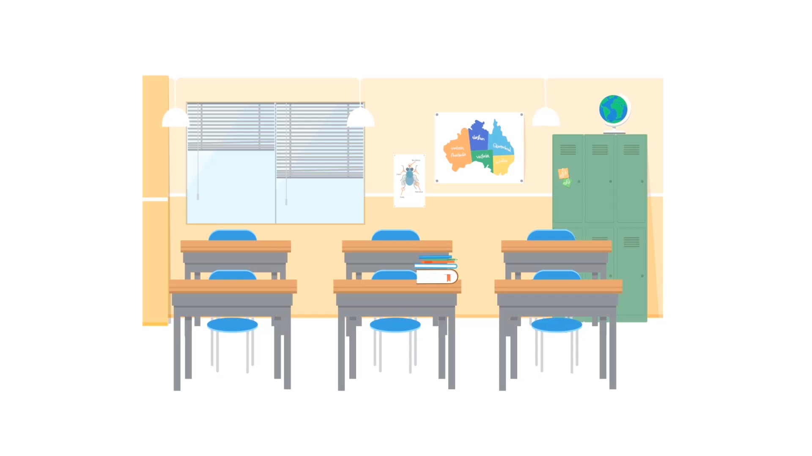
What do your parents do?
My mom is a professor and
my dad is a taxi driver.

Slide 15
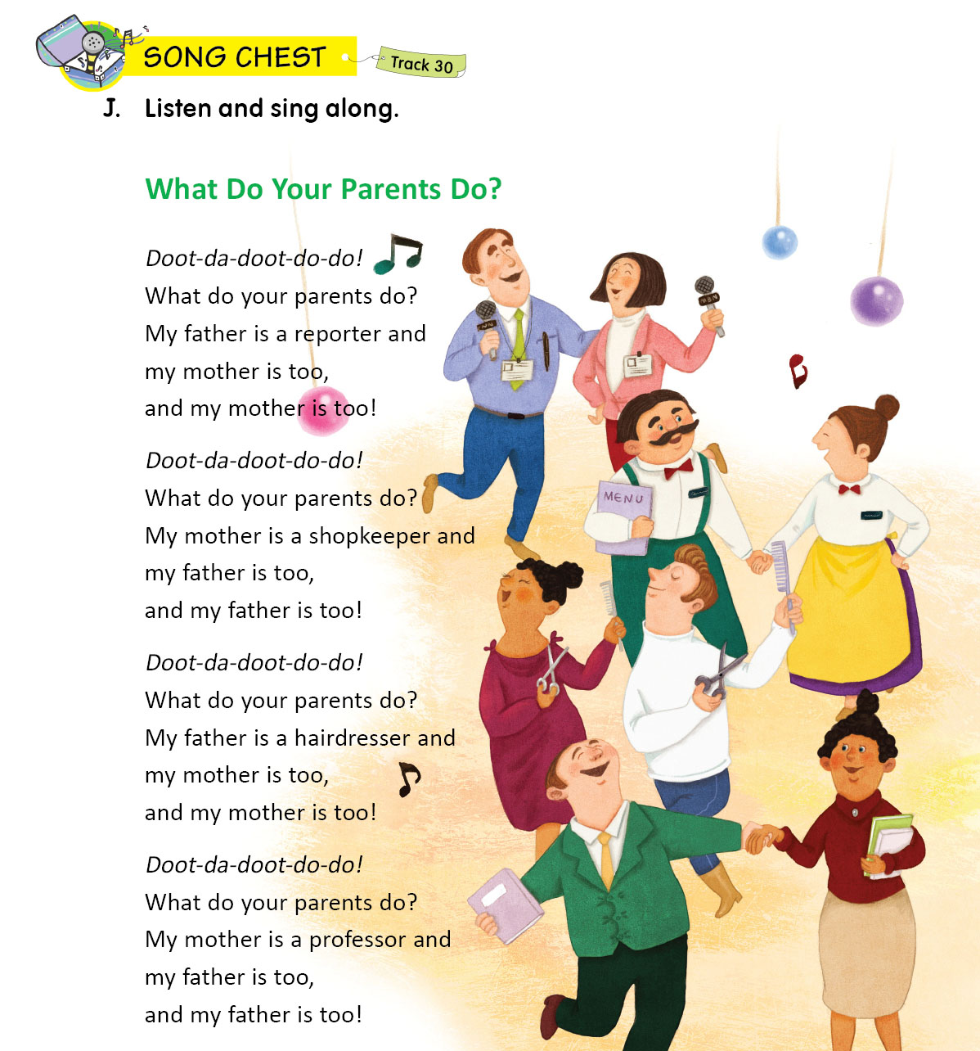

Slide 16
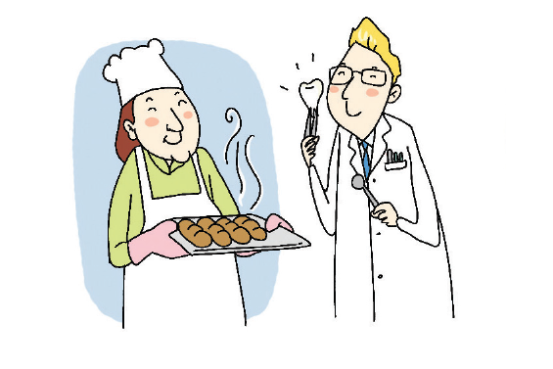
What do her parents do?

Slide 17
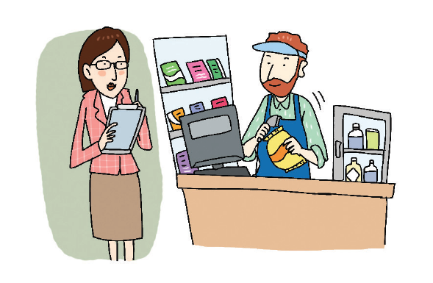
What do his parents do?

Slide 18
do
your
My
a
my
a

Slide 20
THANKS!

