Slide 1

UNIT 1
LESSON 1
What is your name?

Slide 2
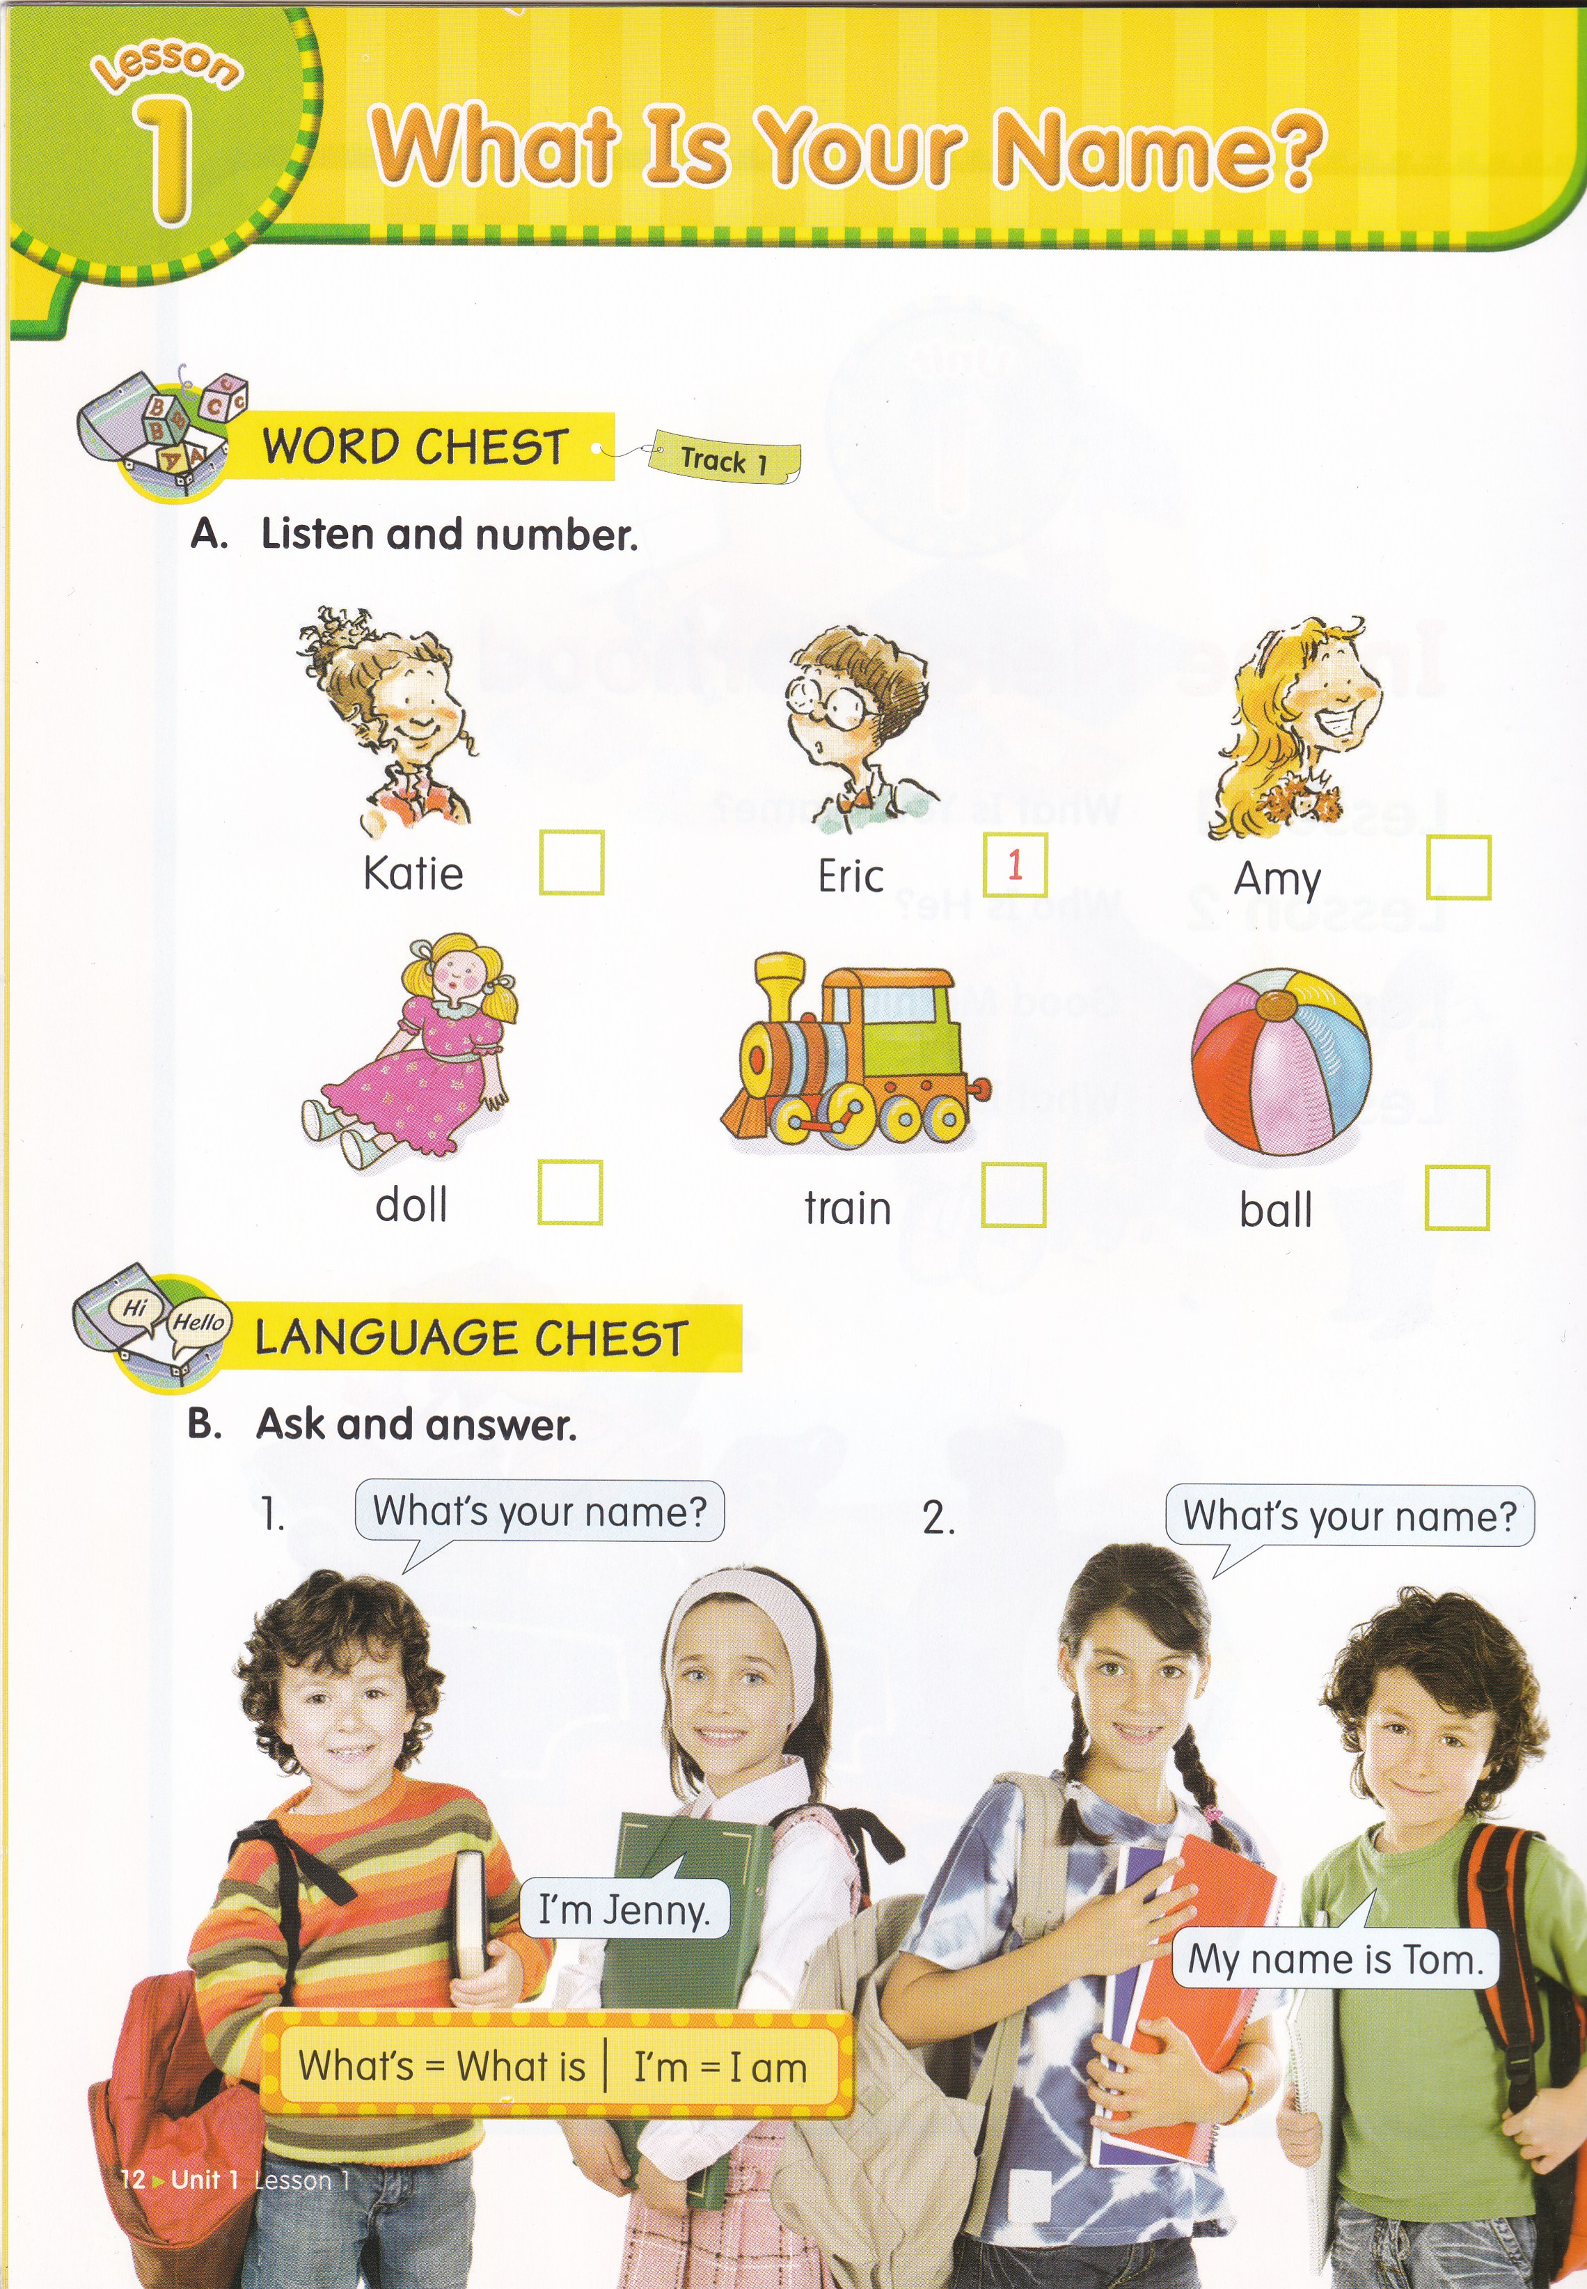

What is this?
This is a ball.

Slide 3
What is this?
This is a train.

Slide 4
What is this?
This is a doll.

Slide 5
What is this?
I’m Tom
This is a boy.

Slide 6
What’s his name?
His name is Tom.
I’m Tom

Slide 7
What is this?
I’m Jenny.
This is a girl.

Slide 8
What’s her name?
Her name is Jenny.
I’m Jenny.

Slide 9
What is your mother’s name?
My mother’s name is _______.

Slide 10
What is your father’s name?
My father’s name is _______.

Slide 11
The Subject is taken from
English Chest 1 Unit 1 Lesson 1
“What is your name?”
In this lesson, you will learn about greetings.

Slide 12
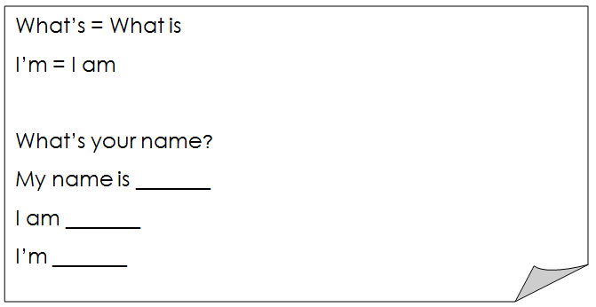
SENTENCE PATTERN

Slide 13
Example
What’s your name?
My name is Jenny.
I am Jenny.
I’m Jenny.
SENTENCE PATTERN

Slide 14


4
6
2
5
3

Slide 16
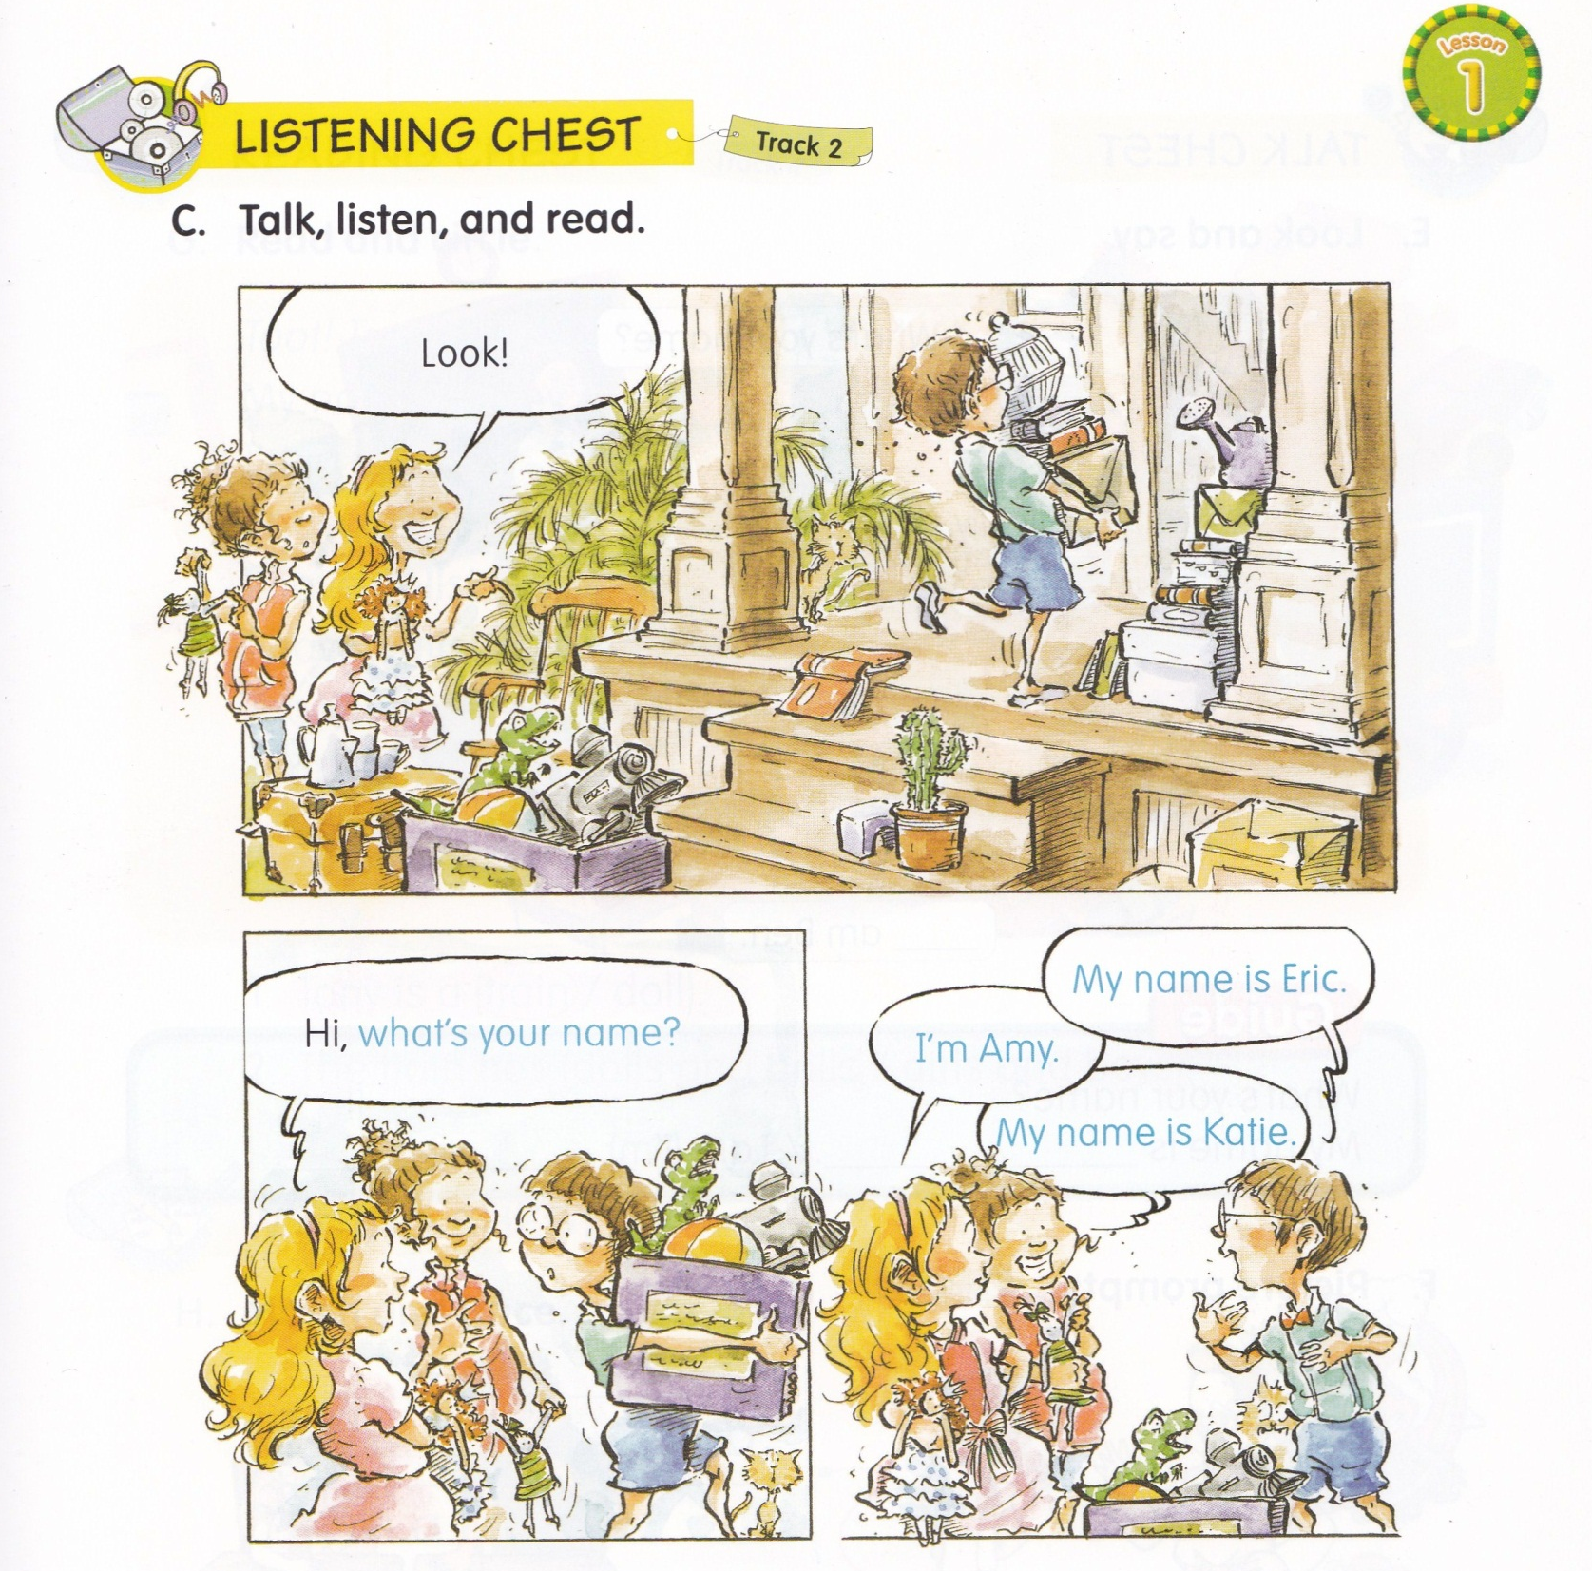

Slide 17
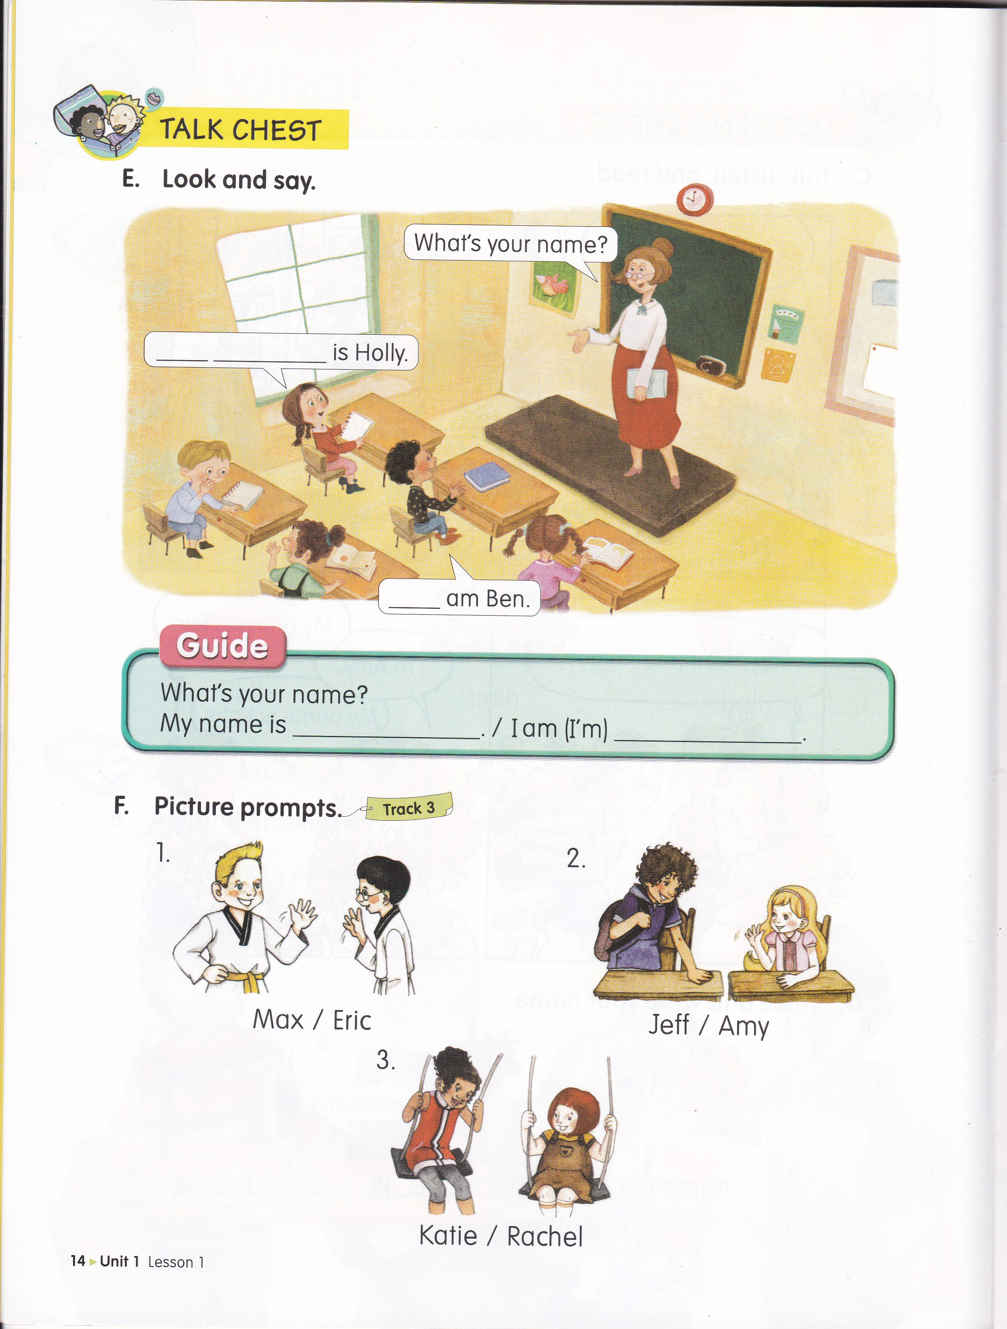
My
name
I

Slide 19
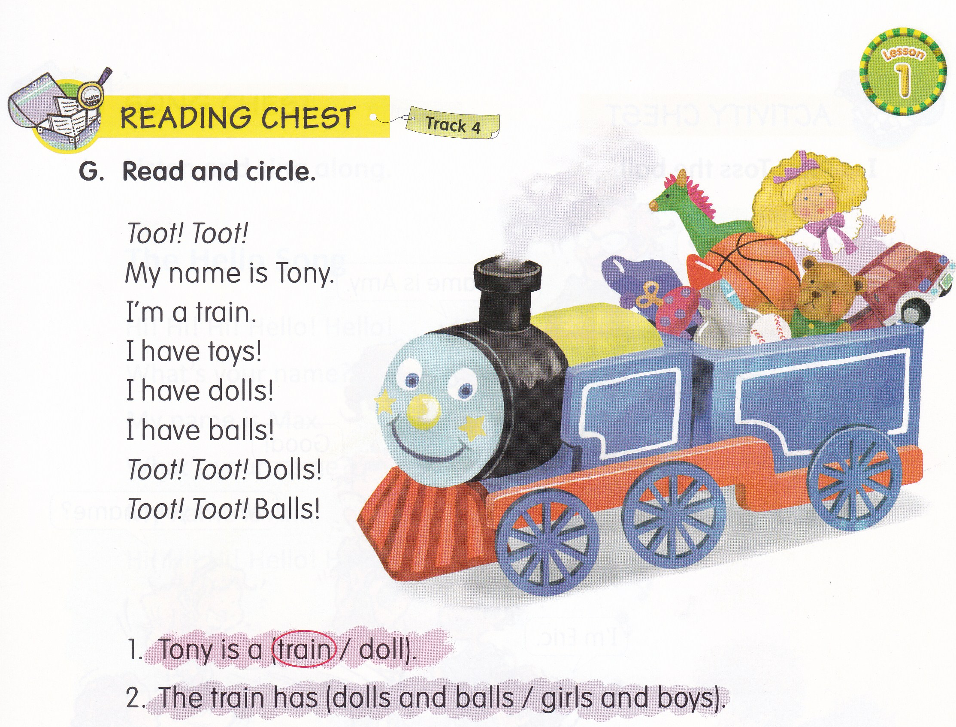

Slide 20
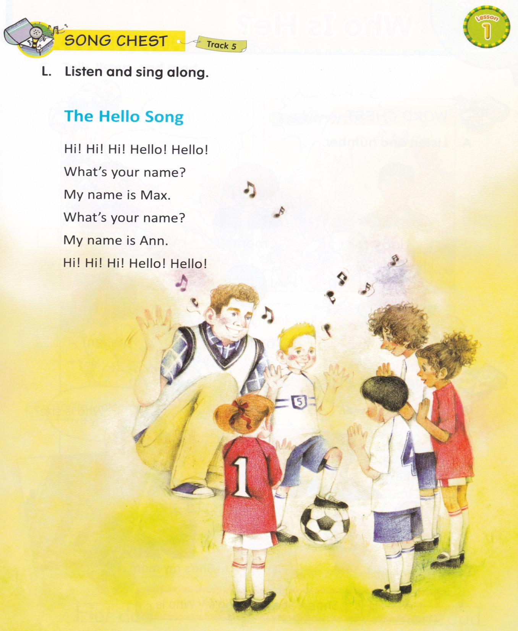

Slide 21
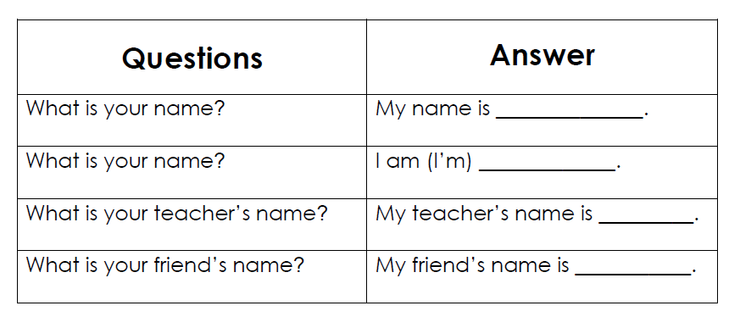
Homework (From EC Summary page 3)

Slide 22


