Slide 1

First Meeting
Unit 1 Lesson 3
Good Morning!

Slide 2

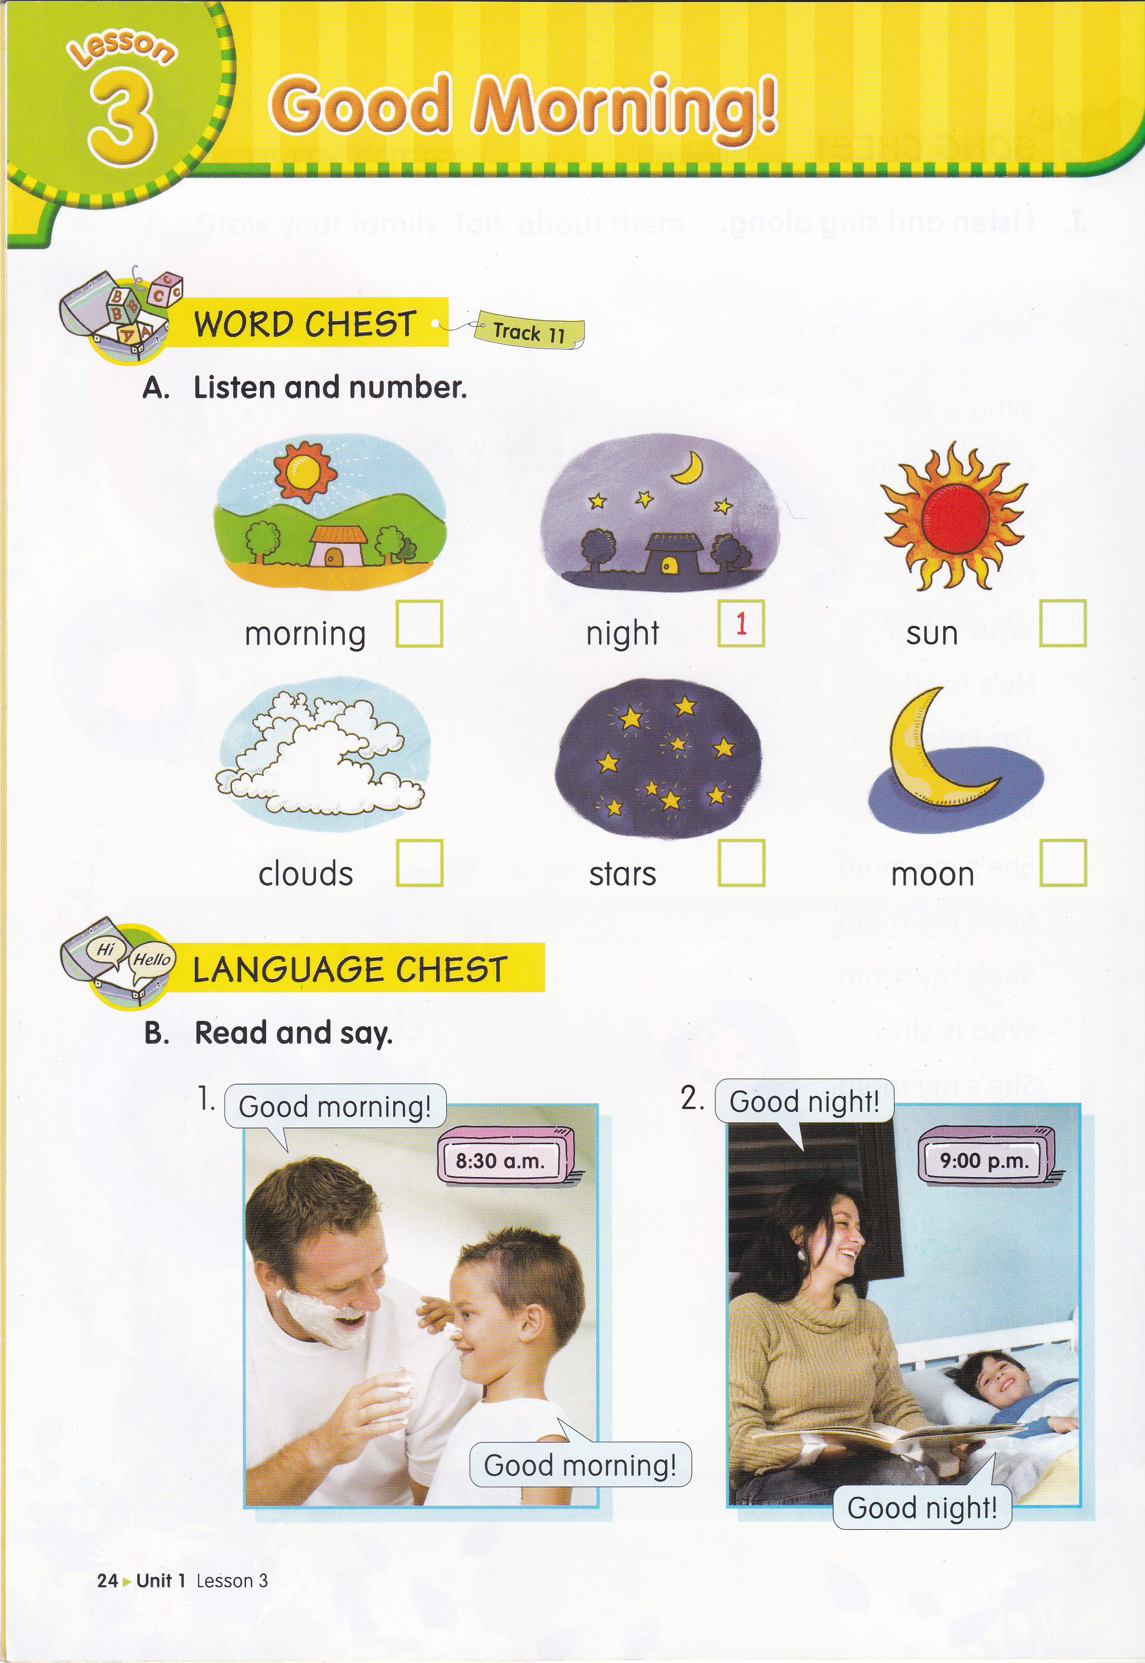
What is this?
This is a sun.

Slide 3
What is this?
This is a moon.

Slide 4
What are they?
They are stars.

Slide 5
What are they?
They are clouds.

Slide 6
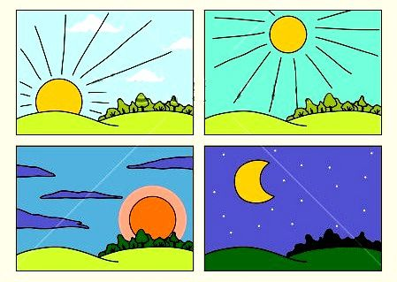
When do you usually take a bath?
I take a bath in the morning.

Slide 7
When do you usually have lunch?
I have lunch in the afternoon.

Slide 8
When do you usually read a story book?
I read a story book in the evening.

Slide 9
When will your dad back from work?
My dad will back from work at night.

Slide 10


Let’s sing a song!
Good Morning! Good Evening!
Good morning to you!
Good morning to you!
Good morning, dear friend!
Good morning to you!
Good evening to you!
Good evening to you!
Good evening, dear friend!
Good evening to you!

Slide 11

In this lesson, you will learn how to identify the different times of day
(morning, afternoon, evening, night)
The Subject is taken from
English Chest 1 Unit 1 Lesson 3
“Good Morning!”

Slide 12
Greeting
hello – hello
hi – hi
nice to meet you – nice to meet you too

Slide 13
Farewell
bye - bye
good bye – good bye
see you – see you

Slide 14
Sentence Patterns
*Mr. is short for Mister.
*Miss or Misses is used for women.
Miss is for an unmarried woman.
Misses is abbreviated as Mrs., means a married woman.
Ms. can be used for any woman.

Slide 15
Examples
Ms. Retno : Hello, children!
Children : Hello, Ms. Retno!
Ms. Retno : Good morning, children!
Children : Good morning, Ms Retno!
Ms. Retno : Good bye, children!
Children : Good bye, Ms. Retno!
Ms. Retno : See you, children!
Children : See you, Ms. Retno!

Slide 16
What is this?
4
5
2
6
3

Slide 17
Homework
Greet your family and ask.
Questions | Answer
Good morning mom. When do you usually cook? | Mother : __________.
Good morning brother. When do you usually have lunch? | Brother : __________.
Good morning dad. When will you back from work? | Father : __________.

Slide 18


