Slide 1
Second Meeting
Unit 1 Lesson 3
Good Morning!

Slide 2
In this lesson, you will learn :
Review homework
How to identify the different times of day
How to greet people using times of day greetings.

Slide 3
Greet your family and ask.
Good morning mom.
When do you usually cook?
I usually cook in the morning.
Good morning brother / sister.
When do you usually have lunch?
I usually have lunch in the afternoon.
Good morning father.
When will you back from work?
I back from work in the evening.

Slide 4
Good morning children!
When do you usually take a bath?
Good morning miss!
I take a bath in the morning.
I take a bath at 6 a.m.

Slide 5
Good morning children!
When do you usually have lunch?
Good morning miss!
I have lunch in the afternoon.
I have lunch at 12 p.m.

Slide 6
Good morning children!
When do you usually sleep?
Good morning miss!
I sleep at night.
I sleep at 8 p.m.

Slide 7
Different times of day.
a.m = ante meridiem
00.59 dini hari – 11.59 siang hari
p.m = post meridiem
12.00 siang hari – 12.00 malam hari

Slide 8
Different times of day.
08.00 = 8 a.m. = 8 o’clock in the morning
William : Good morning!
Jordy : Good morning!
13.00 = 1 p.m. = 1 o’clock in the afternoon
Teacher : Good afternoon!
Hilda : Good afternoon!

Slide 9
Different times of day.
17.00 = 5 p.m. = 5 o’clock in the evening
James : Good evening!
Paul : Good evening!
21.00 = 9 p.m. = 9 o’clock at night
Cecilia : Good night!
Mikhaela : Good night!

Slide 10
Let’s sing a song!
Good Morning! Good Evening!
Good morning to you!
Good morning to you!
Good morning, dear friend!
Good morning to you!
Good evening to you!
Good evening to you!
Good evening, dear friend!
Good evening to you!

Slide 11
Vocabulary
moon
sun
stars
clouds
afternoon
morning
evening
night

Slide 13
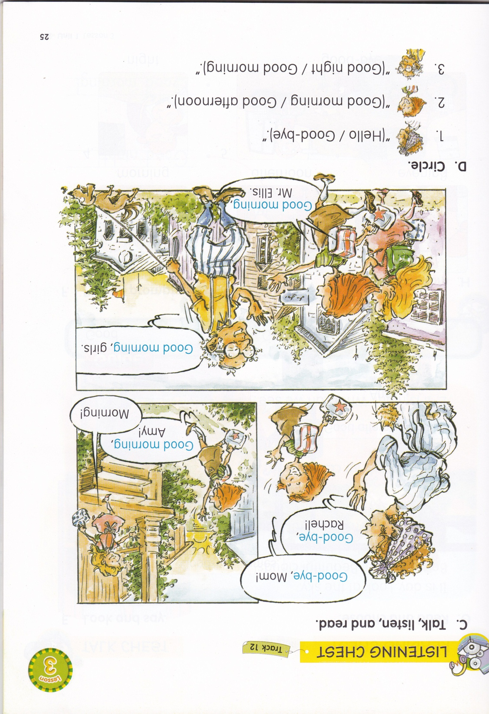

Slide 14
Good-bye
Good afternoon

Slide 17
Good evening!
Good night!
Good morning!

Slide 18
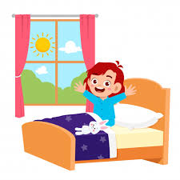
1. It is (day / night).
2. She can see the (moon / sun).

Slide 19
I look at the sky.
It is day.
I can see the _________.
sun

Slide 20
I look at the sky.
It is _________.
I can see the __________.
night
stars

Slide 21
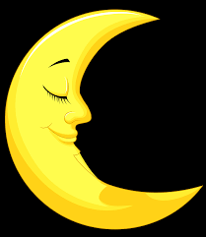
Look at the _______!
It is night.
moon

Slide 22
Look at the _______ !
The ________ is beautiful!
clouds
sky

