Slide 1

Unit 1 Lesson 4
What Is It?

Slide 2

In this lesson
you will learn
how to identify
a few singular objects.

Slide 3

What can you see?
I can see a tree.

Slide 4

What can you see?
I can see a flower.

Slide 5
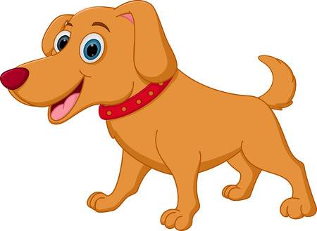
What is it?
It is a dog.

Slide 6
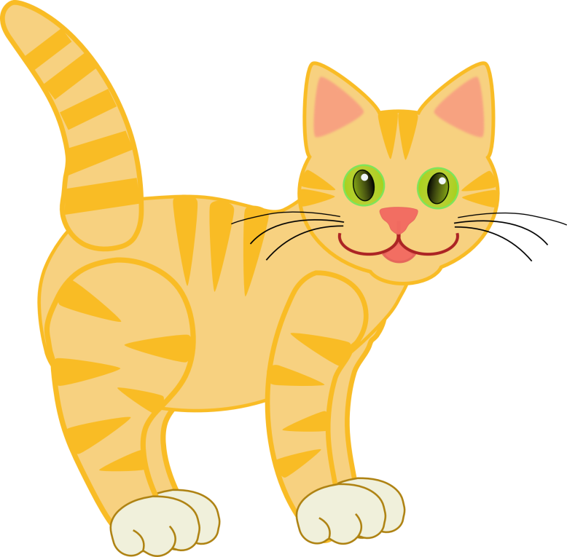
What is it?
It is a cat.

Slide 7

What is it?
It is a bear.

Slide 8

What is it?
It is an apple.

Slide 9

What is it?
It is an umbrella.

Slide 10


Let’s sing a song!
What Is It?
What is it? What is it?
What is it? What is it?
What can you see? What can you see?
It’s a bear. It’s a dog.
It’s a bear. It’s a dog.
It’s a teddy bear! It’s a puppy dog!

Slide 11

SENTENCE PATTERN
What is it?
It is a ________.
It is an _________.
The …

Slide 12
SENTENCE PATTERN
“a” consonants (b, c, d, k, … etc)
Example : a tree, a book
“an” vowel sound (a, i, e, u, o)
Example : an apple, an umbrella
OK is short for OKAY

Slide 13
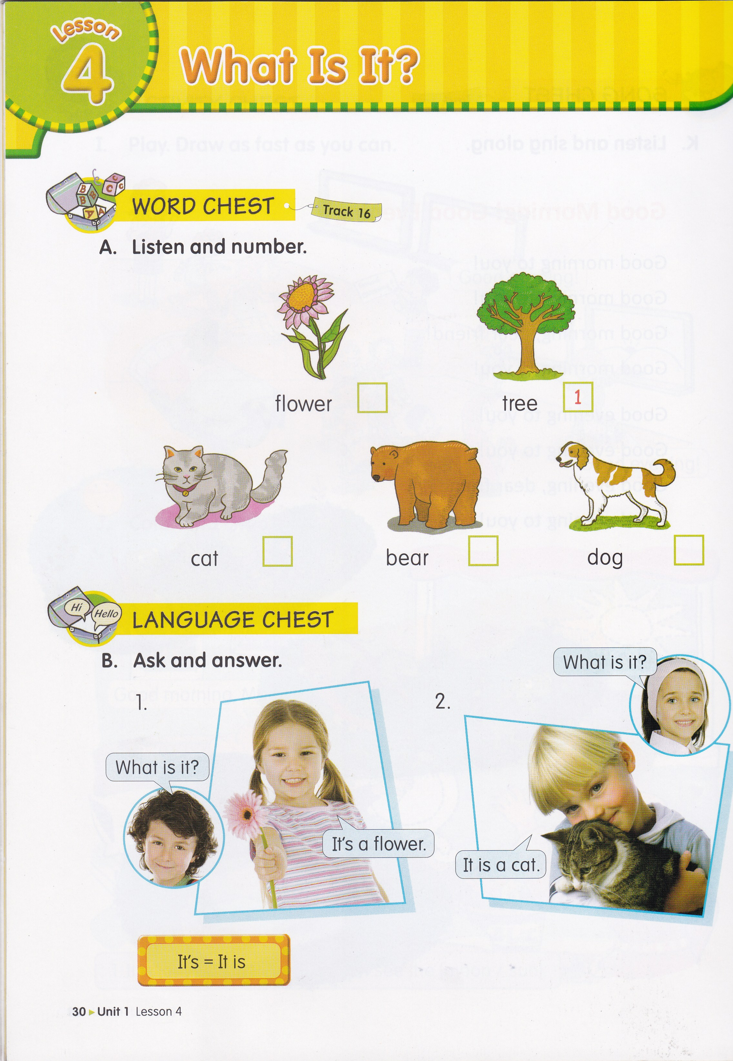
5
2
3
4

Slide 14
It’s = It is

Slide 15
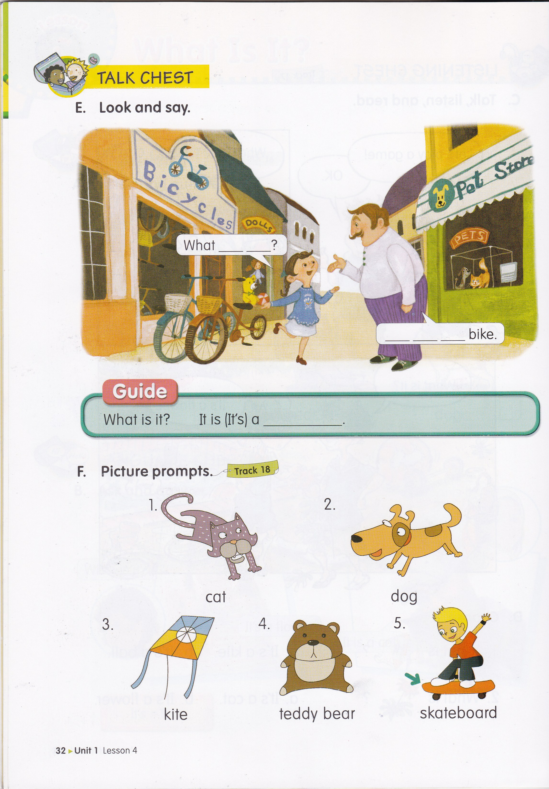
is
it
It
is
a

Slide 16

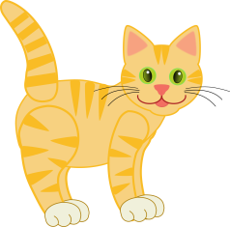
Ask and answer
Lia : What is it?
Dila : It is a flower.
Lia : What is it?
Dila : It is a cat.
Lia : What is it?
Dila : It is an apple.
Lia : What is it?
Dila : It is an umbrella.

Slide 18
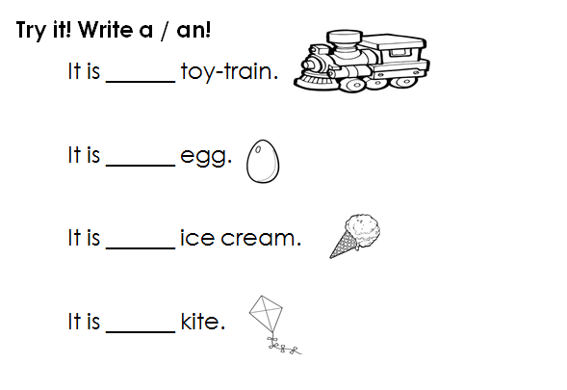
HOMEWORK
(From EC Summary page 11)

Slide 19


