Slide 1
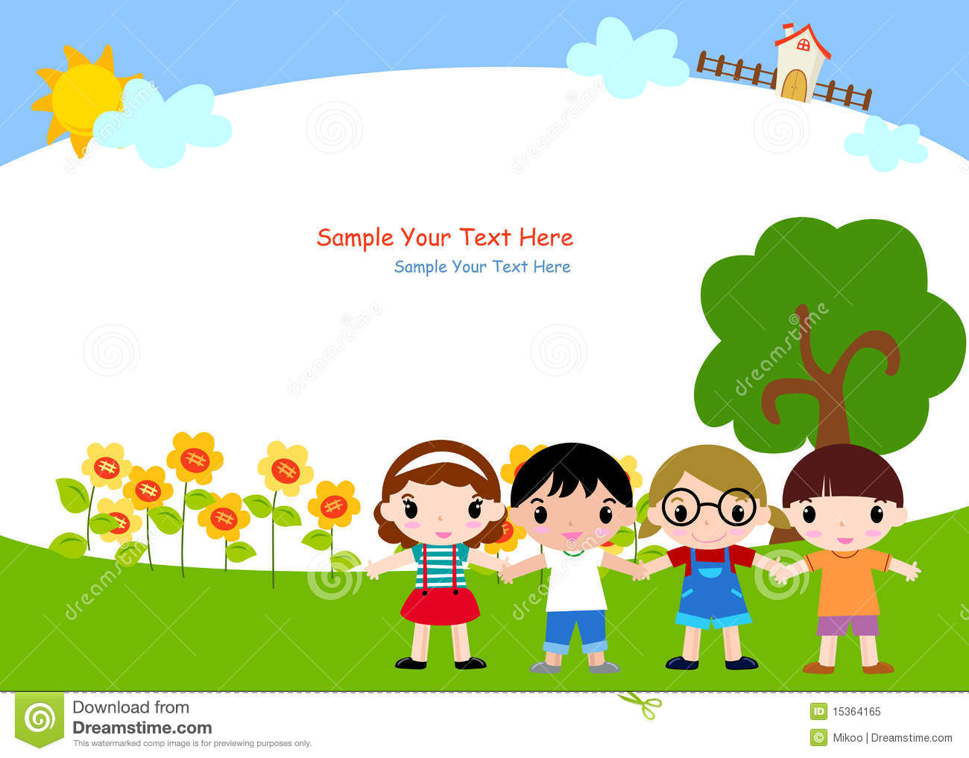
SECOND MEETING
Unit 1 Lesson 4
What Is It?

Slide 2


Let’s sing a song!
What Is It?
What is it? What is it?
What is it? What is it?
What can you see? What can you see?
It’s a bear. It’s a dog.
It’s a bear. It’s a dog.
It’s a teddy bear! It’s a puppy dog!

Slide 3

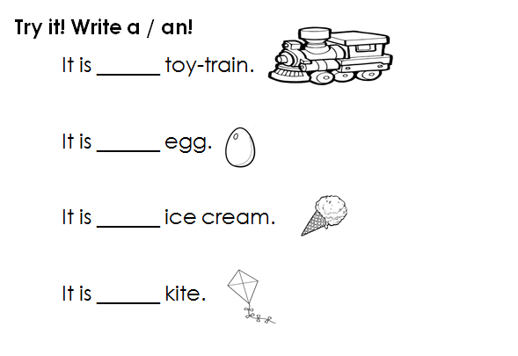
HOMEWORK
(From EC Summary page 11)
a
an
an
a

Slide 4
SENTENCE PATTERN
What is it?
It is a ________.
It is an _________.

Slide 5
SENTENCE PATTERN
“a” consonants (b, c, d, k, … etc)
Example : a tree, a book
“an” vowel sound (a, i, e, u, o)
Example : an apple, an umbrella
OK is short for OKAY

Slide 6

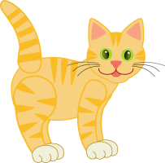
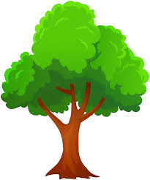


What is it?
It is a flower.
It is a cat.
It is a tree.
It is a pencil.
It is a yoyo.

Slide 7
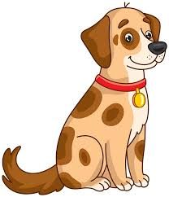

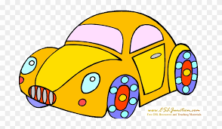
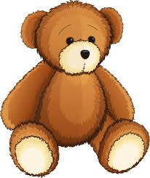
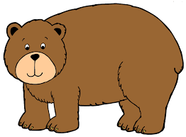
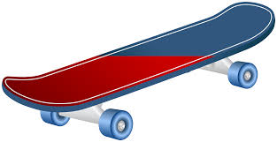
What is it?
It is a hat.
It is a dog.
It is a toy-car.
It is a skateboard.
It is a teddy bear.
It is a bear.

Slide 8
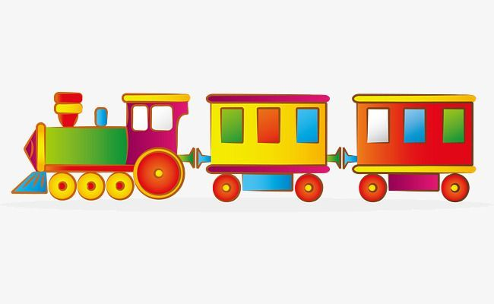
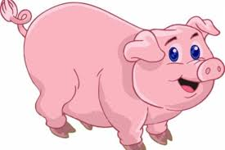

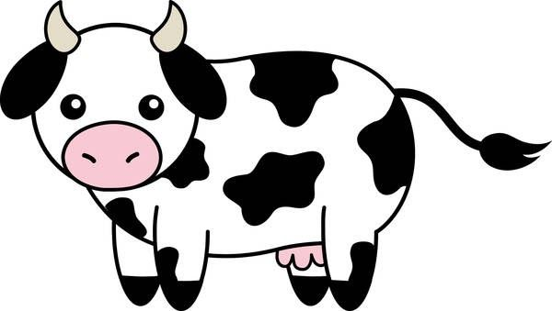
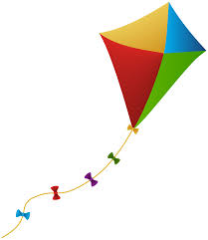

What is it?
It is a pig.
It is a toy-train.
It is a book.
It is a cow.
It is a ball.
It is a kite.

Slide 9

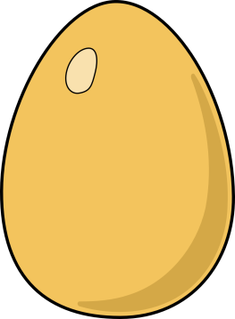


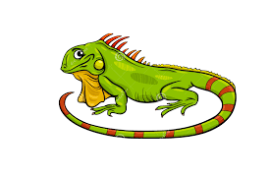
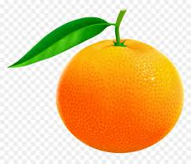
What is it?
It is an egg.
It is an umbrella.
It is an apple.
It is an ice cream.
It is an orange.
It is an iguana.

Slide 10
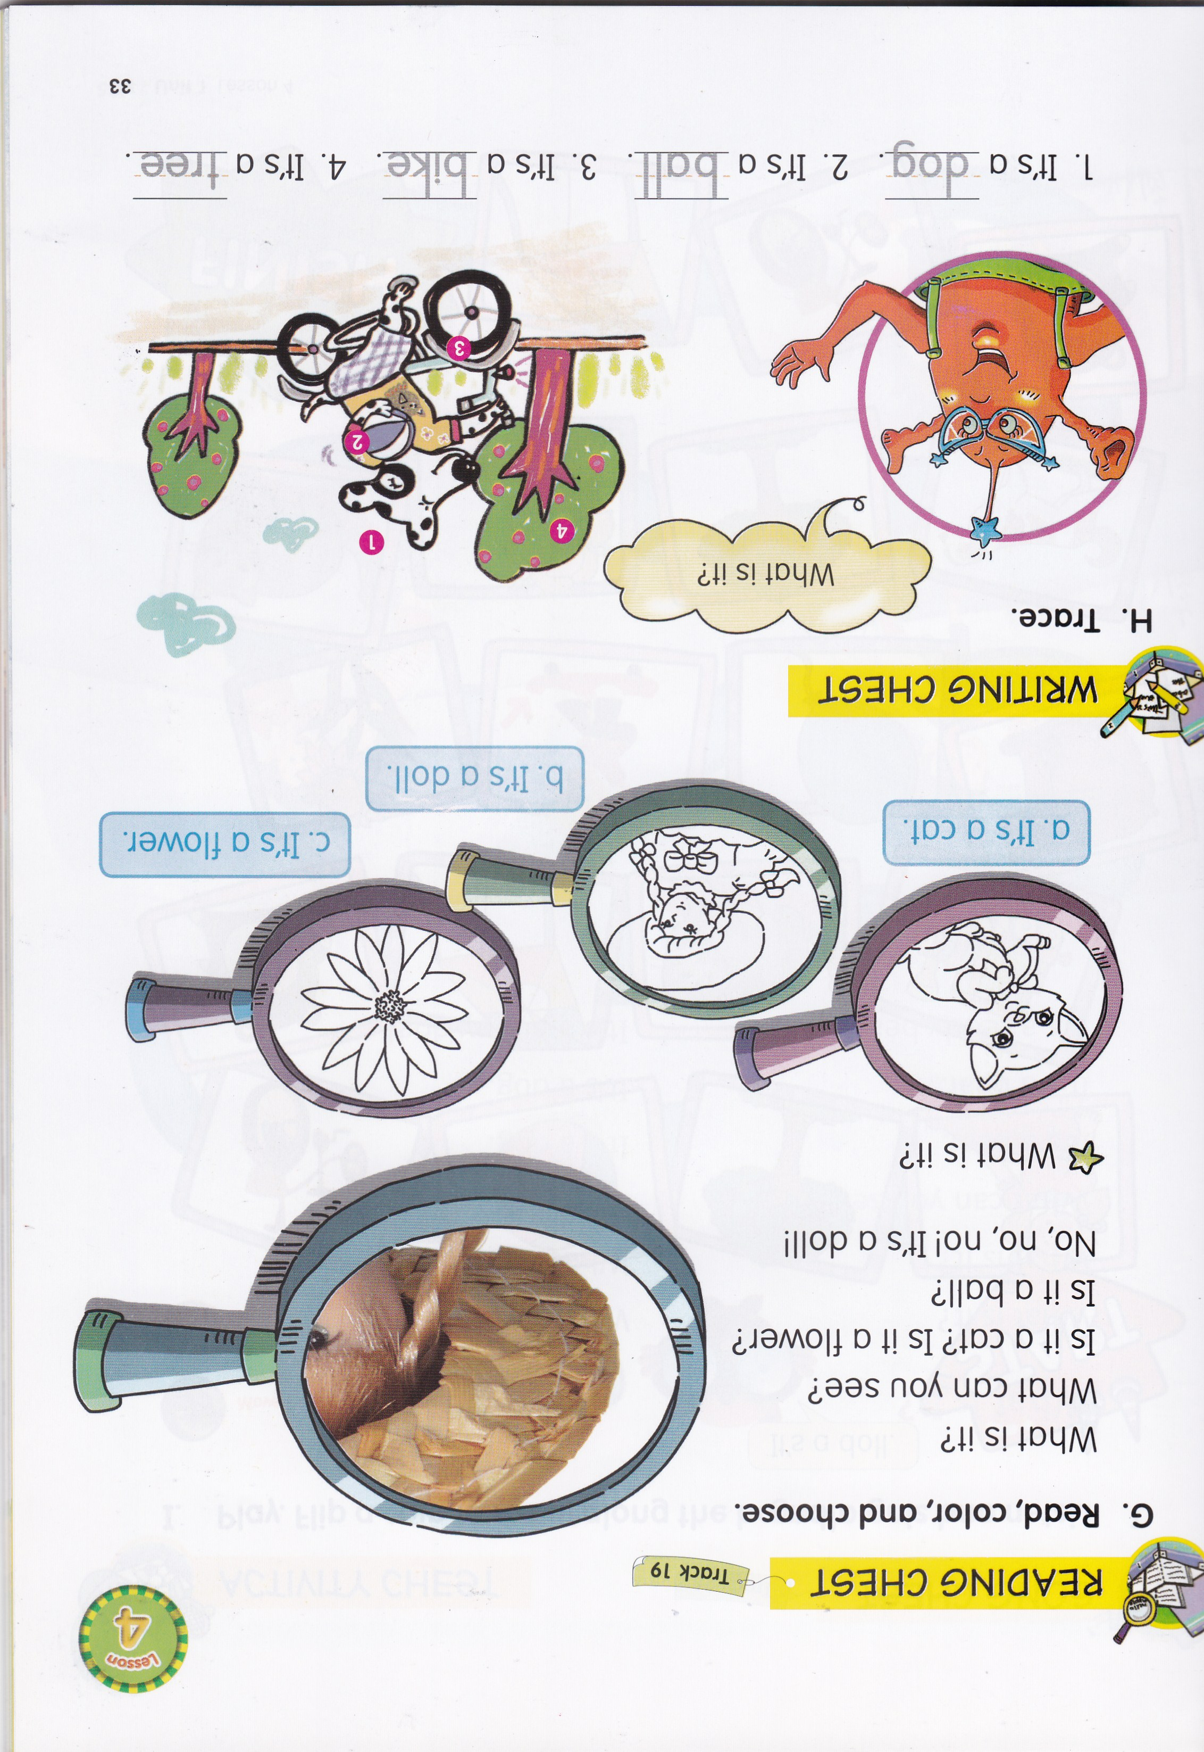

Slide 11

it - What - ? - is
What is it?
is - flower - . - It - a
It is a flower.

Slide 12
it - ? – is - What
What is it?
an - It - . - orange - is
It is an orange.

Slide 13
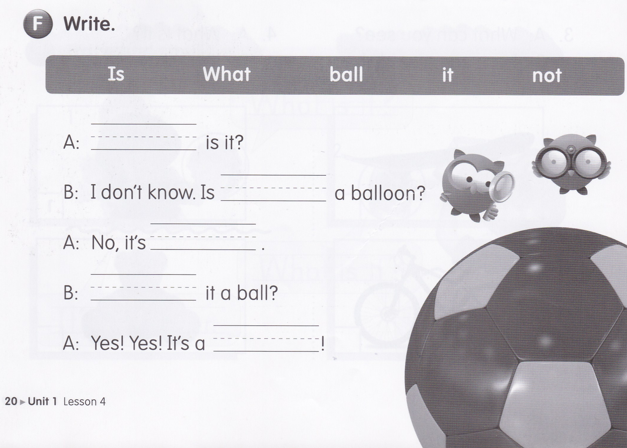
What
it
not
Is
ball

Slide 14
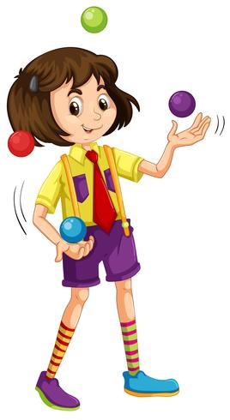
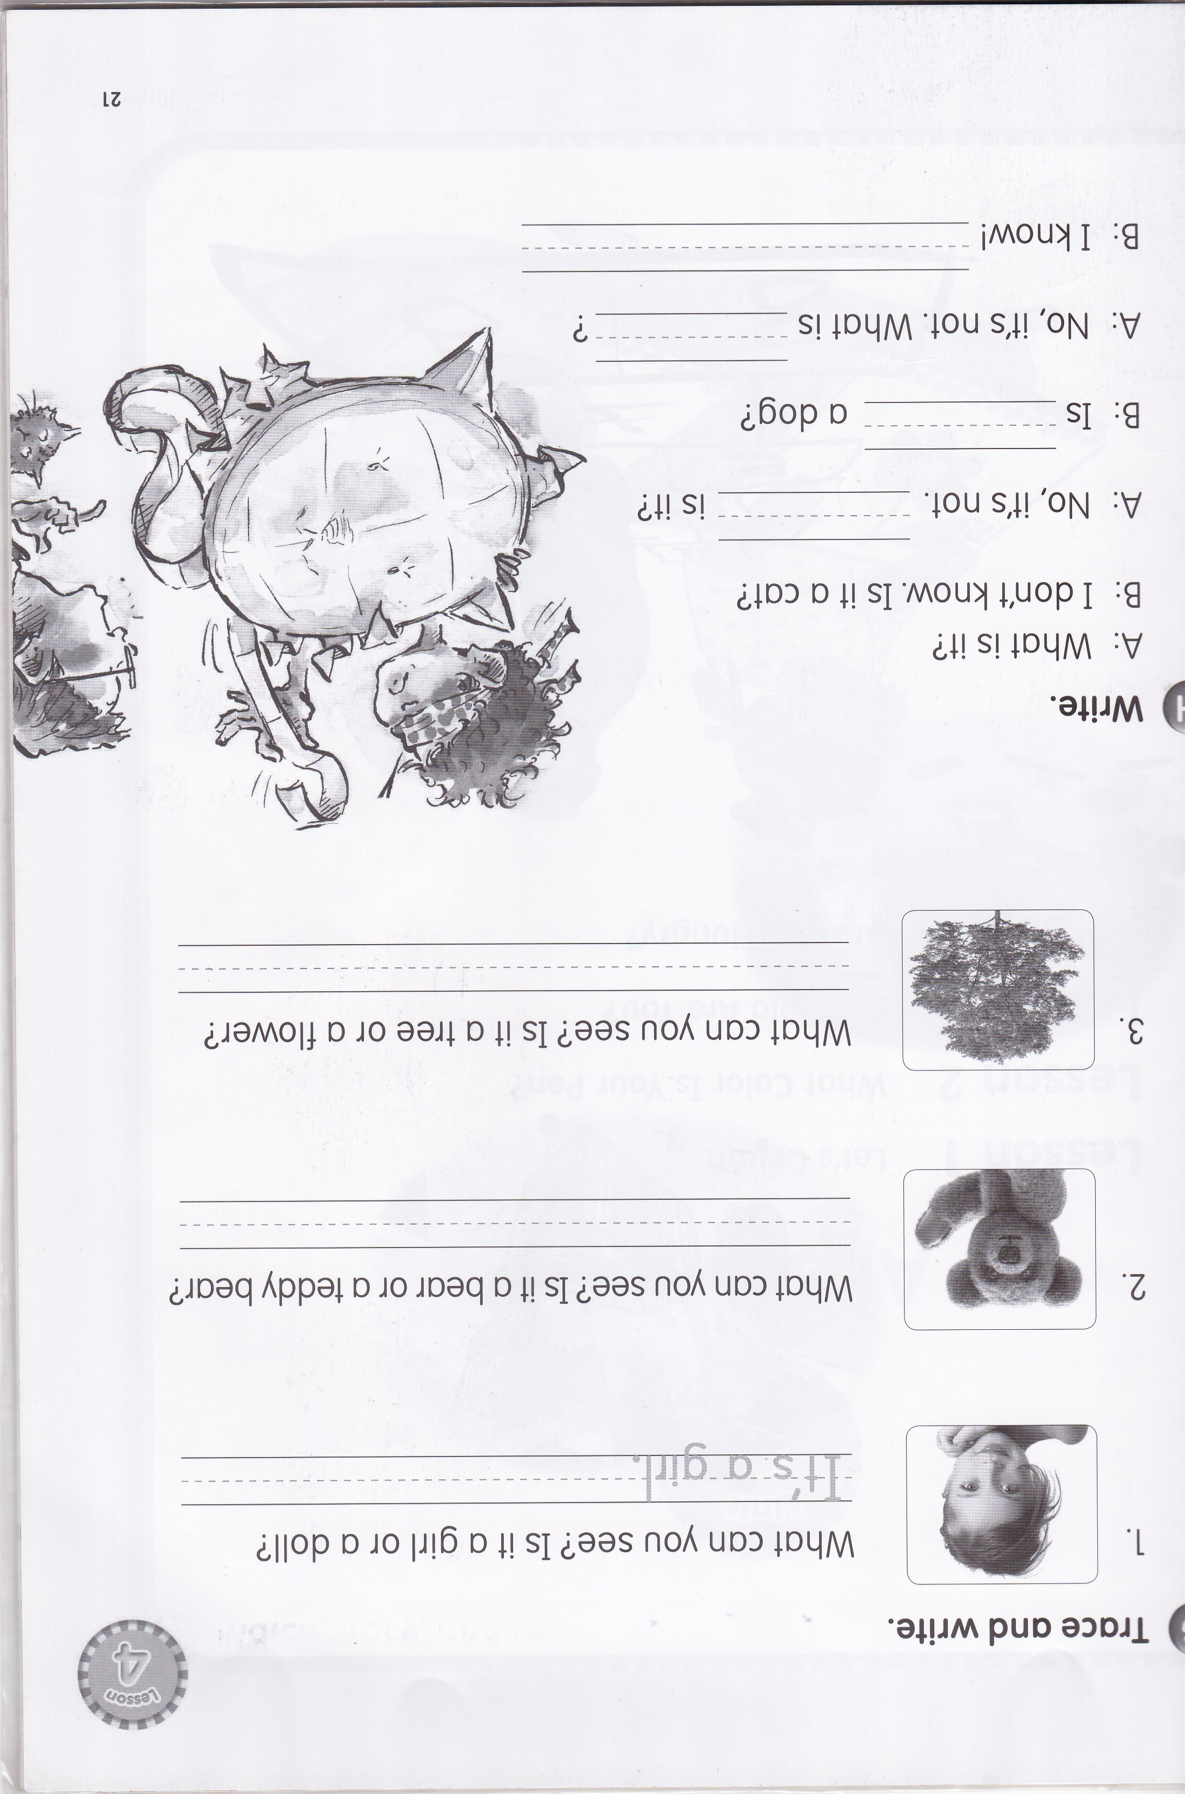
It’s a girl.
It’s a teddy bear.
It’s a tree.

Slide 15


