Slide 1

What Color Is Your Pen?
Unit 2 Lesson 2

Slide 2
LESSON OBJECTIVE
In this lesson you will learn some classroom objects and color.

Slide 3
Possessive Adjectives
their
your
his
my
her
its
our

Slide 4
Possessive Adjectives (kata ganti kepemilikan)
Subject
Possessive Adjectives
I my
You your
We our
They their
He his
She her
It its

Slide 5
Possessive Adjectives (+ noun)
my
1. My pen is green.
2. My notebook is red.
1. Your pencil case is blue.
your
2. Your backpack is black.

Slide 6
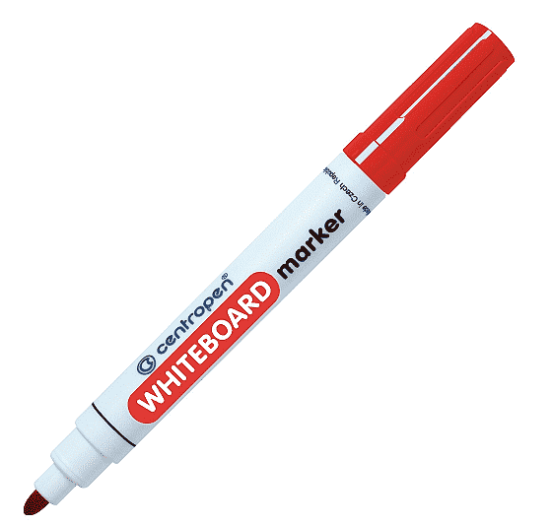
What can you see?
I can see a marker.

Slide 7
What color is it?
It’s red.

Slide 8

What is it?
It is a pen.

Slide 9
What color is it?
It’s green.

Slide 10

What is it?
It’s a rainbow.

Slide 11
What color is it?
It’s red, yellow, green and blue.

Slide 12
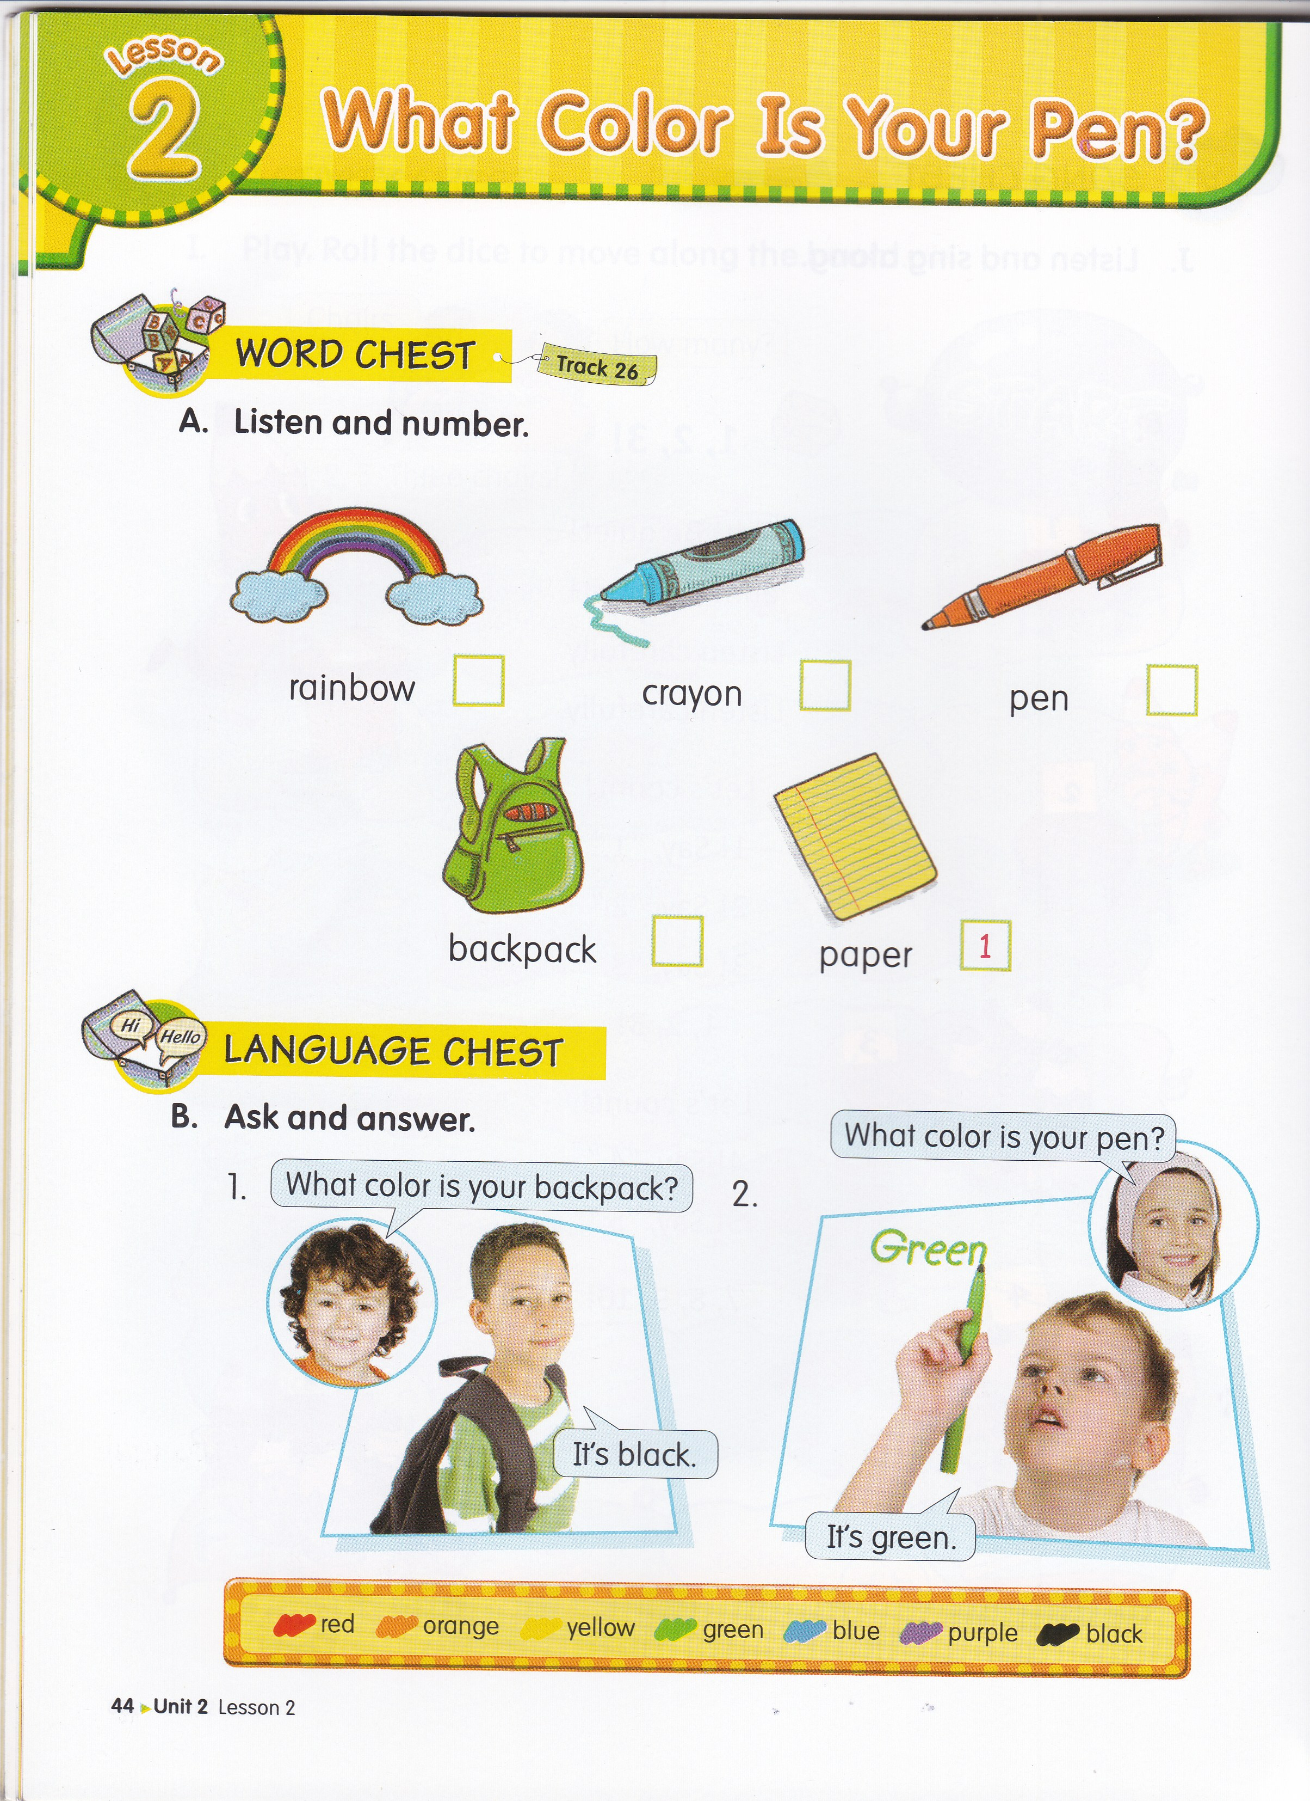

3
4
2
5

Slide 13
SENTENCE PATTERNS
What color is your______?
It is _________.
It’s _________.

Slide 14

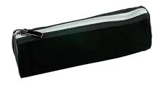
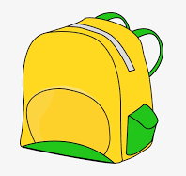
ASK AND ANSWER
Risa : What color is your crayon?
Jack : It’s red.
Risa : What color is your pencil case?
Jack : It’s black.
Risa : What color is your backpack?
Jack : It’s yellow.

Slide 17
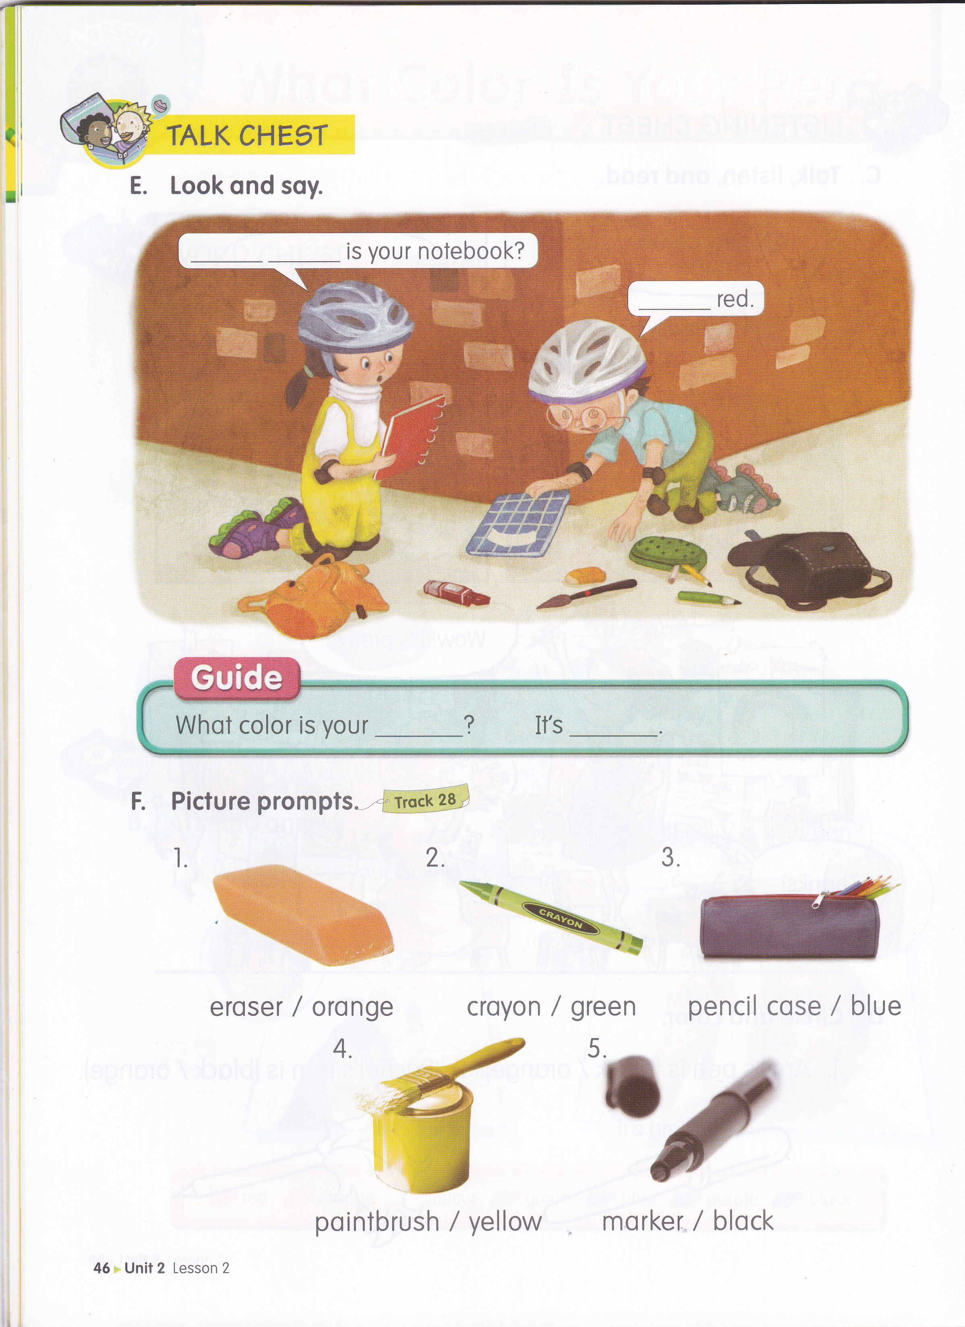
What
color
It’s

Slide 19
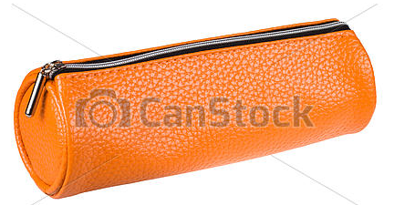
pencil case / orange

Slide 20

note book / yellow

Slide 21
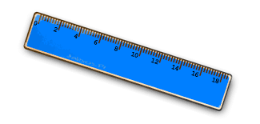
ruler / blue

Slide 22

backpack / orange

Slide 23
Let’s sing a song!
I like Red
Red, orange , yellow,
green and blue
Red, red, I like red.
Red, orange , yellow,
green and blue
Green, green, I like green.
Red, orange , yellow,
green and blue
Blue, blue, I like blue.

Slide 24
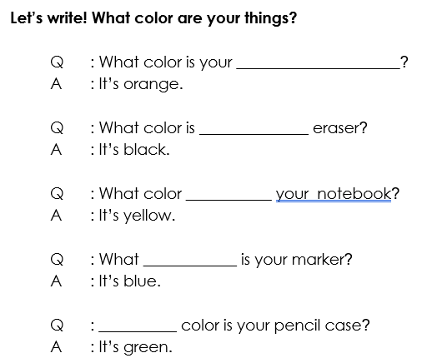
HOMEWORK (from EC Summary page 16)

Slide 25


