Slide 1
What Color Is Your Pen?
Unit 2 Lesson 2

Slide 2
HOMEWORK (from EC Summary page 16)
pen
your
is
color
What

Slide 3
LESSON OBJECTIVE
In this lesson you will learn some classroom objects and color.

Slide 4
Possessive Adjectives
your
my

Slide 5
Possessive Adjectives (kata ganti kepemilikan)
Subject
Possessive Adjectives
I my
You your

Slide 6
SENTENCE PATTERNS
What color is your______?
It is _________.
It’s _________.

Slide 7
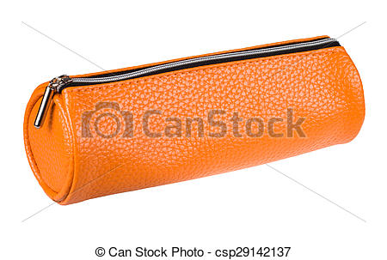
What is it?
marker
pen
rainbow
paper
pencil case
notebook

Slide 8
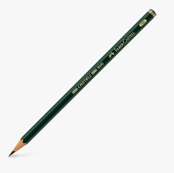
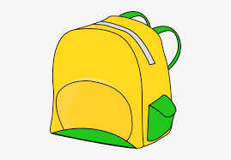
What is it?
eraser
eraser
color pencils
pencil
crayon
backpack

Slide 9
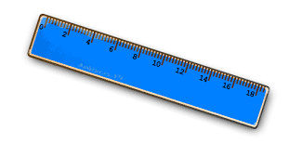
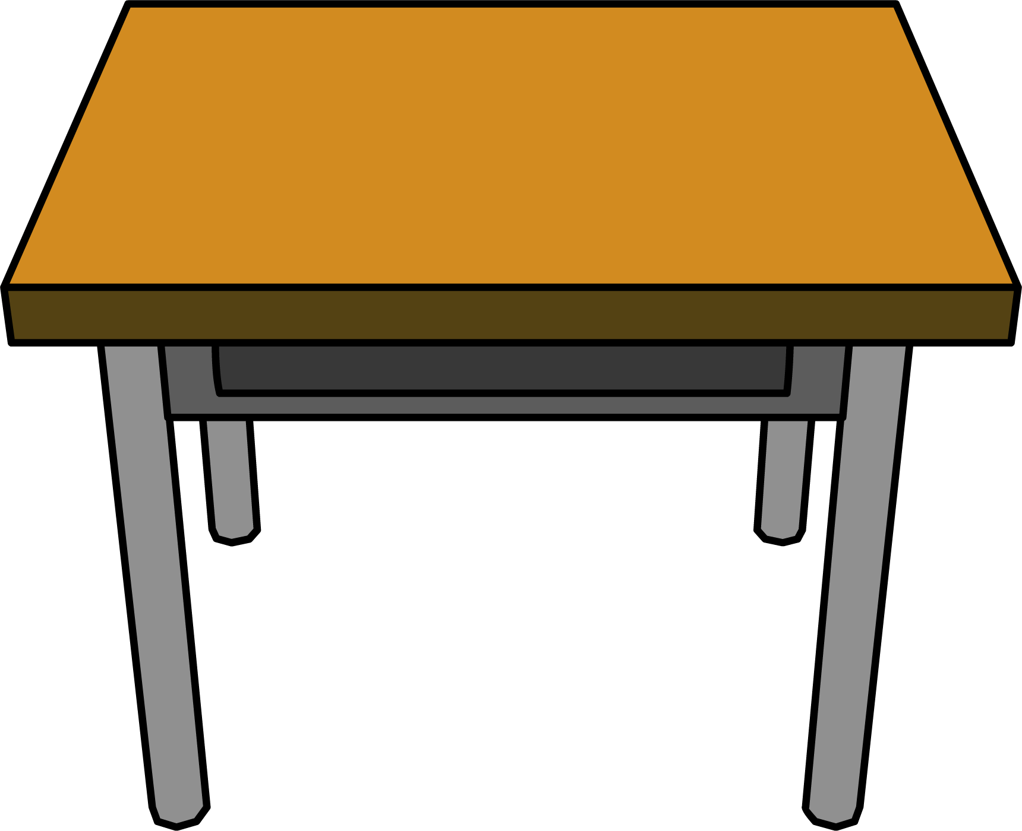
What is it?
window
ruler
paintbrush
door
whiteboard
desk

Slide 10
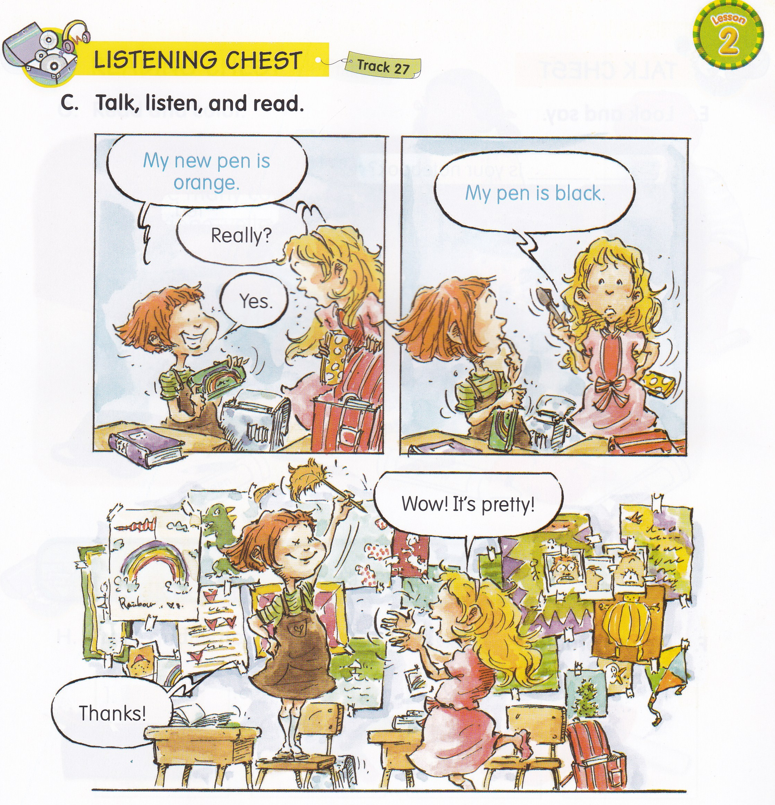
Boys : My bag is black.
Girls : Wow! It’s pretty!
Boys : Thanks!
Girls : My eraser is yellow.
Boys: Wow! It’s beautiful!
Girls : Thanks!

Slide 12
yellow
blue
red
green

Slide 13
My eraser is ____________.
orange
My _____________ is yellow.
notebook
My pen is ____________.
red
My ______________ is blue.
pencil case

Slide 14
color
crayon
your paper
orange
color is
red

Slide 15
What
flower
color
your
orange
blue

Slide 16
color
What color
It’s

Slide 17
green.
yellow.
orange.
It’s red.

Slide 18
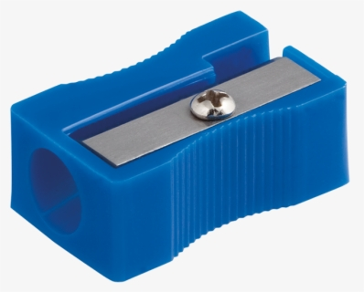
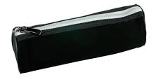
green.
yellow.
orange.
It’s red.

Slide 19
1. color / is / pen / What / your
What color is your pen?
2. is / My / blue / . / book
My book is blue.

Slide 20
Let’s sing a song!
I like Red
Red, orange , yellow,
green and blue
Red, red, I like red.
Red, orange , yellow,
green and blue
Green, green, I like green.
Red, orange , yellow,
green and blue
Blue, blue, I like blue.

