Slide 1
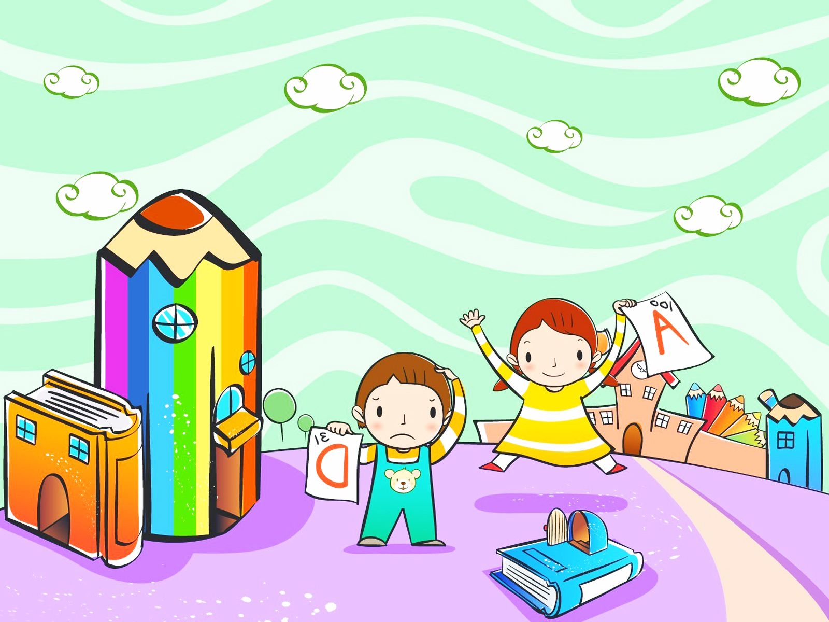
UNIT 1 : THE WEEKEND
LESSON 1
How Are You Today?

Slide 2
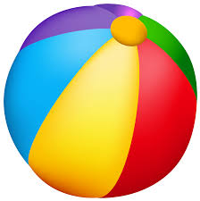
What is this?
It is _______.
a ball.

Slide 3

What colour is this?
It’s _________.
red

Slide 4
What is your feeling during learning from home?
4
?
Me : I am very happy because I can study and play with my sister.
What about you?

Slide 5
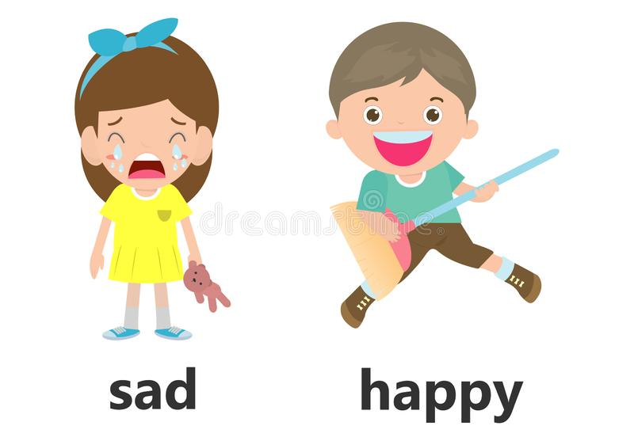
Is he happy?
Yes, he is.

Slide 6
Is she happy?
No, she is not.

Slide 7
In this lesson, you will learn about : How to express feeling in English
The Subject is taken from
English Chest 2 Unit 1 Lesson 1
“How Are You Today”

Slide 8

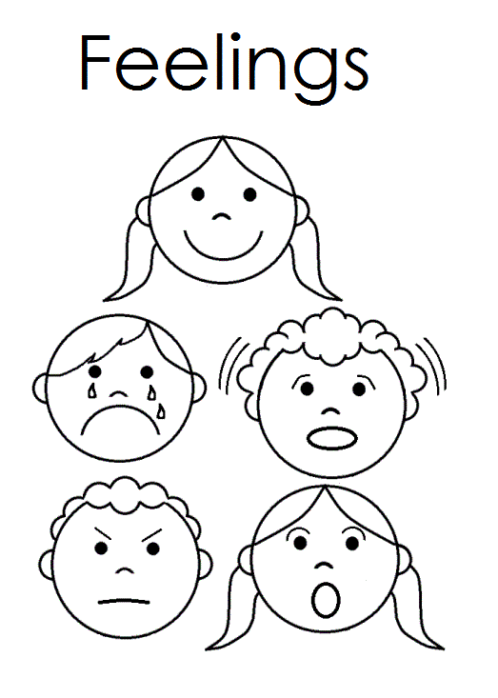
4
good
1
Some expressions in good feeling/ conditions
great
terrific
fine
well
OK

Slide 9
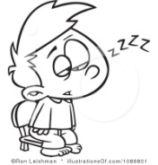
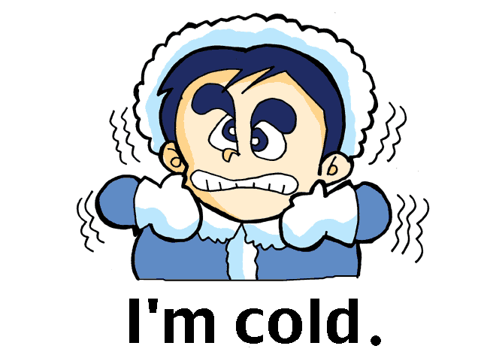
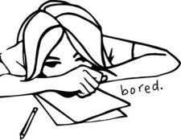
sad
4
Some expressions in bad feeling/
conditions
not so good
bad
sleepy
bored
cold

Slide 10
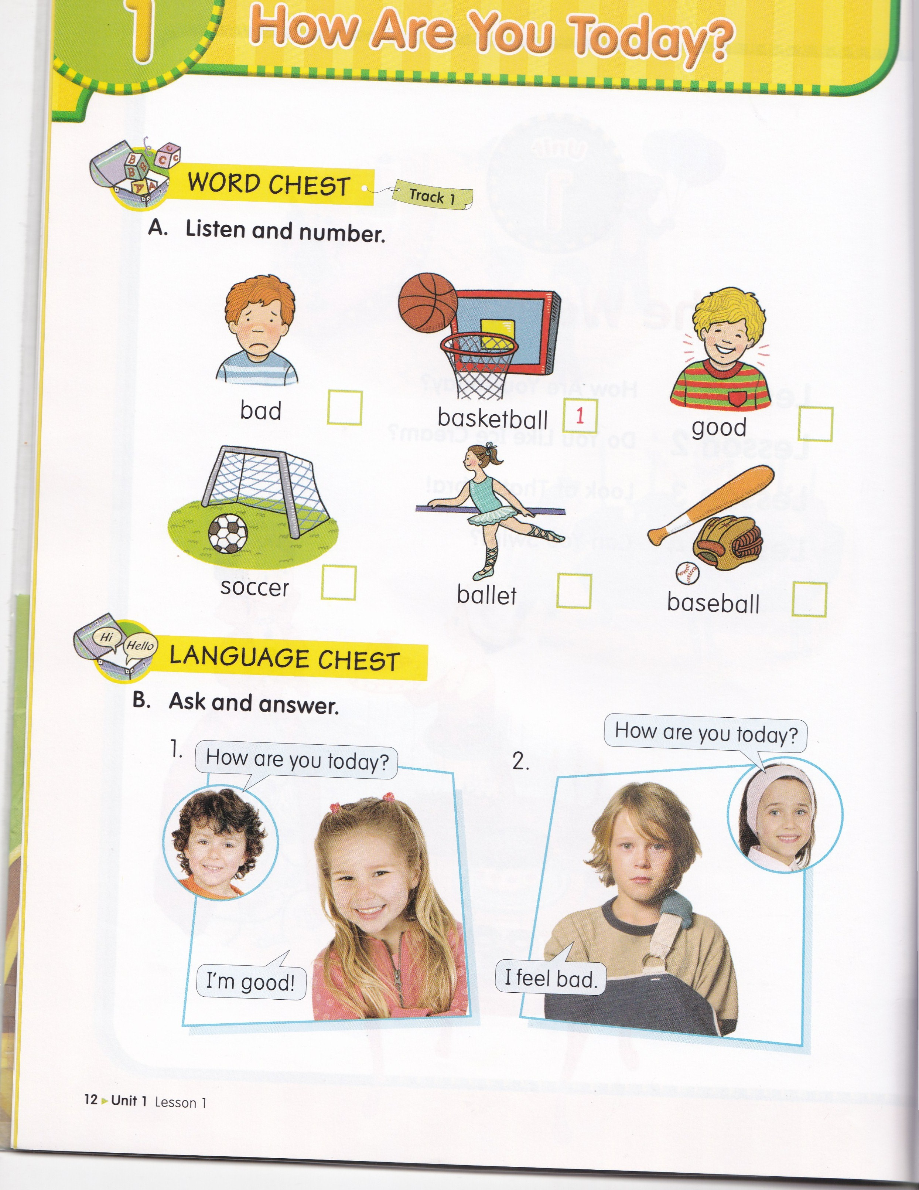


Lesson 1 How Are You today?
6
3
4
2
5

Slide 12
SENTENCE PATTERNS
How are you today?
I am __________.
I’m ___________.
I feel _________.

Slide 13
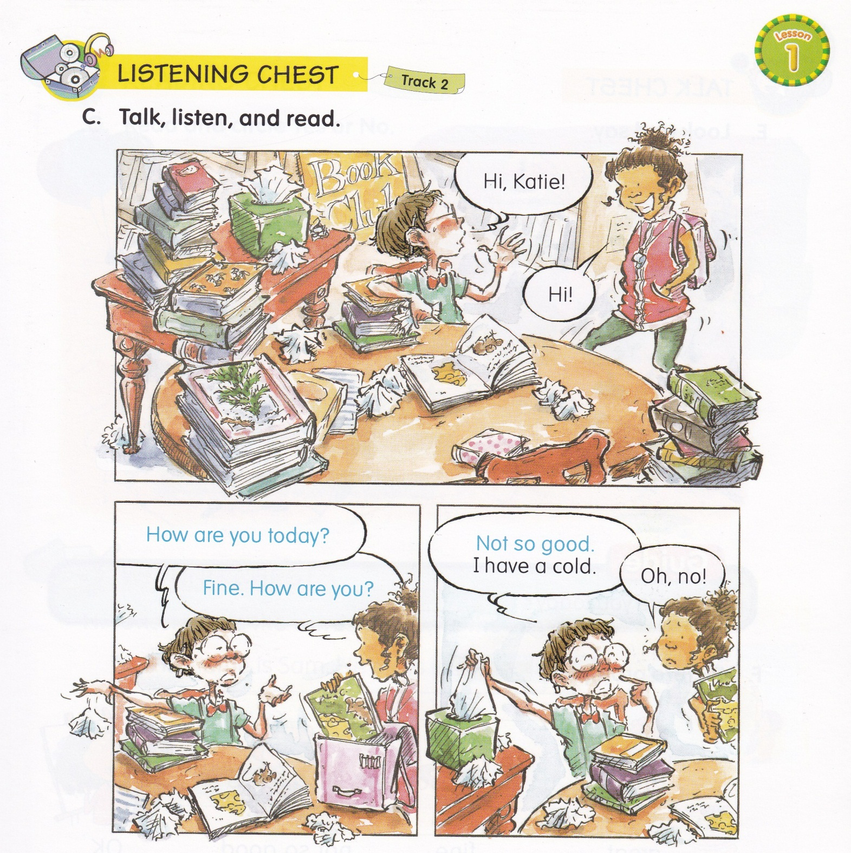

Slide 14
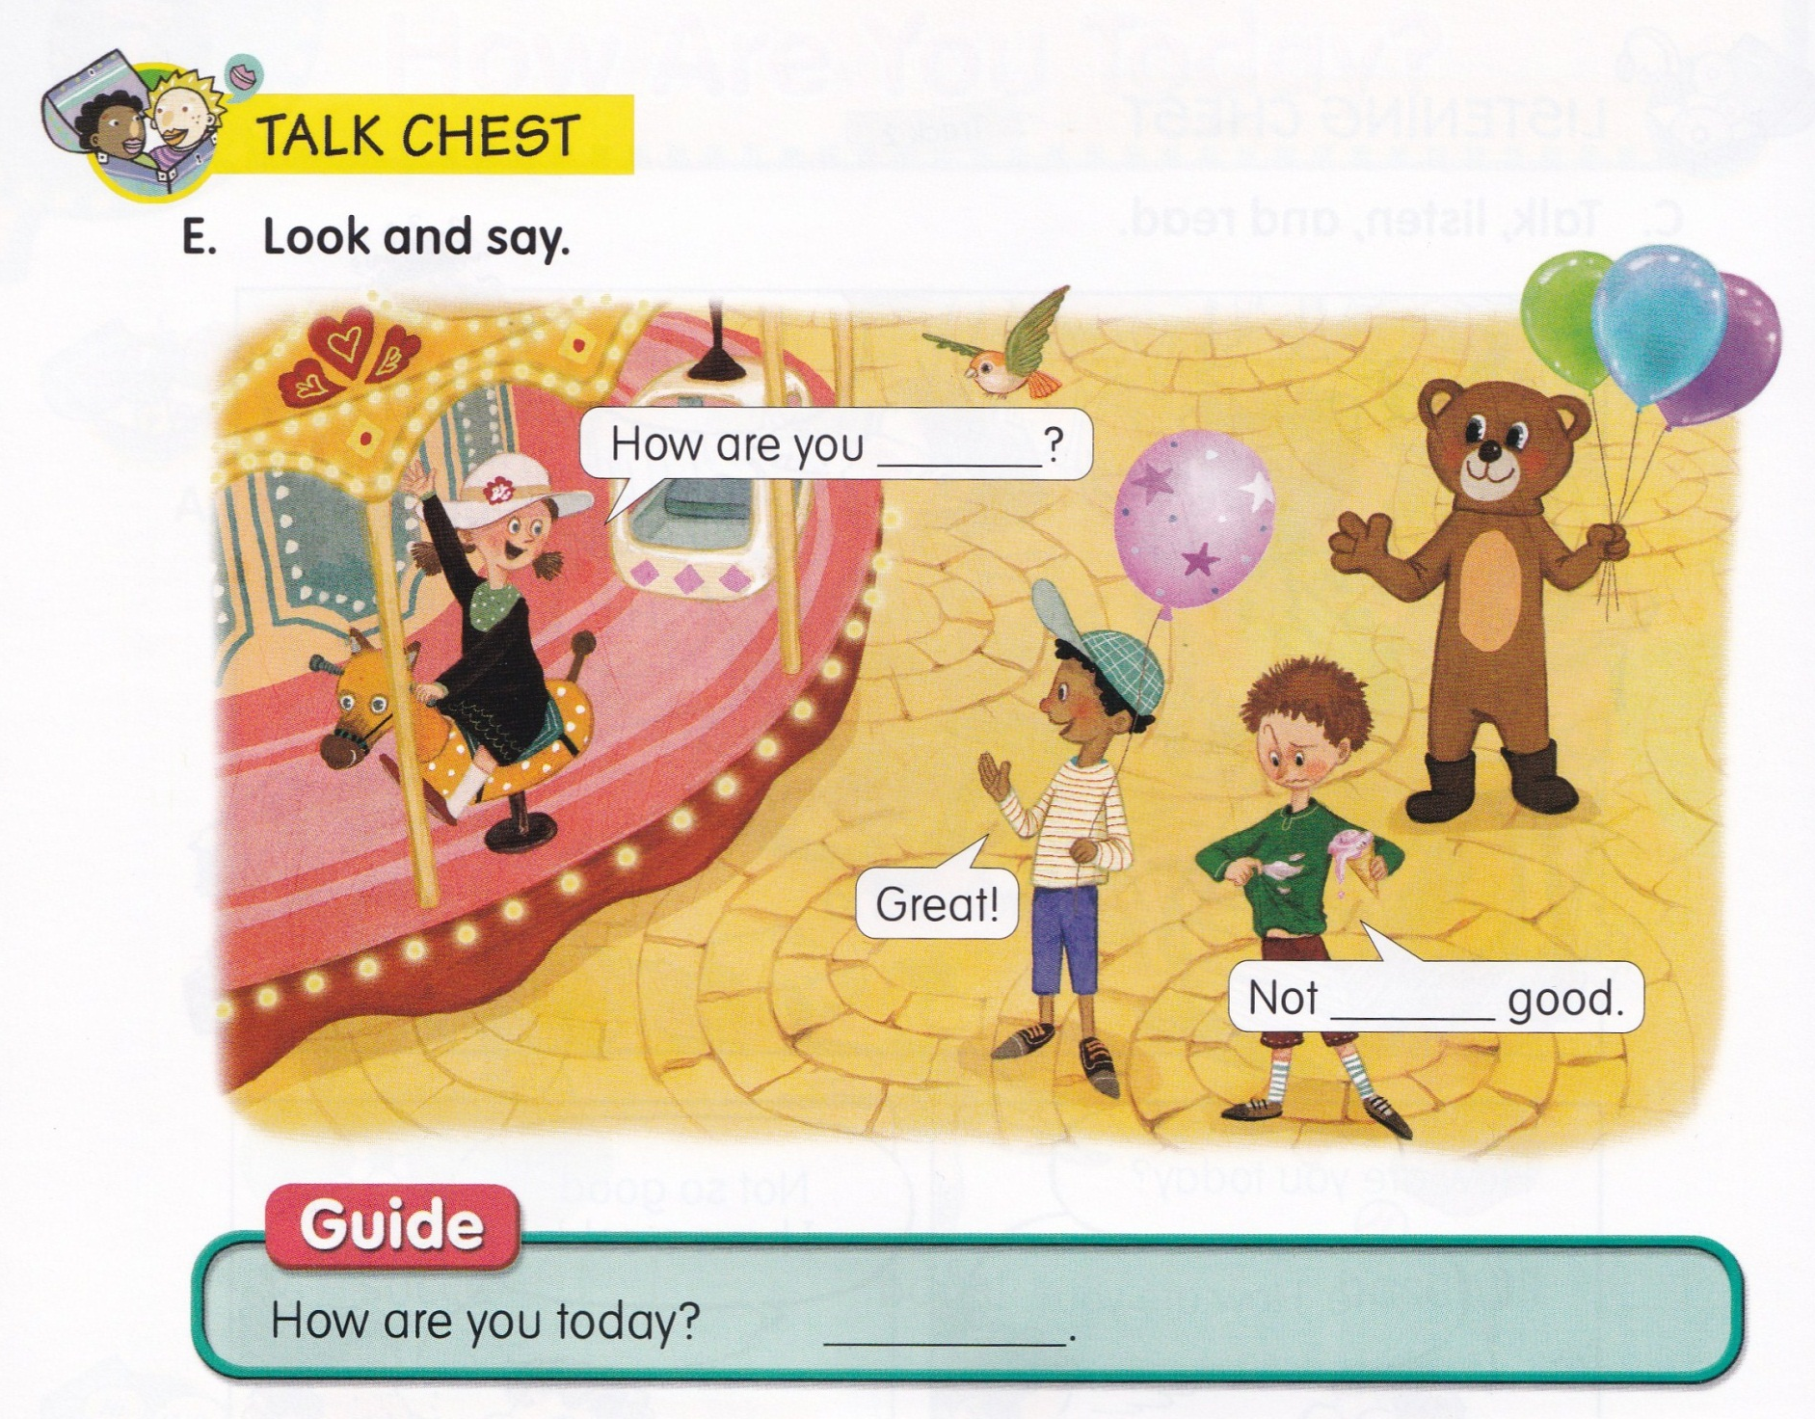
today.
so

Slide 15


Slide 16
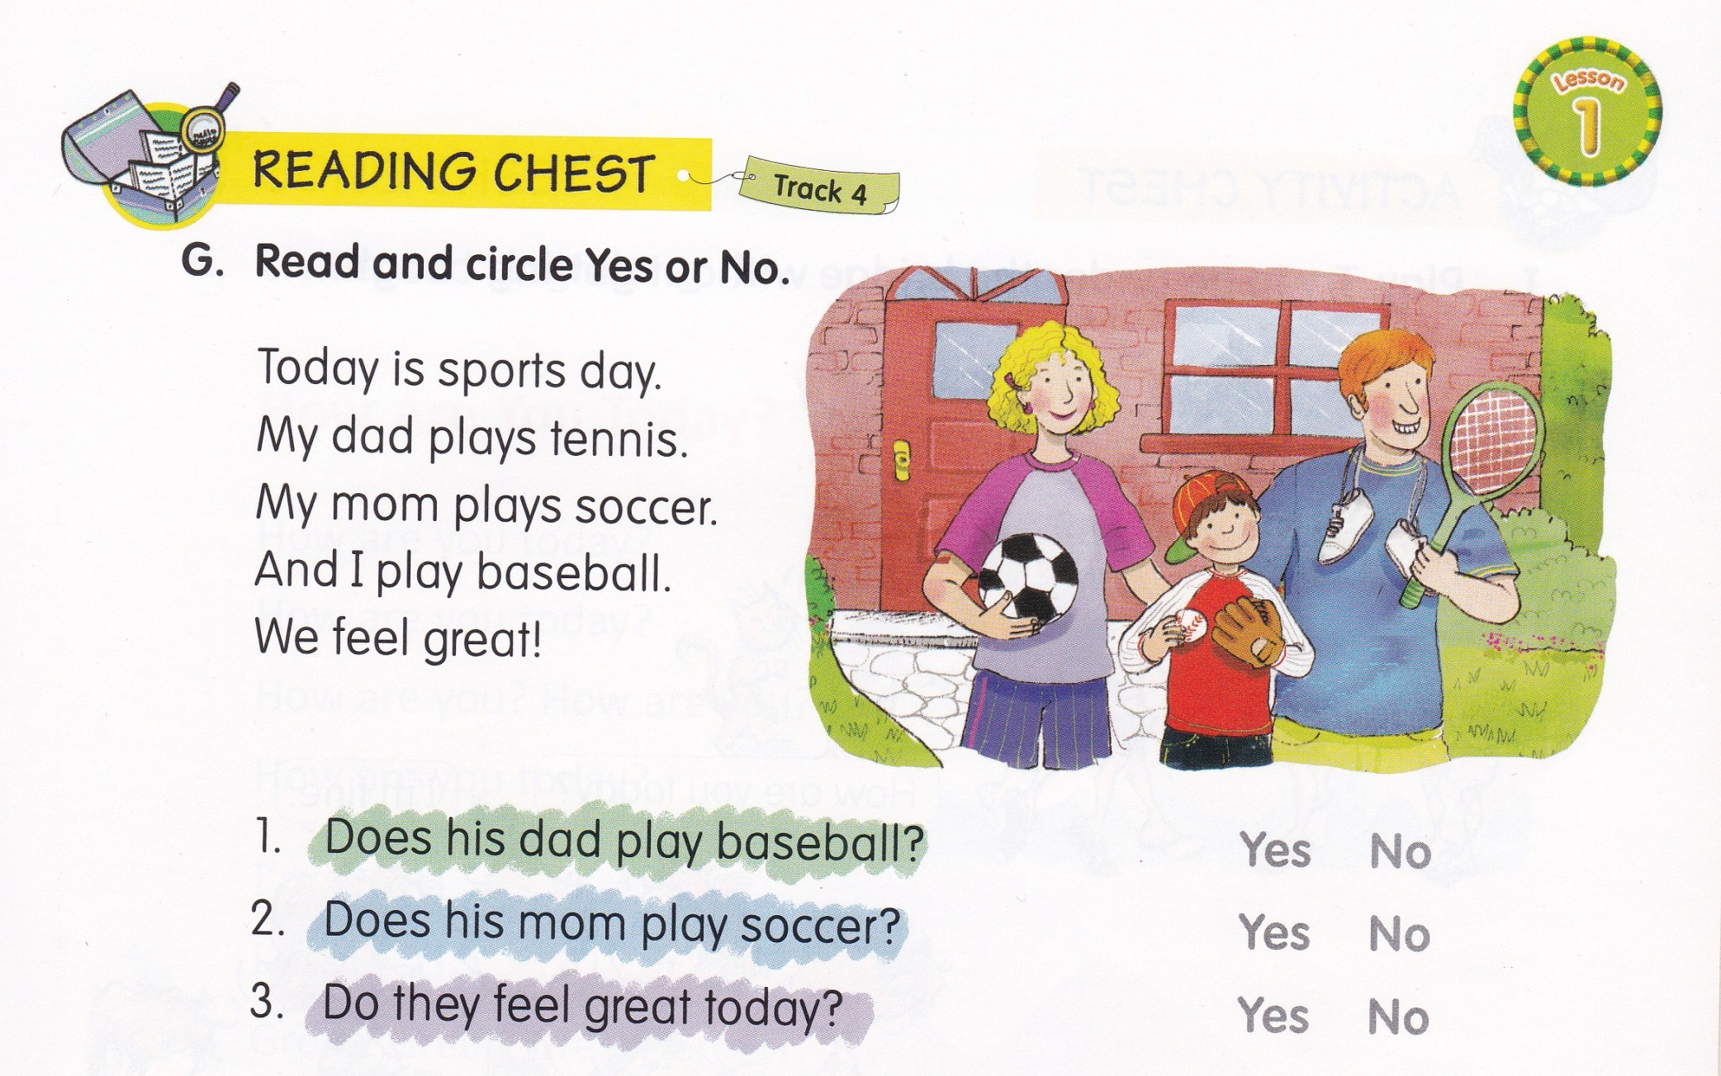

Slide 17
