Slide 1
Unit 1 Lesson 2
Do You Like
Ice Cream?

Slide 2
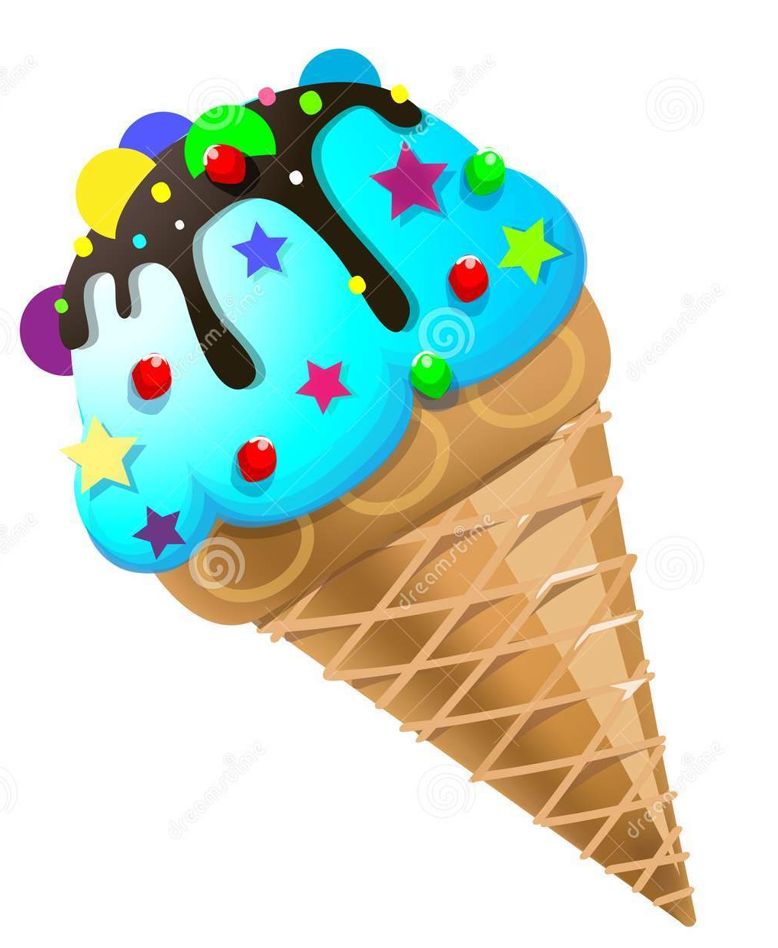
What is this?
This is an ice cream

Slide 3
Do you like ice cream?
Yes, I do.
No, I don’t.

Slide 4
What kind of ice cream do you like?
I like chocolate ice cream
What about you?
?

Slide 5
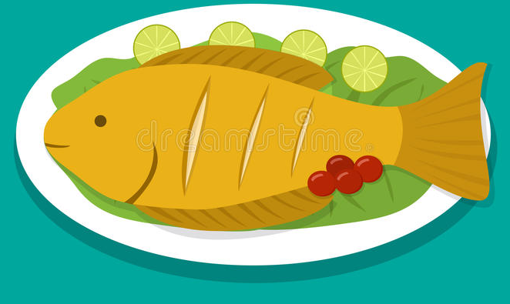
What is this?
This is a fish.

Slide 6
Do you like fish?
Yes, I do.
No, I don’t.

Slide 7
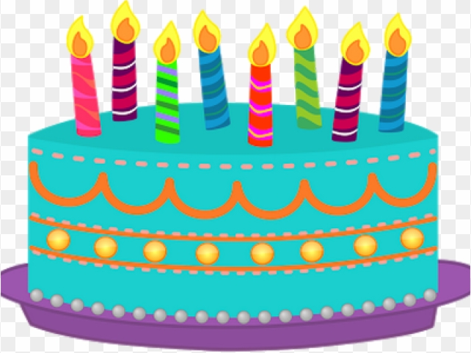
What is this?
This is a cake.

Slide 8
Do you like cake?
Yes, I do.
No, I don’t.

Slide 9
How many candles are on the cake?
There are eight candles.

Slide 10
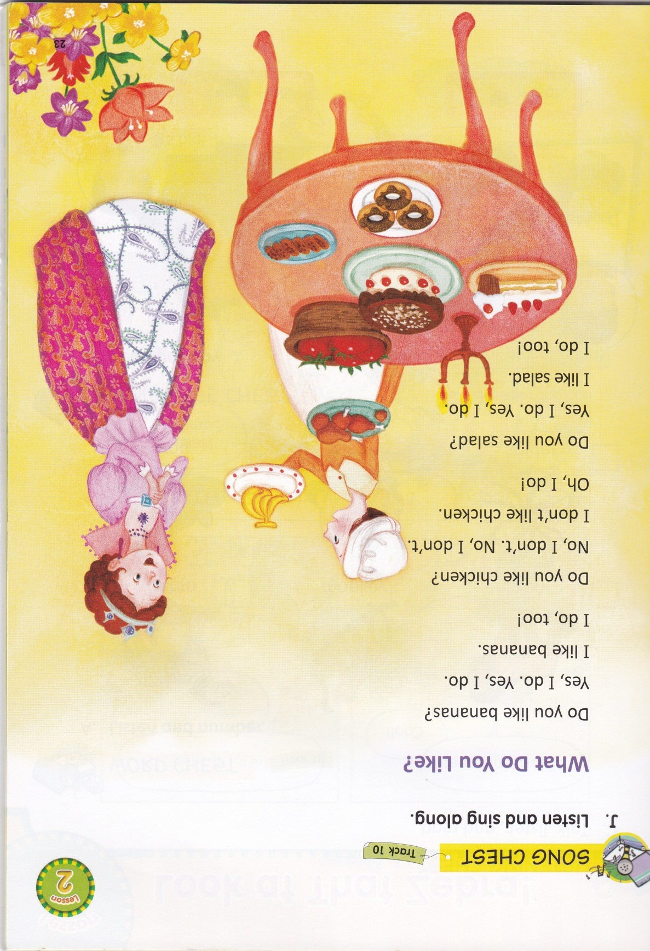

Slide 11
In this lesson, you will learn about food, expressing likes and dislikes.
The Subject is taken from English Chest 2 Unit 1 Lesson 2 “Do you like ice cream?”

Slide 12
SENTENCE PATTERNS
Do you like __________?
Yes, I do.
No, I don’t.
What do you like?
I like ________.

Slide 13
If someone ask you about food that you like, you can response by saying….
Yes, I do.
If someone ask you about food that you don’t like, you can response by saying….
No, I don’t.

Slide 14
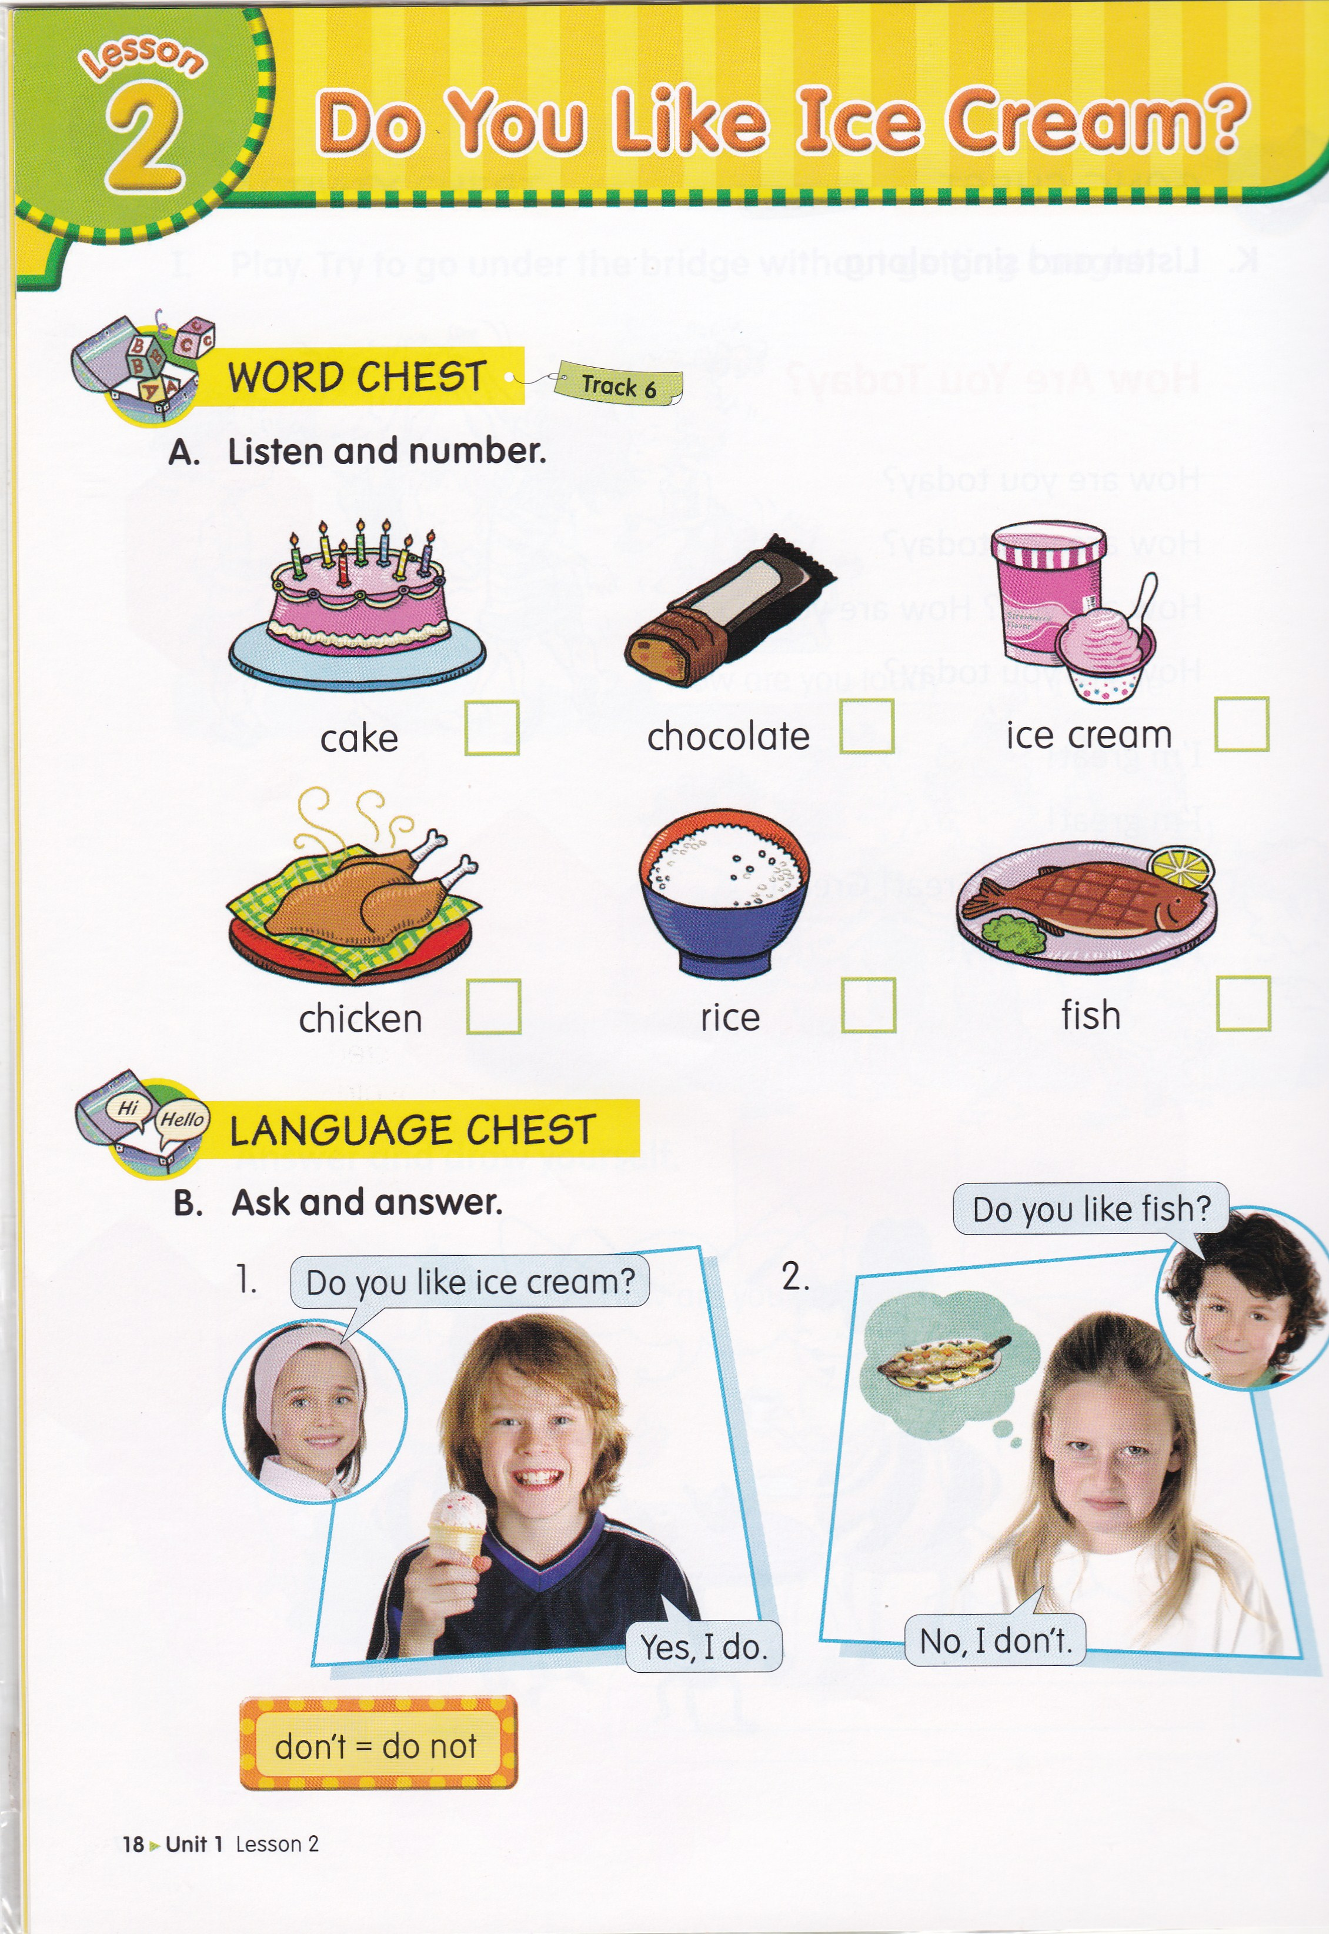
3
5
6
2
1
4

Slide 16
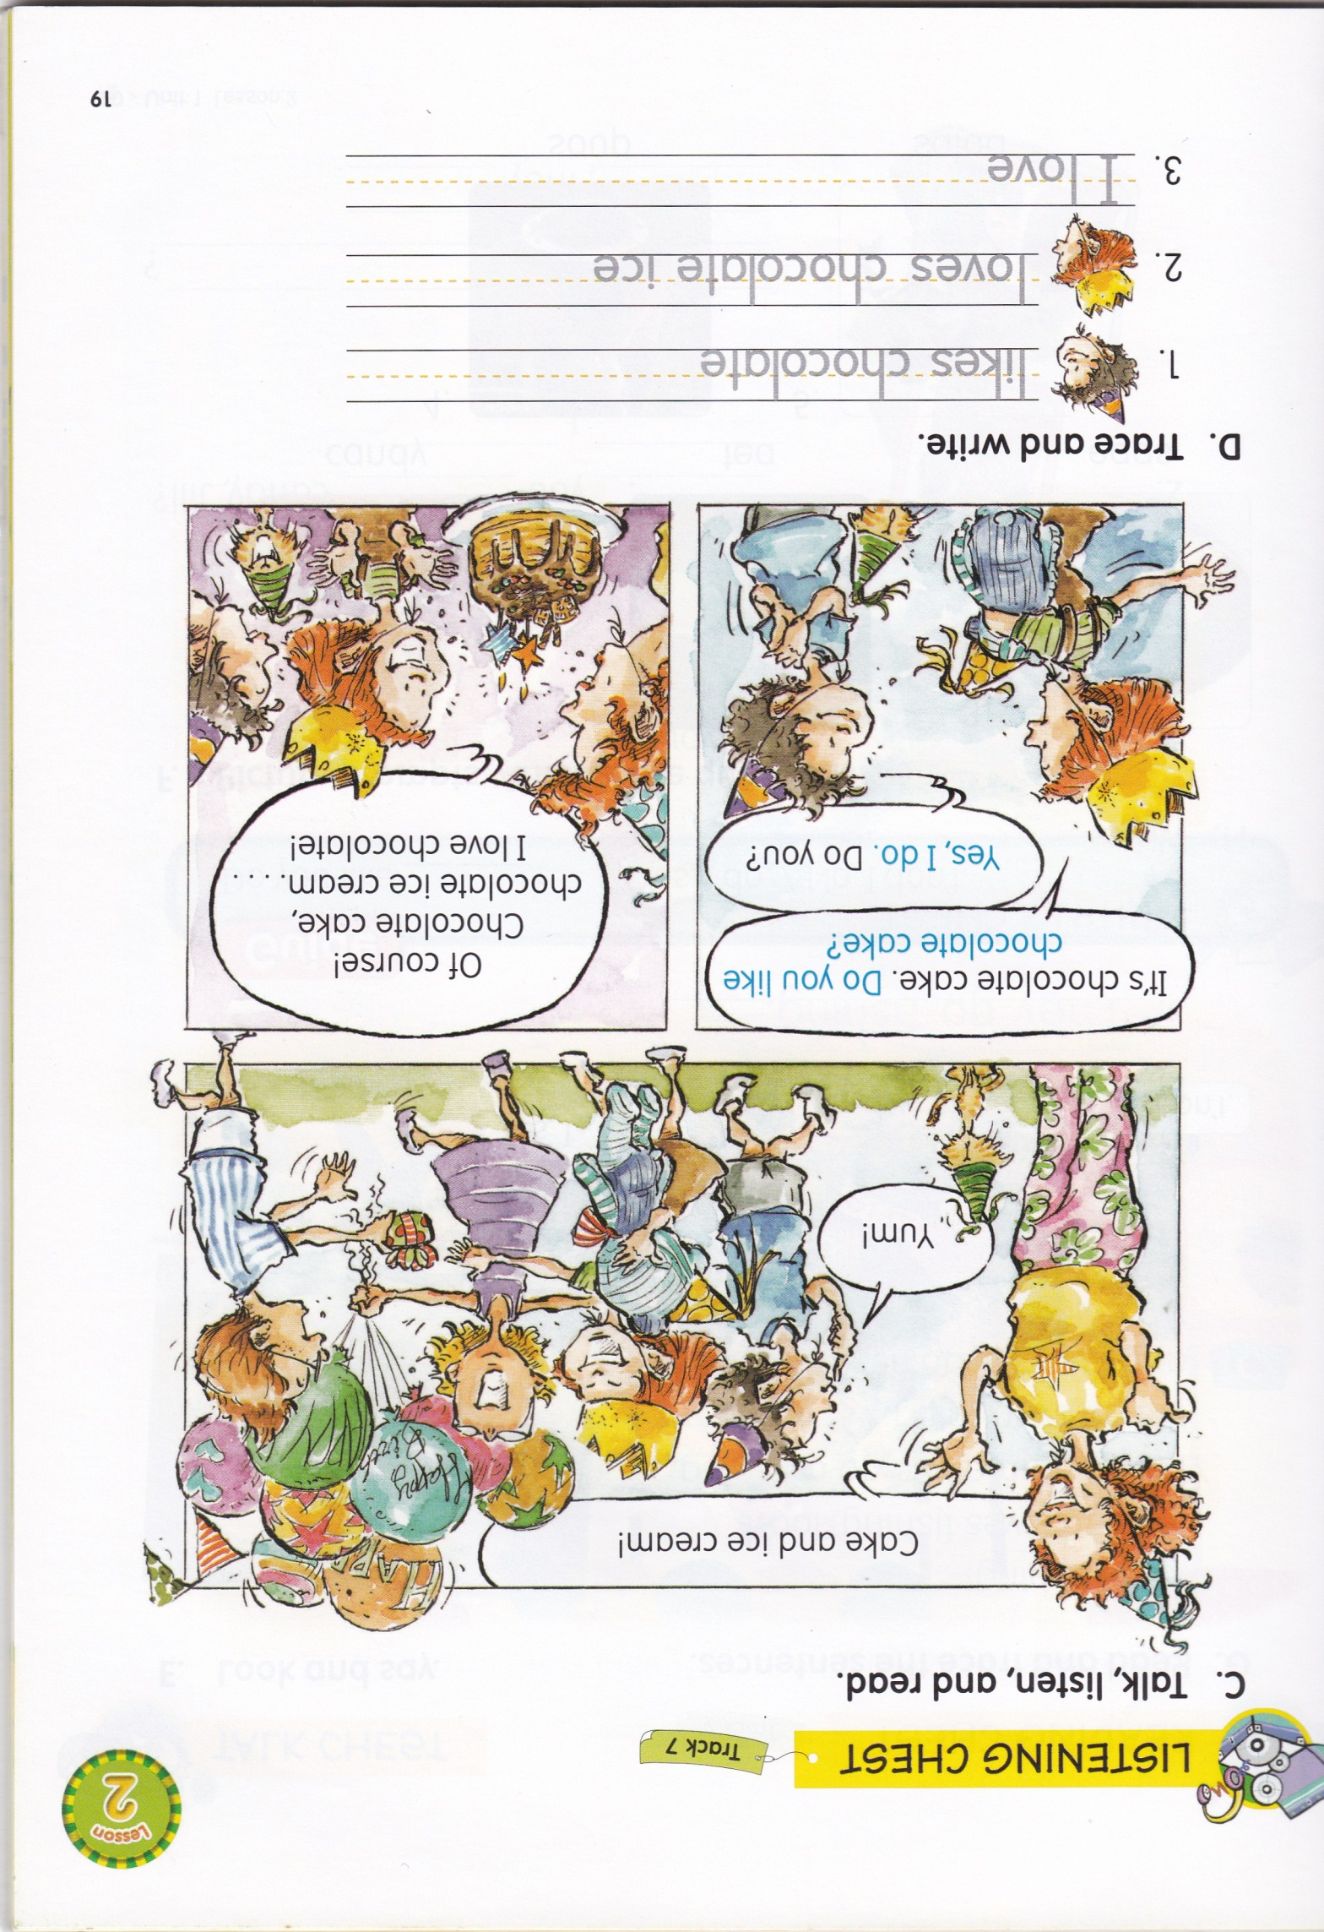

Slide 17
you
like
do
No

Slide 20
