Slide 1
Unit 1 Lesson 3
Look at That Zebra!

Slide 2
In this lesson, you will learn :
1. The names of some different animals
2. How to describe them

Slide 3
What is it?
It is a rabbit.

Slide 4
What color is this animal?
It’s white.

Slide 5
Do you like this animal?
Yes, I do.
No, I don’t.

Slide 6
What is it?
It is a frog.

Slide 7
What color is this animal?
It’s green.

Slide 8
Do you like this animal?
Yes, I do.
No, I don’t.

Slide 9
Do you know which one is the….
LION?
a
b
c

Slide 10
Do you know which one is the….
ZEBRA?
a
b
c

Slide 11
Do you know which one is the….
MONKEY?
a
b
c

Slide 12
Do you know which one is the….
SPIDER?
a
b
c

Slide 13
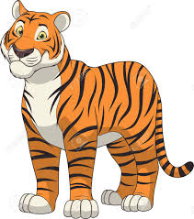
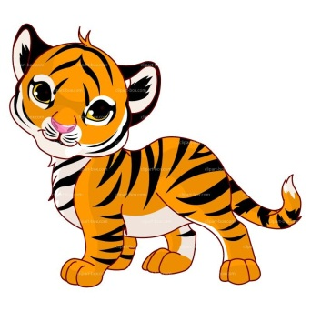
Adjectives and opposites
big
small
x

Slide 14
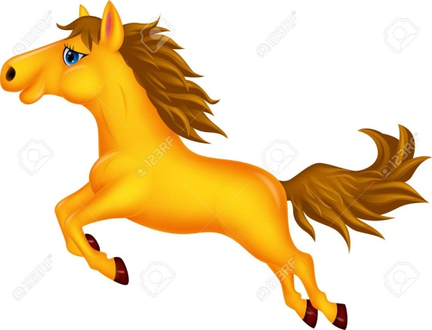
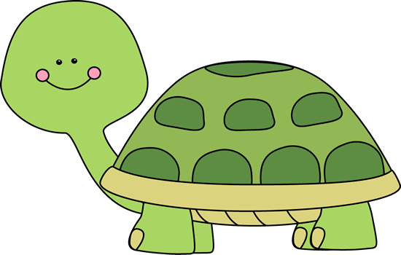
Adjectives and opposites
fast
slow
x

Slide 15
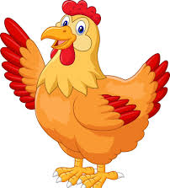
Adjectives and opposites
old
young
x

Slide 16
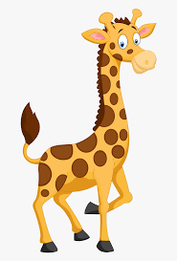
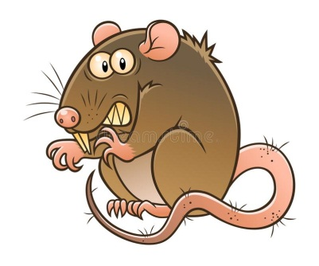
Adjectives and opposites
cute
ugly
x

Slide 17
Let’s sing a song!
Welcome to the Zoo!
Welcome to the zoo!
Zoo, zoo, zoo!
Welcome to the zoo!
Zoo!
This is a big elephant.
This is a small monkey.
This is a cute zebra.
And that is a dangerous lion.
Welcome to the zoo!
Zoo, zoo, zoo!
Welcome to the zoo!
Zoo!

Slide 18
SENTENCE PATTERNS
Look at this ___!
This
Wow! It’s ______.

Slide 19
SENTENCE PATTERNS
That
Look at that ___!
Wow! It’s ______.

Slide 21
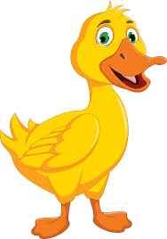
EXAMPLE
Dian : Look at this duck!
Fani : Wow! It’s cute!
Luis : Look at this chick!
Rara : Wow! It’s young!

Slide 22
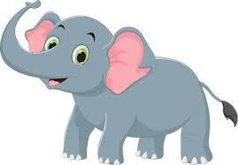
EXAMPLE
Doni : Look at that horse!
Bagas : Wow! It’s fast!
Risma : Look at that elephant!
Jhon : Wow! It’s big!

Slide 23
What is it?
5
3
6
4
1
2

Slide 24
at
Look
at
Wow
It’s

Slide 25
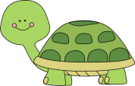
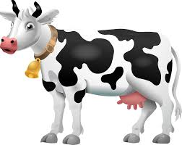
HOMEWORK (from EC Summary page 9)
Complete the dialoques!
Barkah : Look at this ___________________!
Lisa : Wow! It’s _____________________.
Grace : Look at that __________________!
Meta : Wow! It’s _____________________.
Benny : Look at this ___________________!
Jean : Wow! It’s _____________________.
Floren : Look at that __________________!
Kevin : Wow! It’s _____________________.
Adjectives :
big
small
cute
ugly
fast
slow
old
young

