Slide 1
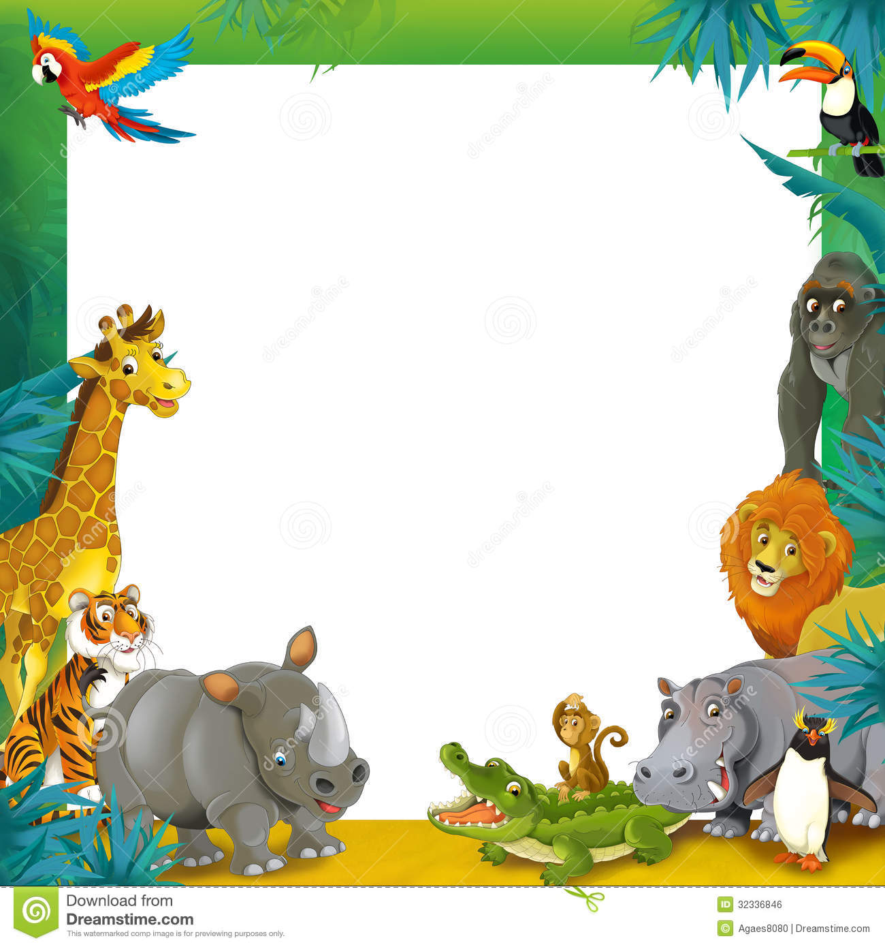
Second Meeting
Unit 1 Lesson 3
Look at That Zebra!

Slide 2
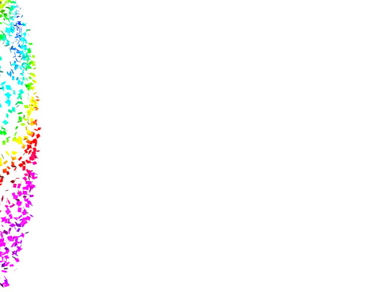
In this lesson, you will learn :
1. Review homework
2. The names of some different animals
3. How to describe them

Slide 3

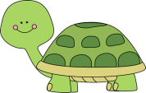
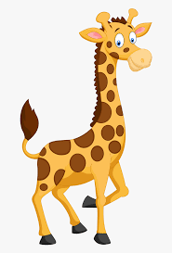

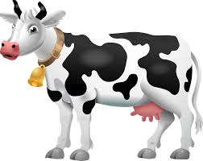

Homework
Barkah : Look at this _______________!
Lisa : __________________________.
turtle
Wow! It’s slow
Grace : Look at that ______________!
Meta : __________________________.
giraffe
Wow! It’s cute
Benny : Look at this ______________!
Jean : __________________________.
butterfly
Wow! It’s beautiful
Floren : Look at that ______________!
Kevin : __________________________.
cow
Wow! It’s big

Slide 4
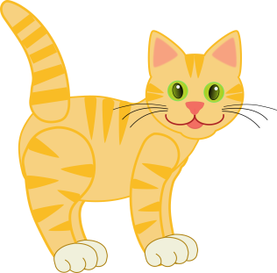
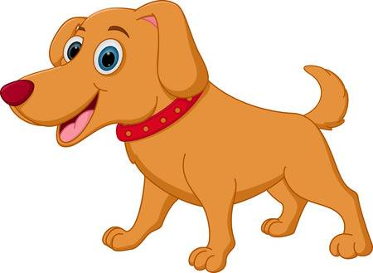
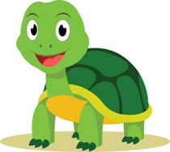
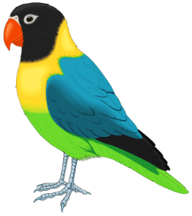
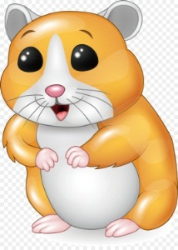

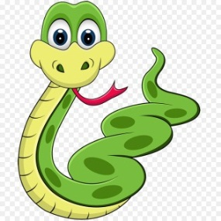
Pet
cat
dog
turtle
bird
fish
hamster
snake

Slide 5
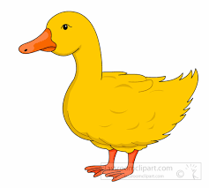
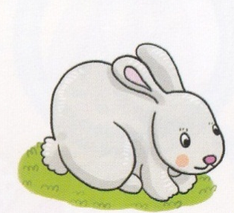
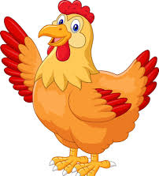
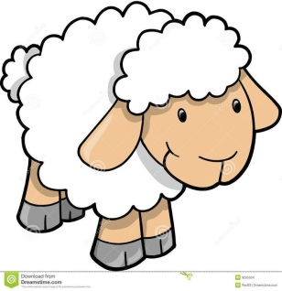
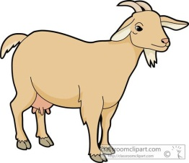
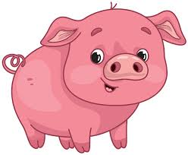
Farm Animals
chicken
rabbit
duck
goat
sheep
cow
pig

Slide 6

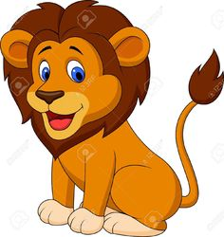

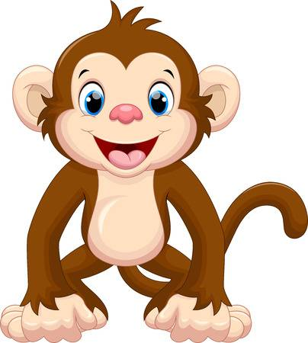
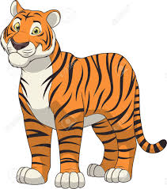
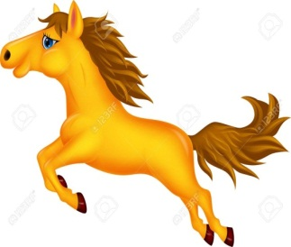
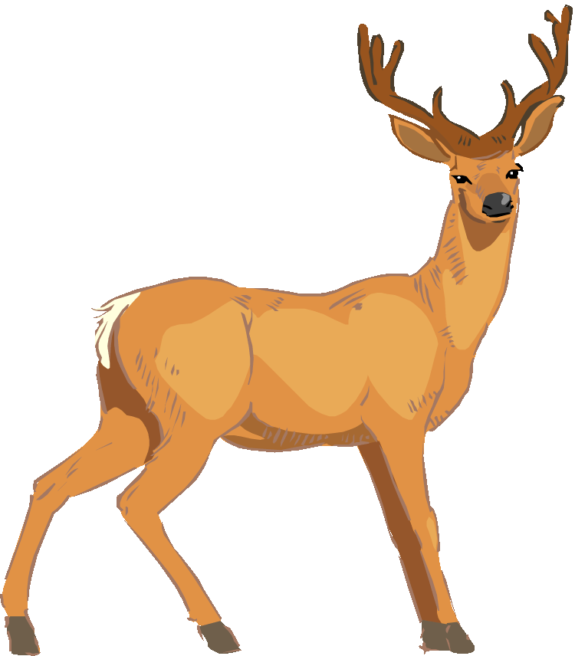
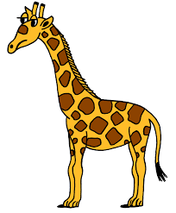
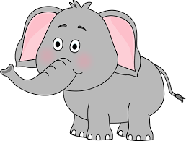
Wild Animals
spider
lion
zebra
monkey
tiger
horse
giraffe
elephant
deer

Slide 7


Let’s sing a song!
Welcome to the Zoo!
Welcome to the zoo!
Zoo, zoo, zoo!
Welcome to the zoo!
Zoo!
This is a big elephant.
This is a small monkey.
This is a cute zebra.
And that is a dangerous lion.
Welcome to the zoo!
Zoo, zoo, zoo!
Welcome to the zoo!
Zoo!

Slide 8
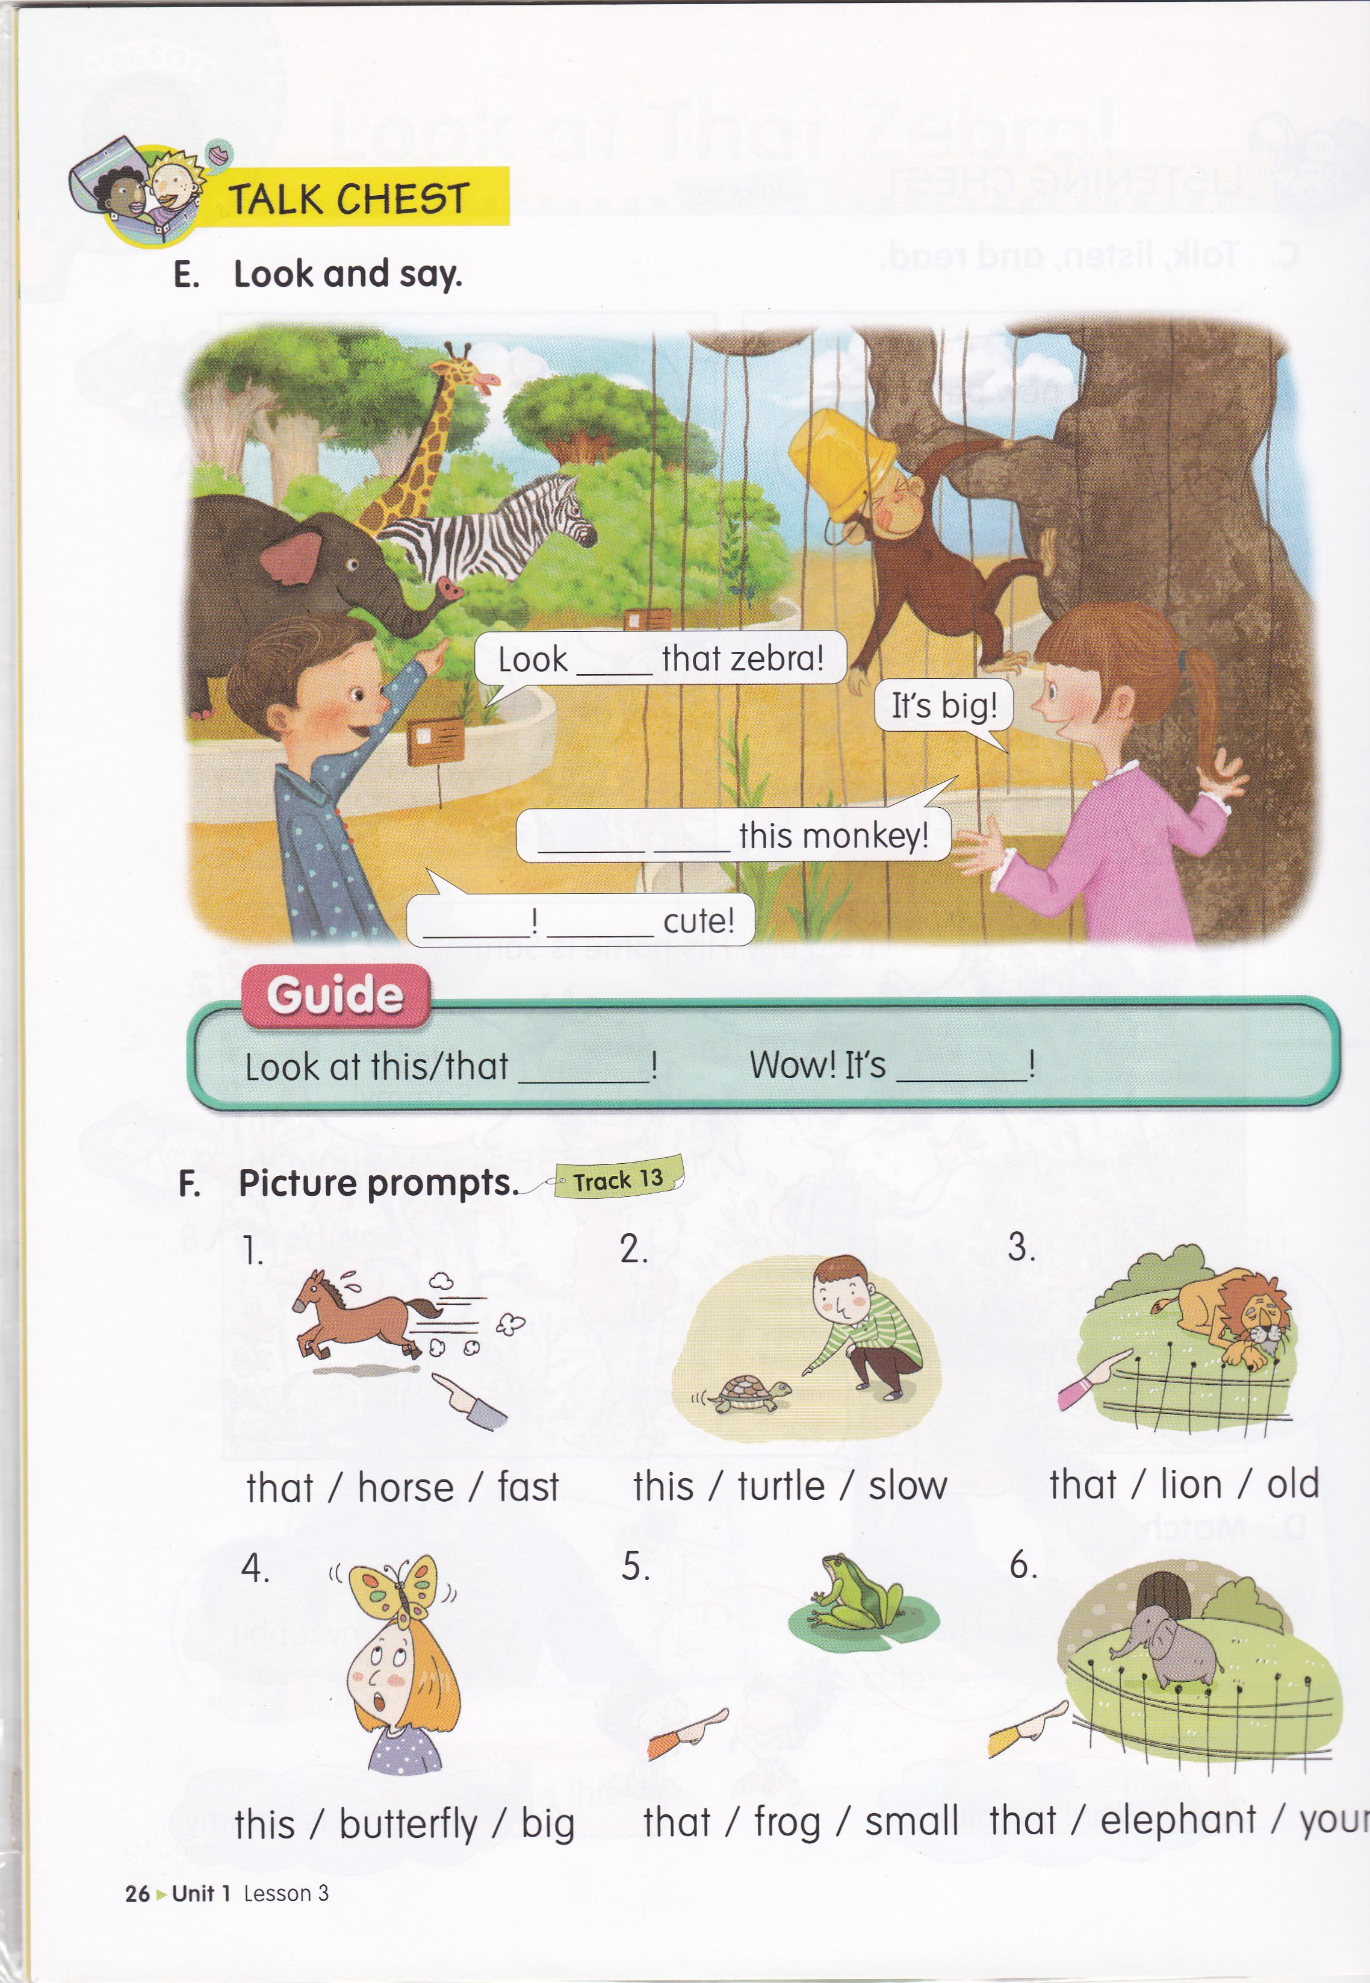

Slide 9
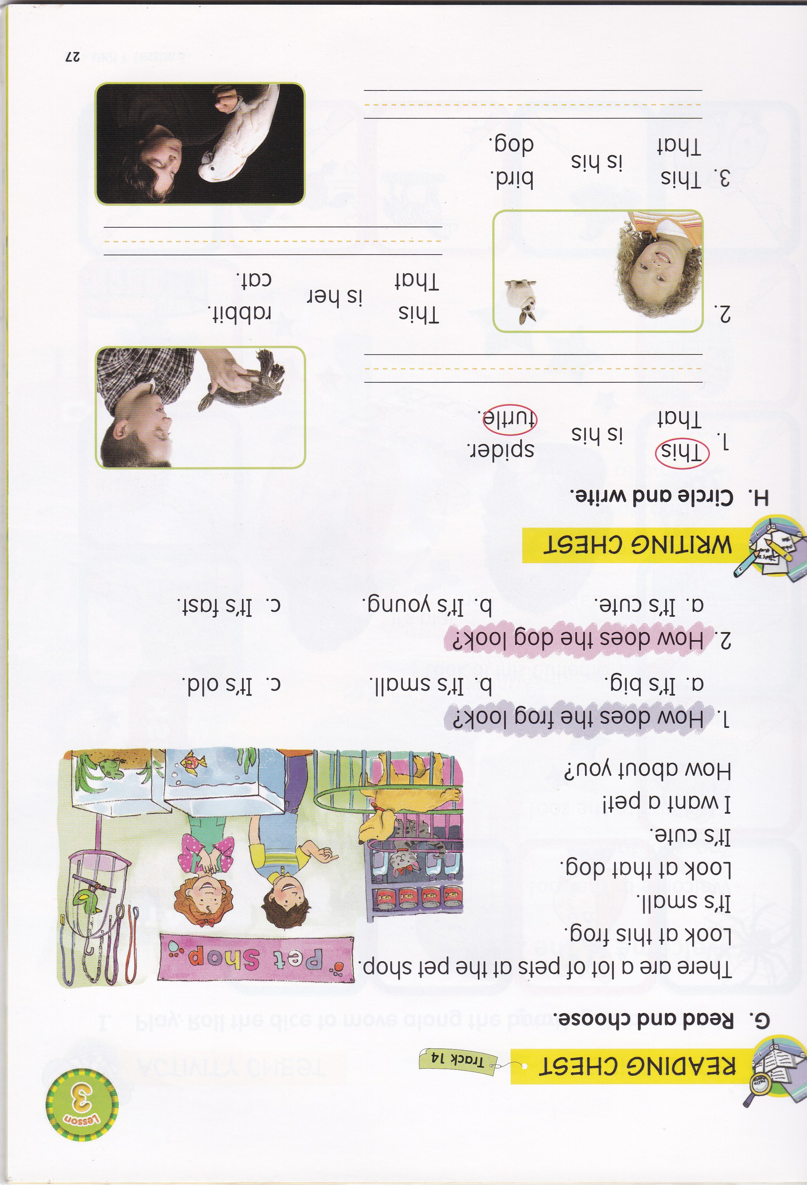

Slide 10
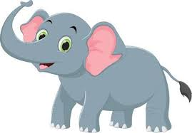
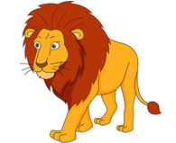
elephant fast lion cute
That rabbit is ____________.
cute
That horse is ____________.
fast
That ____________ is big.
elephant
That ____________ is old.
lion

Slide 11
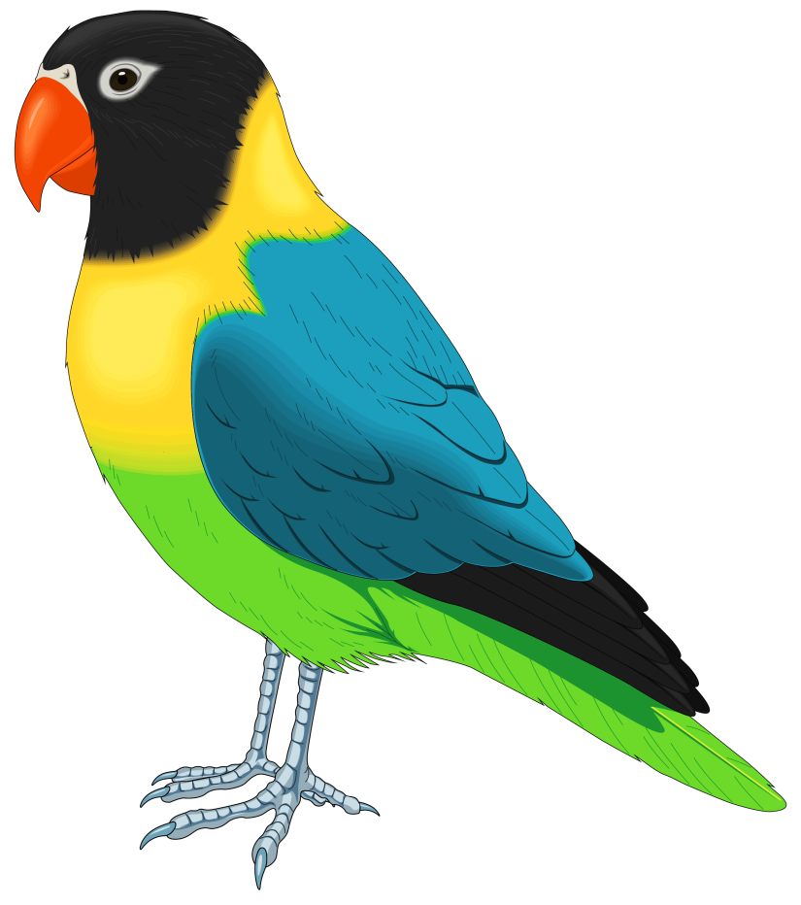
That _________ is cute / ugly.
bird

Slide 12

This ___________ is fast / beautiful.
butterfly

Slide 13

This ___________ is fast/ slow.
tiger

Slide 14
This ___________ is fast/ slow.
turtle

Slide 15

That / fast / . / is / frog
That frog is fast.

Slide 16

spider / This / . / small / is
This spider is small.

Slide 17
cute / This / is / . / monkey
This monkey is cute.

Slide 18
zebra it that fast is
A : Look at ________ monkey!
B : That’s not a monkey.
It’s a __________.
C : Ooops! It ______ very _________.
D : Yes, _________ is also young.
that
zebra
is
fast
it

Slide 19


