Slide 1
First Meeting
Unit 1 Lesson 4
Can You Swim?

Slide 2
In this lesson you will learn
how to express ability.

Slide 3
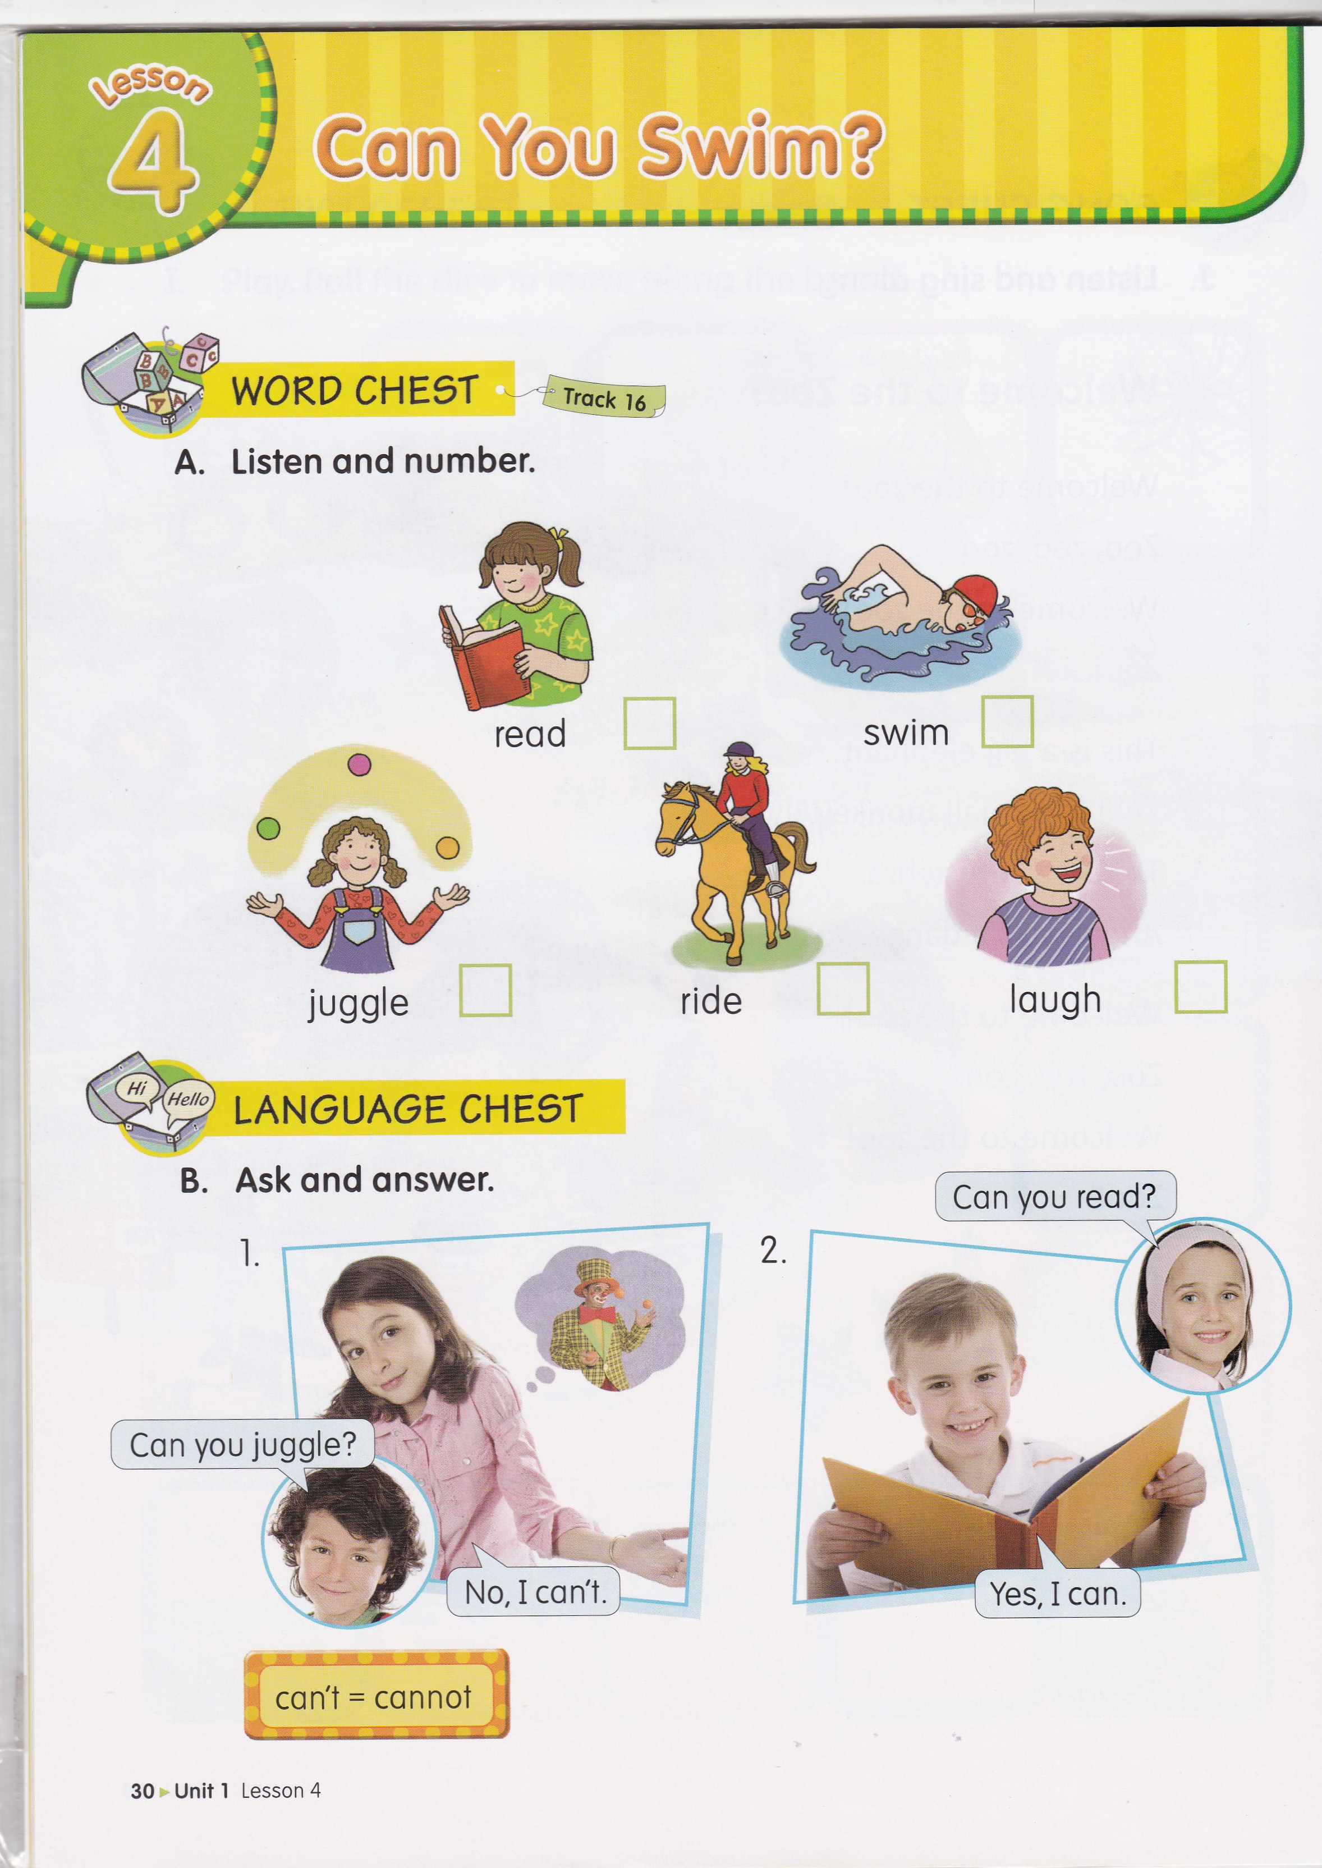
5
4
1
2
3

Slide 4
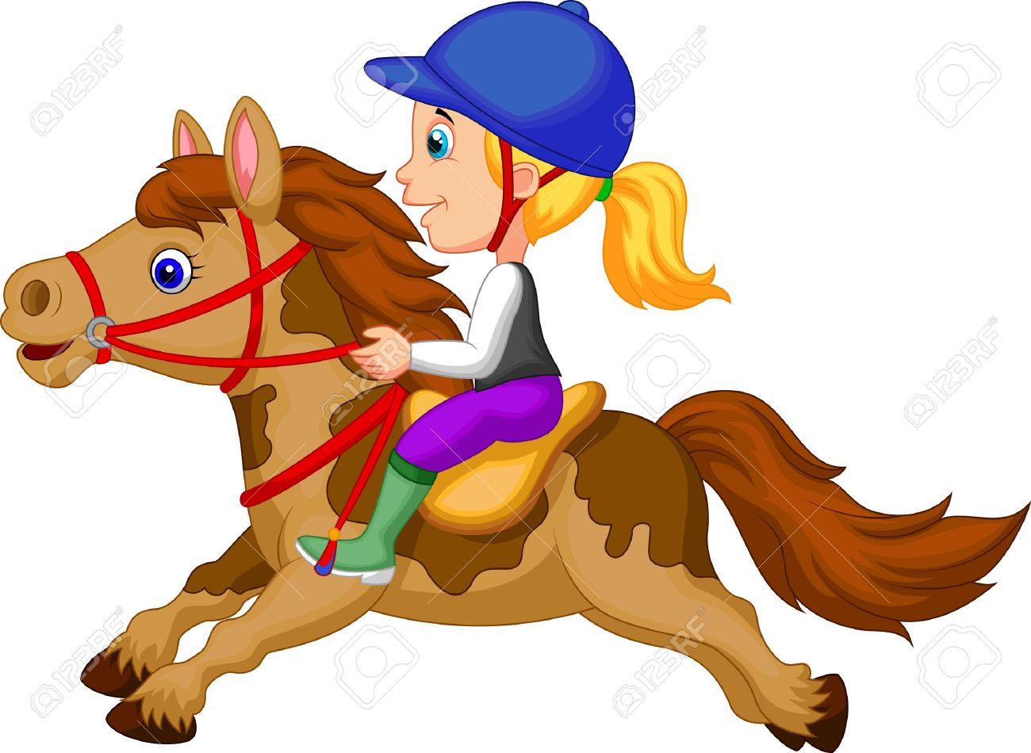
What can you see?
I can see a girl.

Slide 5
What can she do?
She can ride a horse.

Slide 6
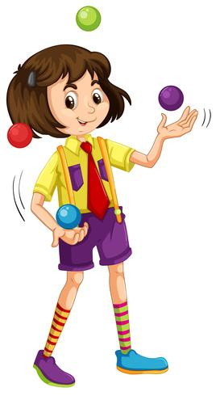
What can the girl do?
She can juggle.

Slide 7
What can you see?
I can see a boy.

Slide 8
Can he swim?

Slide 9
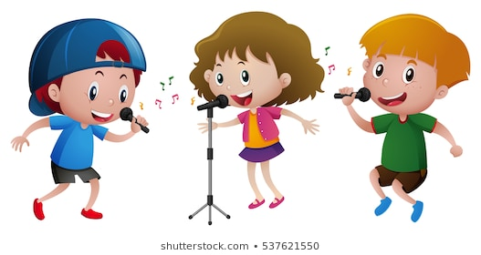
Can they sing?

Slide 10
Let’s sing a song!
Yes, I Can!
Can you sing? Can you dance? Can you play the guitar?
Can you draw? Can you juggle? Can you jump high?
Can you walk on your hands?
Yes, I can sing. I can dance. I can play the guitar.
I can draw. I can juggle. I can jump high.
I can walk on my hands.
Yes, I can!

Slide 11
SENTENCE PATTERN
Can you ____________ ?
(+ Verb 1)
Yes, I can.
No, I can’t.
No, I cannot.
can’t = cannot

Slide 12
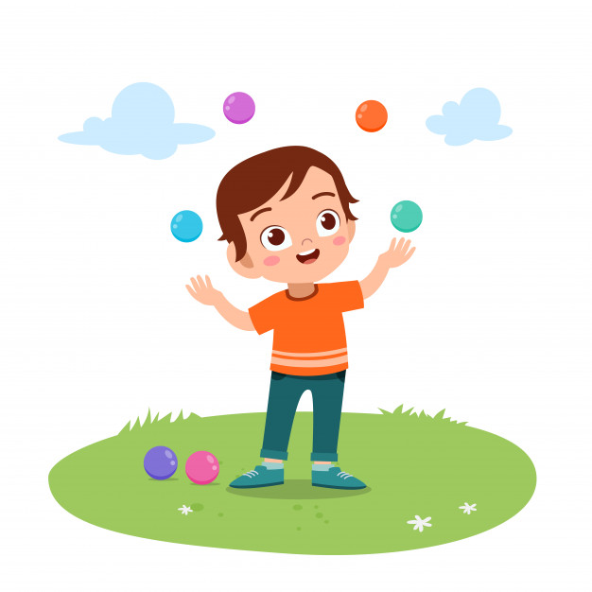
Can you juggle?
Yes, I can.
No, I can’t.

Slide 13
Ask and answer
Joshua : Can you swim?
Jolin : ___________.
Yes, I can
Rena : Can you sing?
Rey : _____________.
No, I can’t

Slide 15
Can
you
Yes
can’t
Can
you

Slide 17
HOMEWORK
(From EC Summary page 11)

