Slide 1
UNIT 2 LESSON 1
What’s This?
2nd Meeting
Let’s go!

Slide 2
GRAMMAR FOCUS
Demonstrative Pronouns : this/that
Preposition : from

Slide 3
LESSON OBJECTIVE
In this lesson you will learn how to identify some objects and their origin.

Slide 4
SENTENCE PATTERN
What’s this?
What’s that?
It’s a ____________.
It’s from my __________.

Slide 5

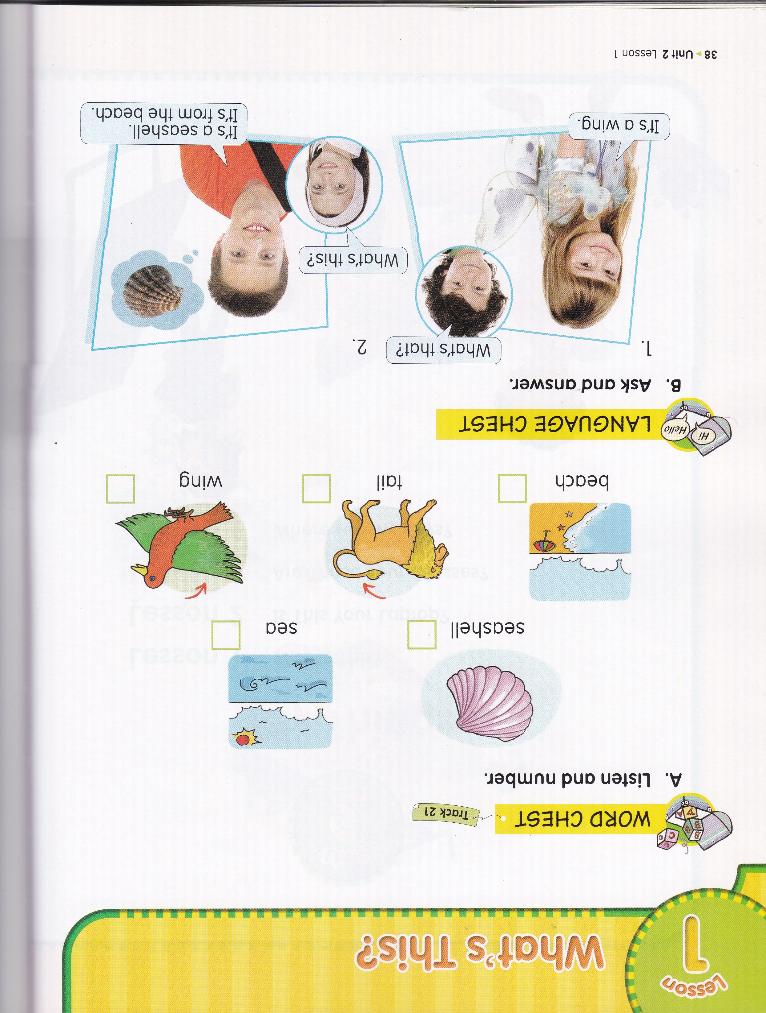

What’s this?
It’s a seashell.
They’re from the beach.
It’s a starfish.

Slide 6
What’s this?
It’s a tail.
It’s from a lion.

Slide 7

What’s this?
It’s a tail.
It’s from a toy-horse.

Slide 8
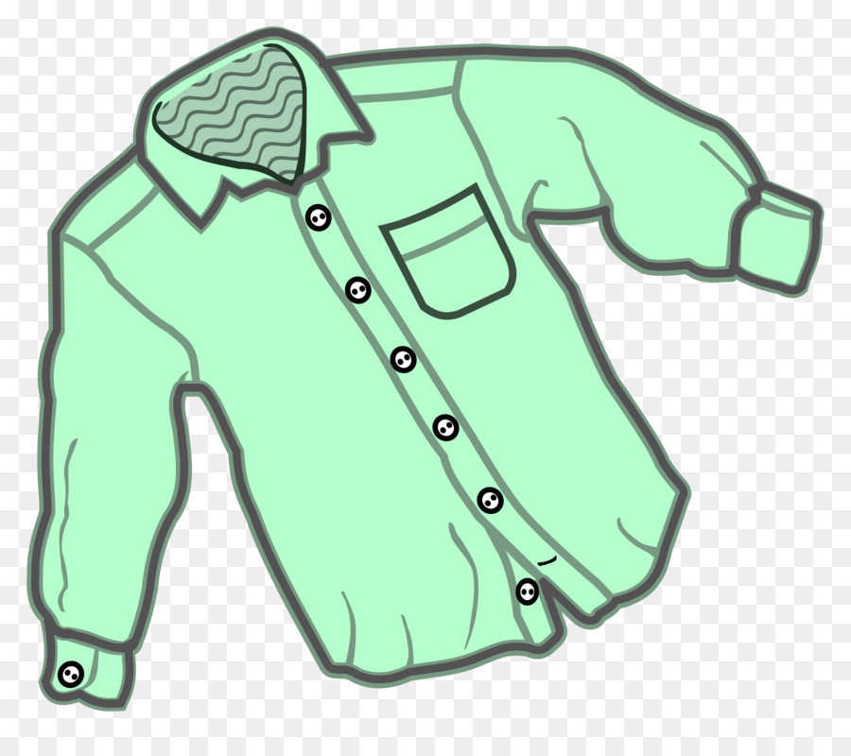

What’s this?
It’s a button.
It’s from my shirt.

Slide 9
What’s this?
It’s a wing.
It’s from a bird.

Slide 10

What’s that?
It’s a wing.
It’s from a toy airplane.

Slide 11
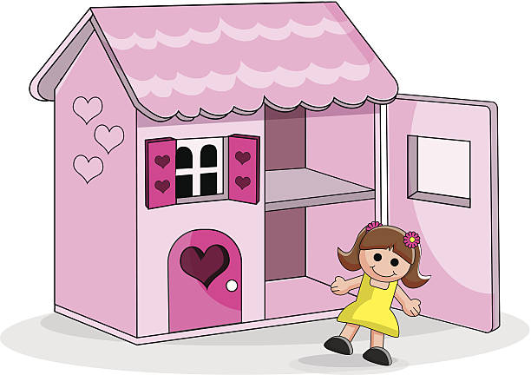
What’s this?
It’s a roof.
It’s from my doll house.

Slide 12
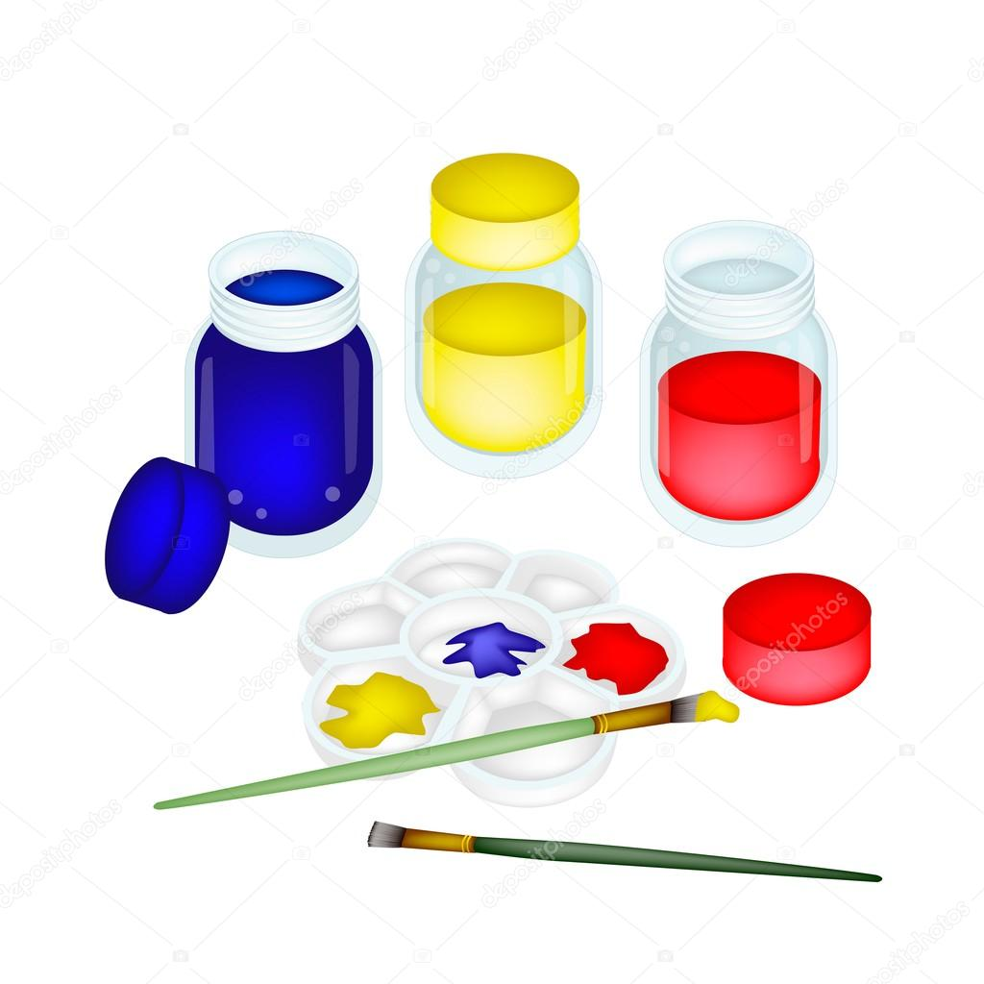
What’s that?
It’s a lid.
It’s from my paint set.

Slide 13
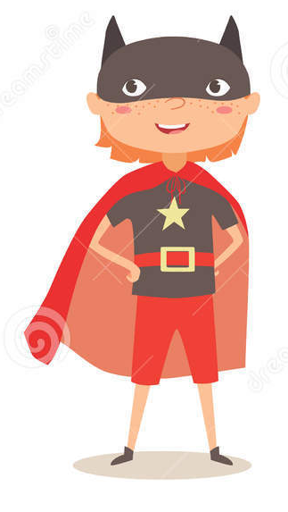

What’s this?
It’s a mask.
It’s from my costume.

Slide 14

What’s this?
It’s a helmet.
It’s from my robot.

Slide 15

What’s that?
It’s a string.
It’s from my yoyo.

Slide 16

What’s that?
It’s a cable.
It’s from my earphone.

Slide 17
EXERCISE
What’s this? Is it a helmet?
Yes, it is.
It’s from my robot.

Slide 18
What’s that? Is it a mask?
No, it isn’t.
It is a string. It’s from a yoyo.

Slide 19
Is it a wing from a toy airplane?
No, it isn’t.
It is a wing from a bird.

Slide 20
They’re from the beach.
Where are seashells from, the beach or the mountain?

Slide 21
A : _______ this?
B : ______ a ______. It’s ______ my yoyo.
What’s
It’s
string
from
A : _______ that?
B : It’s ____ ______. It’s from my doll ______.
What’s
a
roof
house

Slide 22
is / seashell / This / . / my
This is my seashell.
the / . / beach / from / It’s
It’s from the beach.

Slide 23
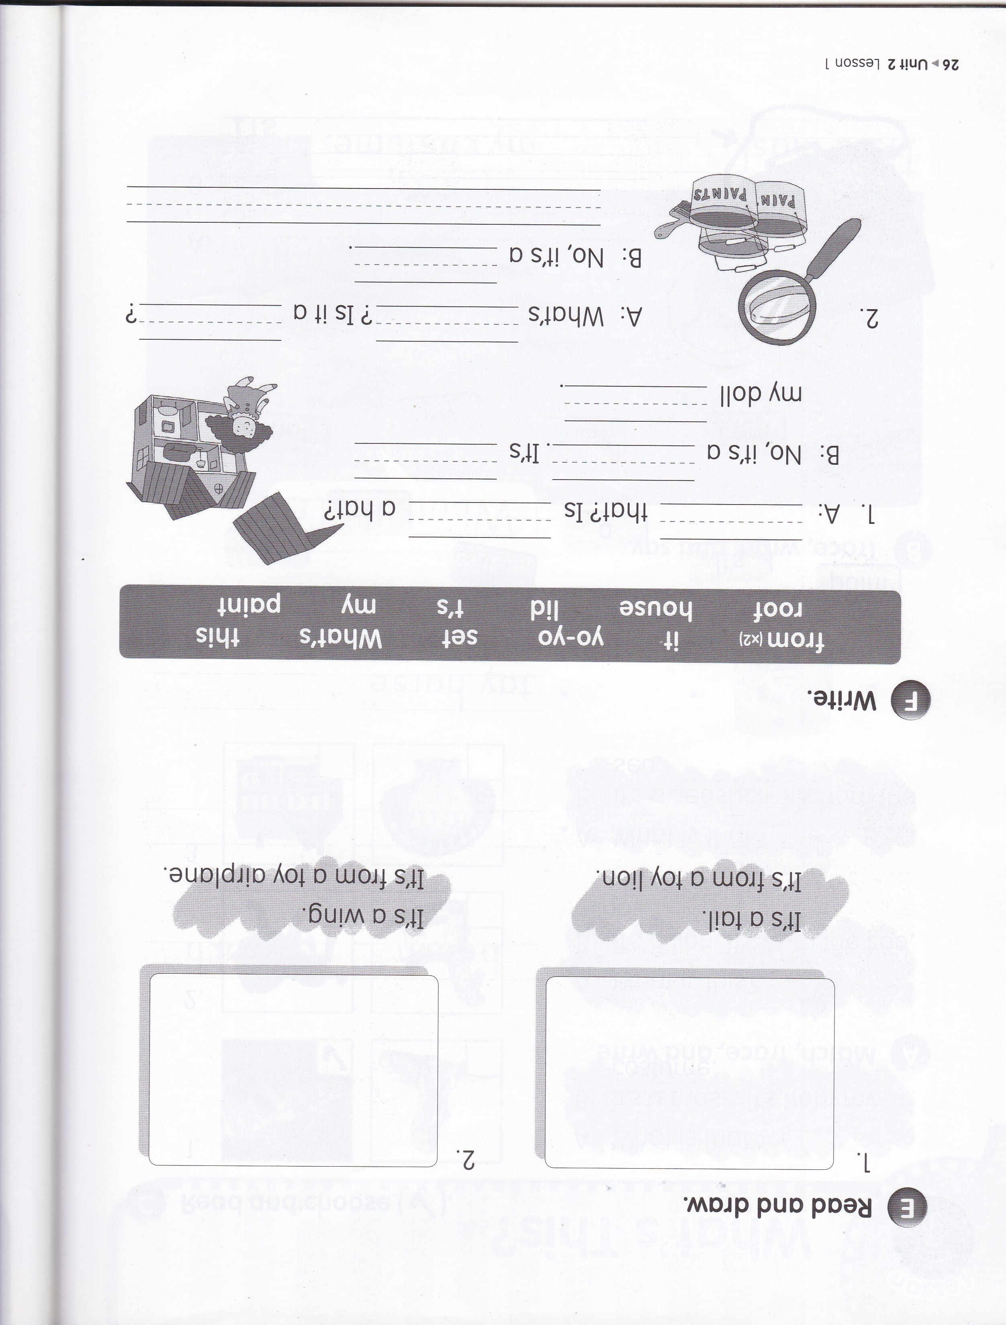
What’s
it
roof
from
house
this
yoyo
lid
It’s from my paint set.

Slide 24

Let’s sing a song!
This and That
That! What’s that?
That! What’s that?
Roof! It’s a roof. It’s from my doll house.
This! What’s this?
This! What’s this?
String! It’s a string. It’s from my yoyo.
That! What’s that?
That! What’s that?
Lid! It’s a lid. It’s from my paint set.

Slide 25



