Slide 1
Is This Your Laptop?
Unit 2 Lesson 2
Let’s go!

Slide 2
his

Slide 3
Adjective !
This is my book.
This is your glue.
This is her camera
This is his laptop.
This is our MP3 player.

Slide 4
Possessive Adjectives
their
your
his
my
her
it
our

Slide 5
Is this your ________ ?
Is that your ________ ?
Yes, it is. It’s mine.
No, it’s not. It’s my _____.
No, it isn’t. It’s _____ (possessive).

Slide 6
Possessive Adjectives (kata ganti kepemilikan)
Subject
Possessive Adjectives
I my
You your
We our
They their
He his
She her
It its

Slide 7
Possessive Adjectives (+ noun)
1. This is my laptop.
2. This is your glue.
3. This is our camera.
4. This is their computer.
5. This is his cell phone.
6. This is her pencil sharpener.
7. This is its ball.

Slide 8
What can you see?
I can see a laptop.

Slide 9
What is it?
It’s a stapler.

Slide 10
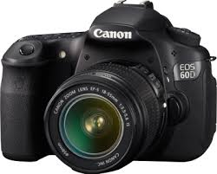
What is it?
It’s a camera.

Slide 11
What is it?
It’s a glue.

Slide 12
What is it?
It’s a pencil sharpener.

Slide 13
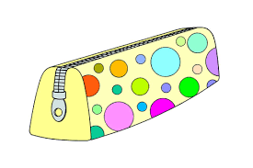
What is it?
It’s a pencil case.

Slide 14
What is it?
It is a stereo.

Slide 15
What is it?
It is a computer.

Slide 16
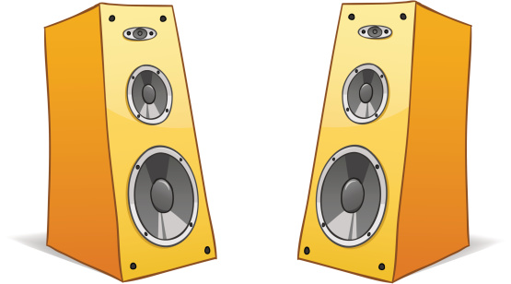
What is it?
It’s speakers.

Slide 17
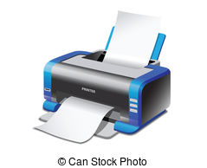
What is it?
It’s a printer.

Slide 18
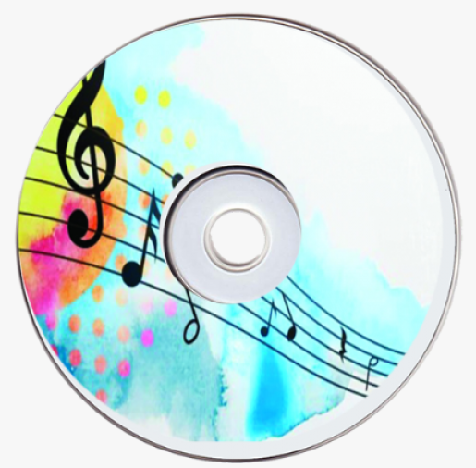
What is it?
It’s a CD.

Slide 19
What is it?
It’s a flash disk.

Slide 20
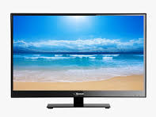
What is it?
It’s a TV.

Slide 21
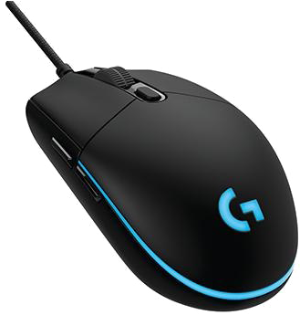
What is it?
It’s a mouse.

Slide 22
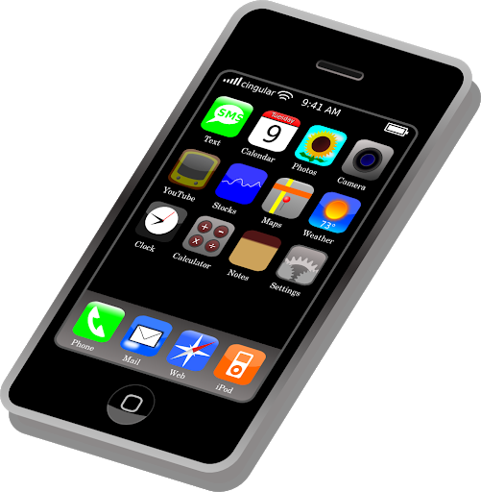
What is it?
It’s a cell phone.

Slide 23
What is it?
It’s a MP3 player.

Slide 24
Q : Whose _____ is it?
A : It’s ________.

Slide 25
Is
your
No
It
is
Is
your
Yes
is

Slide 27
Is this your cell phone?
No, it isn’t.
Lisa, is this yours?
No, this camera is mine.

Slide 28
No, it’s my sister’s.
Is that your cell phone?
Yes, it is.

Slide 29
your pencil sharpener?
your stapler?
Is that your glue?

Slide 30
stereo
isn’t
dad’s
your
is

Slide 31
camera
4
2
stapler
laptop
3

Slide 33
Let’s sing a song!
Whose Ball Is It?
Whose ball is it? Whose ball is it?
It’s Tom’s. It’s Tom’s.
Whose book is it? Whose book is it?
It’s Anne’s. It’s Anne’s.
Whose ball is it? Whose book is it?
Whose ball is it? Whose book is it?
It’s Tom’s soccer ball, and it’s Anne’s red book.
.

