Slide 1
UNIT 1 :
AT HOME
LESSON 1 :
What Do You Do in the Morning?

Slide 2
What is this?
This is pajamas.

Slide 3
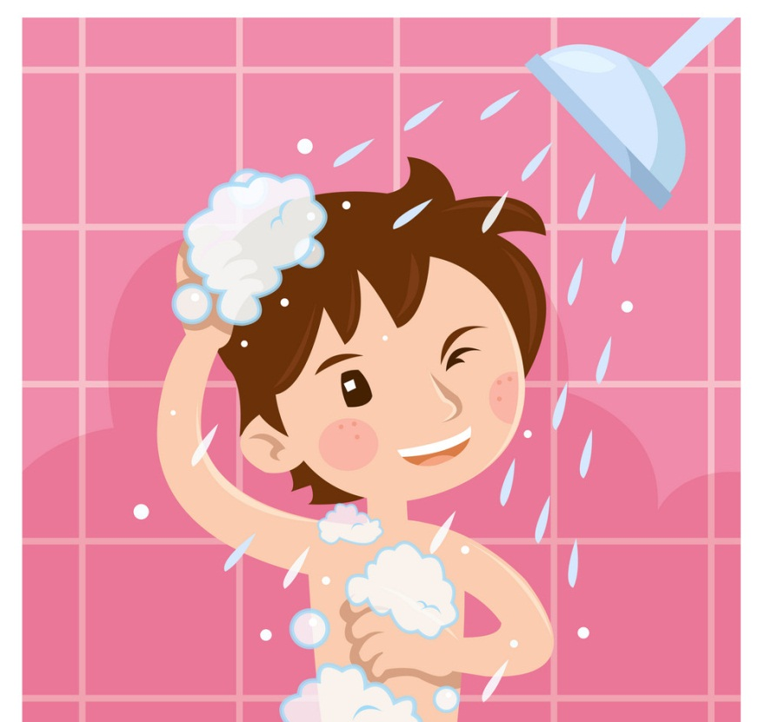
What do you do after waking up?
I take a shower.

Slide 4
What do you do at 11.am ?
I study at home.

Slide 5
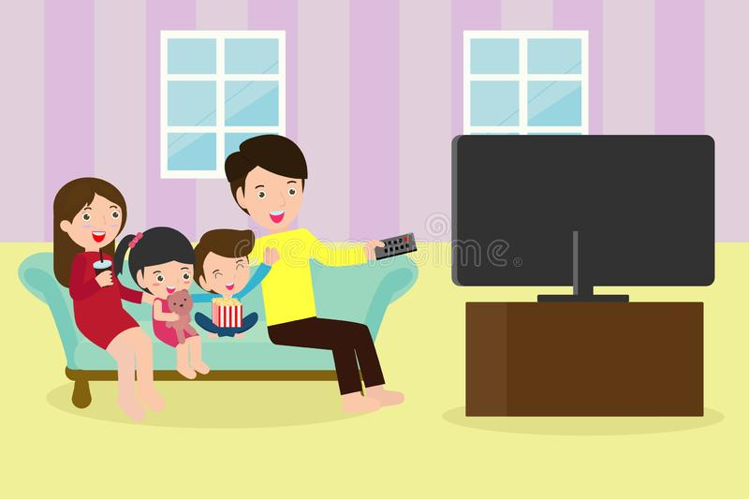
What do they do in the evening?
They watch television.

Slide 6
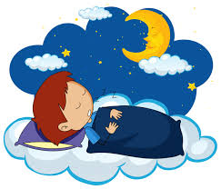
What does he do at night?
He sleeps.

Slide 7
What is your routine activity during learning from home?
Me :
I take a shower and then eat breakfast.
?
What about you?

Slide 8
The Subject is taken from English Chest 3 Unit 1 Lesson 1 “What do you do in the morning?”
In this lesson, you will learn about routines activities.

Slide 9
SENTENCE PATTERNS
What do you do in the morning?
What do you do in the afternoon?
What do you do in the evening?
What do you do at night?
I ____________________.

Slide 10
SENTENCE PATTERNS
Example :
I eat breakfast.
You take a shower.
We get dressed.
They watch television.
He eats dinner.
She goes to school.
The dog sleeps at night.
SUBJECT VERB
I
You VERB
They
We
He
She VERB (s/es)
It

Slide 11
5
3
2
4

Slide 13
What
do
you
do
I
dad
I

Slide 15
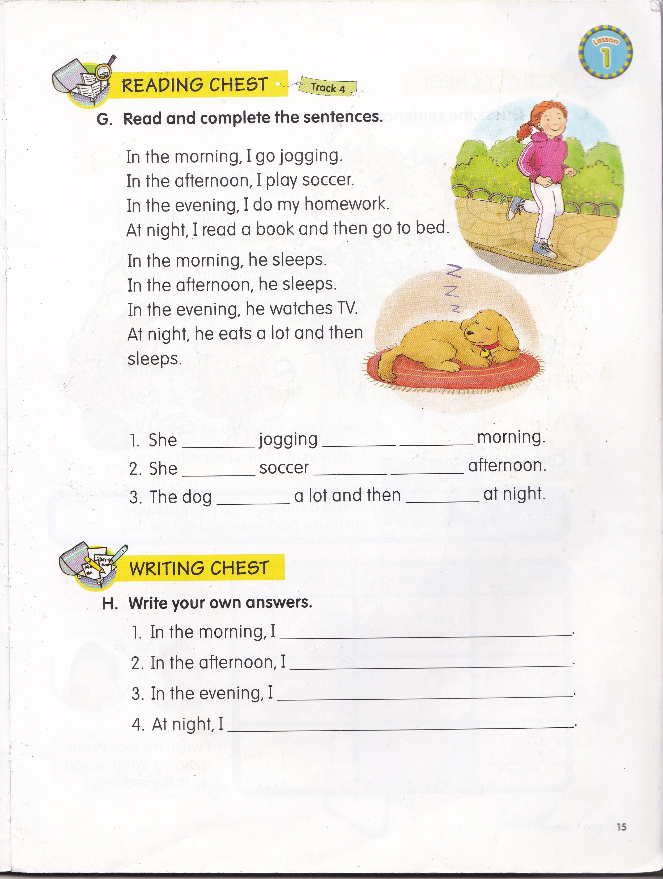
goes
in
the
plays
in
the
eats
sleeps

Slide 16
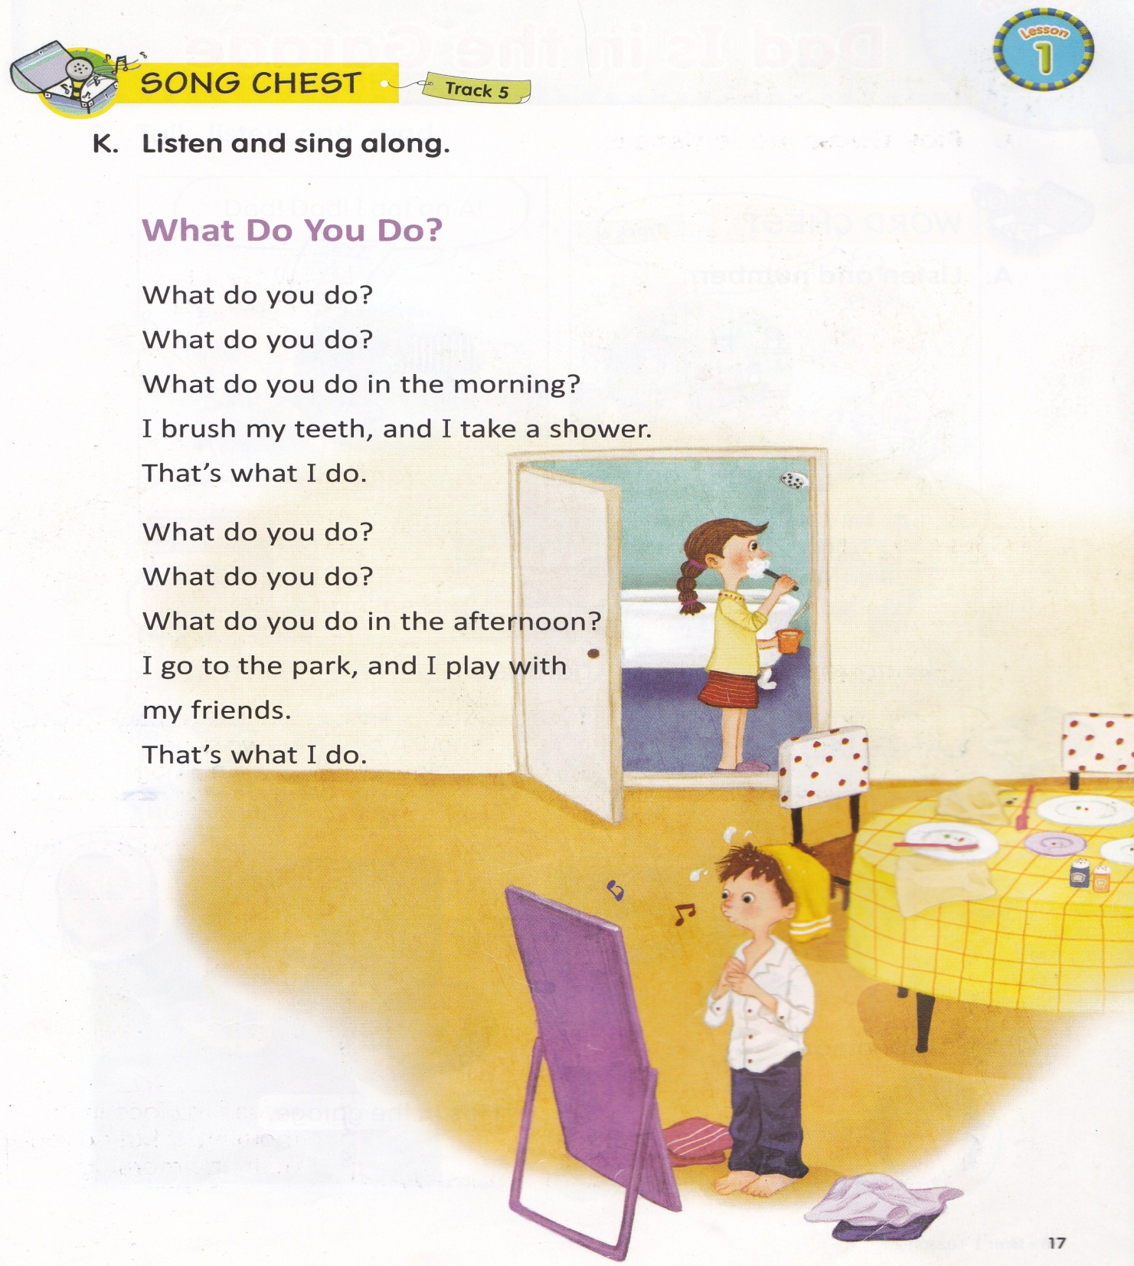

Slide 17
Try it! Change the verbs form based on the subject! Example: Jane (swim) swims in the afternoon. I (go) go to the park in the morning. 1. Anya (wake) ________________ up in the morning. 2. Then, she (take) ________________ a shower. 3. After that, she (get) ________________ dressed. 4. She (go) ________________ to school with her brother Willy. 5. Anya and Billy (go) ________________ to school by car. 6. Uncle (drive) ________________ us to school. 7. Mother (stay) ________________ at home and do house works. 8. She (cook) ________________ delicious foods for us.
Homework (from EC Summary page 4)

