Slide 1

Unit 1 Lesson 2
Dad Is In The Garage

Slide 2

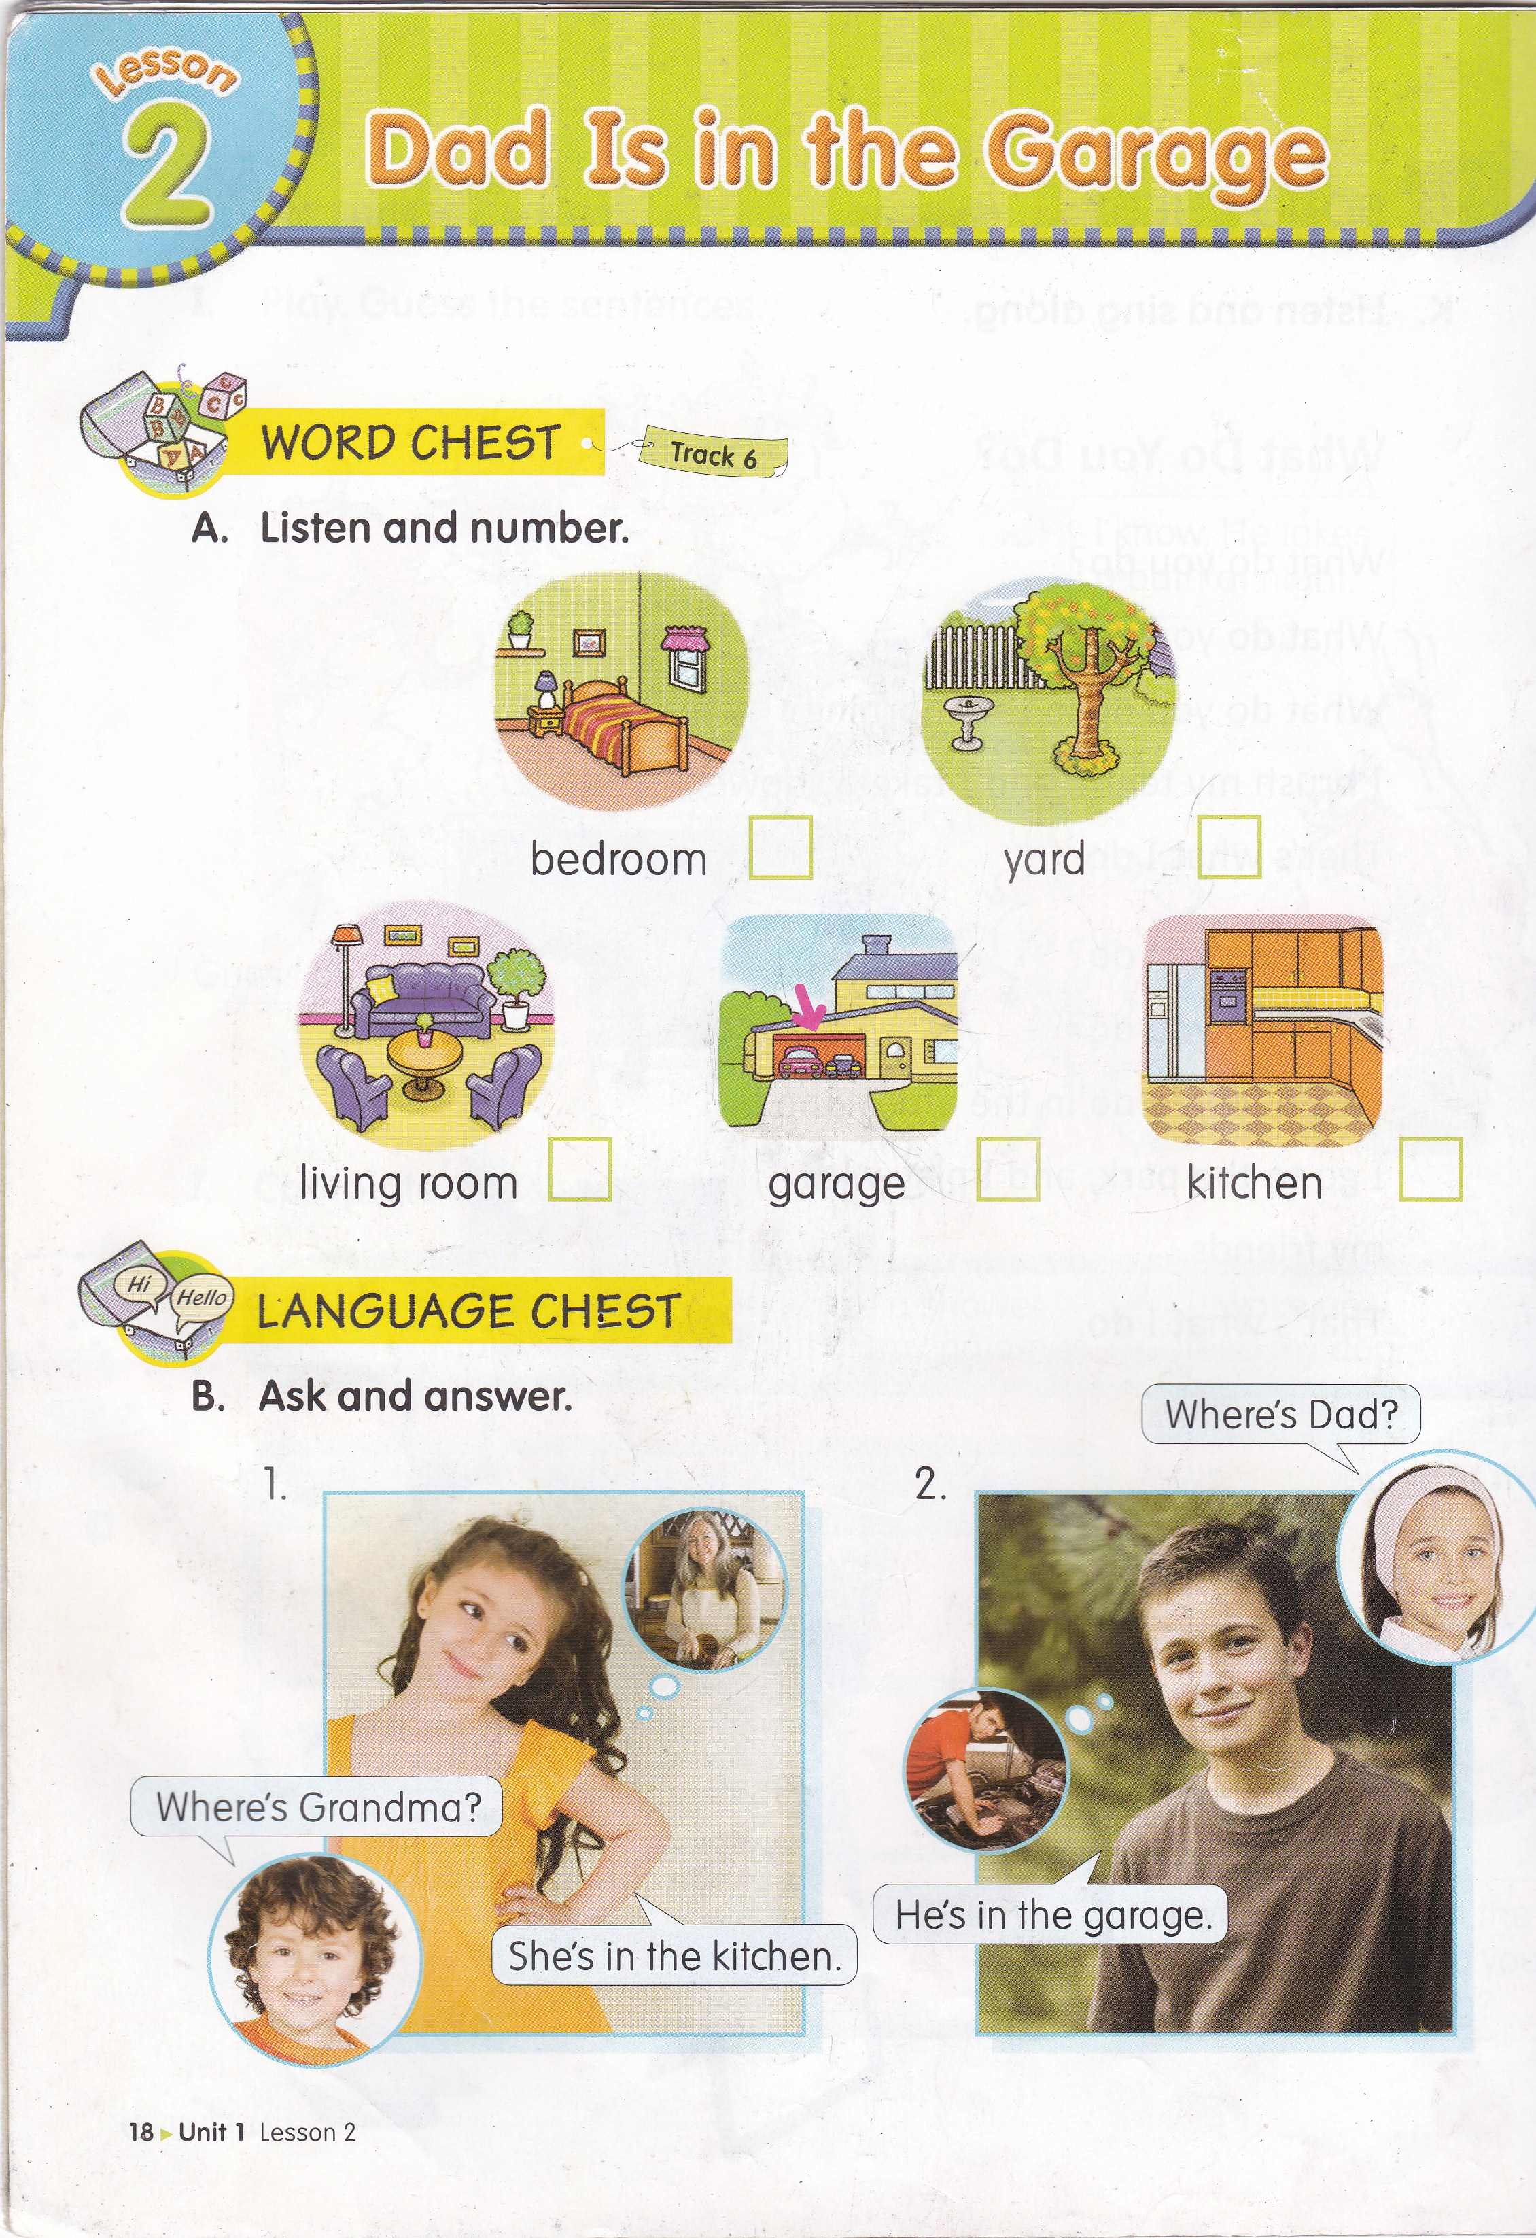
What can you see?
I can see ___________.

Slide 3
Great….
It is a yard.

Slide 4
What do you usually do in the yard?
Me : I play soccer with my friend.
?
What about you?

Slide 5
What can you see?
I can see ___________.

Slide 6
Good jod….
It is a living room.

Slide 7
What do you usually do in the living room?
Me : I drink orange juice.
?
What about you?

Slide 8


Let’s sing a song
Where Are They?
Where is Father?
He’s in the garage.
Garage! Garage! Here he is!
Where is Mother?
She’s in the bathroom.
Bathroom! Bathroom! Here she is.
Where is Billy?
He’s in the kitchen.
Kitchen! Kitchen! Here he is.
Where is Rossy?
She’s in her bedroom.
Bedroom! Bedroom! Here she is.

Slide 9

In this lesson, you will learn about rooms / areas in the house.
The Subject is taken from
English Chest 3 Unit 1 Lesson 2
“Dad is in the garage”

Slide 10
SENTENCE PATTERNS
Where’s ___________?
He’s in the ____________.
She’s in the ___________.

Slide 11
EXAMPLE
Where’s Jenny?
She’s in the garage.

Slide 12
Where’s Tom?
He’s in the bedroom.

Slide 13
Where’s Grandma?
She’s in the kitchen.

Slide 14
Where’s Dad?
He’s in the living room.

Slide 15
2
5
3
4
1

Slide 17
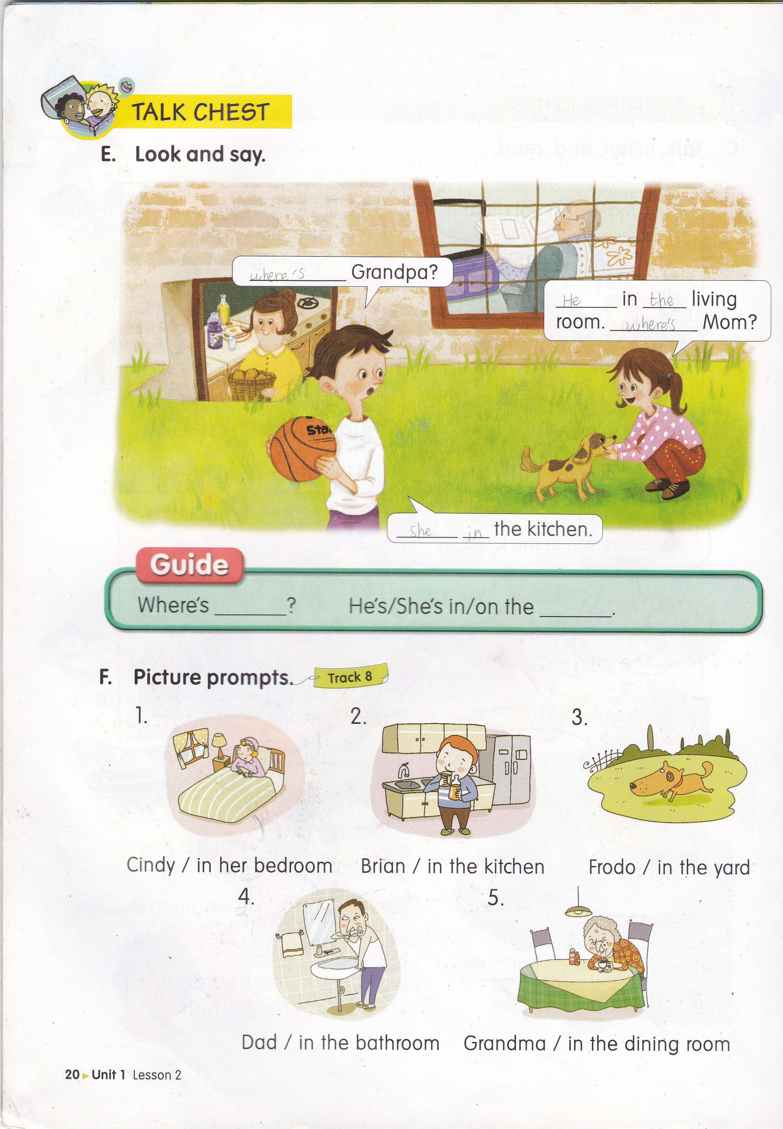
Where’s
He’s
the
Where’s
She’s
in

Slide 19
Let’s sing a song
Where Are They?
Where is Father?
He’s in the garage.
Garage! Garage! Here he is!
Where is Mother?
She’s in the bathroom.
Bathroom! Bathroom! Here she is.
Where is Billy?
He’s in the kitchen.
Kitchen! Kitchen! Here he is.
Where is Rossy?
She’s in her bedroom.
Bedroom! Bedroom! Here she is.

Slide 20


