Slide 1
UNIT 1 LESSON 2
Dad Is In The Garage

Slide 2
Let’s sing a song
Where Are They?
Where is Father?
He’s in the garage.
Garage! Garage! Here he is!
Where is Mother?
She’s in the bathroom.
Bathroom! Bathroom! Here she is.
Where is Billy?
He’s in the kitchen.
Kitchen! Kitchen! Here he is.
Where is Rossy?
She’s in her bedroom.
Bedroom! Bedroom! Here she is.

Slide 3
ROOMS / AREAS IN THE HOUSE
living room
yard
bathroom
dining room
bedroom
kitchen

Slide 4
THINGS IN THE HOUSE
motorcycle
bicycle
car
computer
sofa
toys
table

Slide 5
What do you usually do in the yard?
I __________________________.

Slide 6
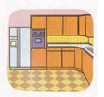
What do you usually do in the kitchen?
I ______________________.

Slide 7
What do you usually do in the living room?
I __________________________.

Slide 8
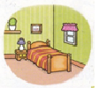
What do you usually do in the bedroom?
I __________________________.

Slide 9
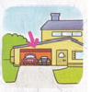
What do you usually do in the garage?
I __________________________.

Slide 10
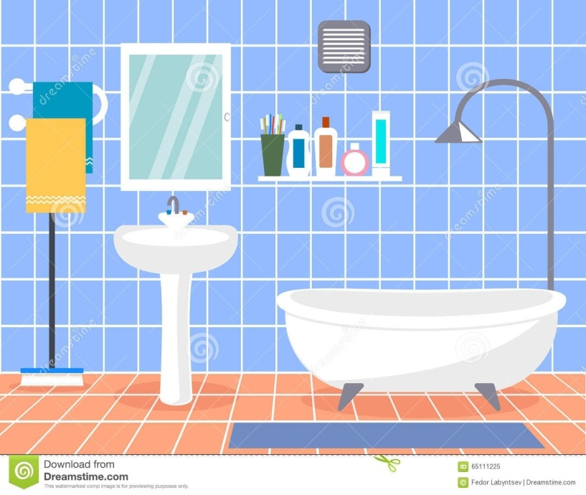
What do you usually do in the bathroom?
I __________________________.

Slide 11
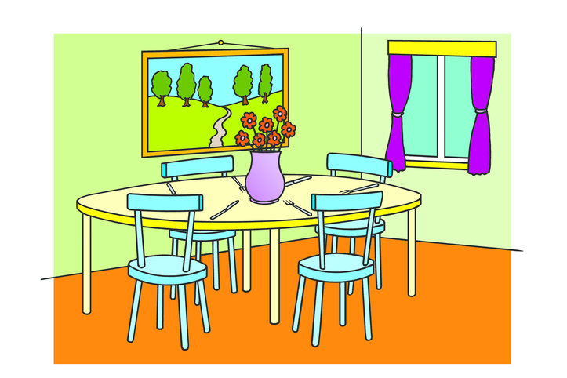
What do you usually do in the dining room?
I __________________________.

Slide 12
Reading Chest

Slide 13
Where are dad and his son?
They are in the garage.

Slide 14
Where does dad take lunch?
He has lunch in the dining room

Slide 15
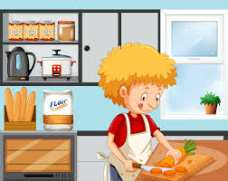
Where is Bill? Is he in the garage?
No, he isn’t. He is in the kitchen .

Slide 16
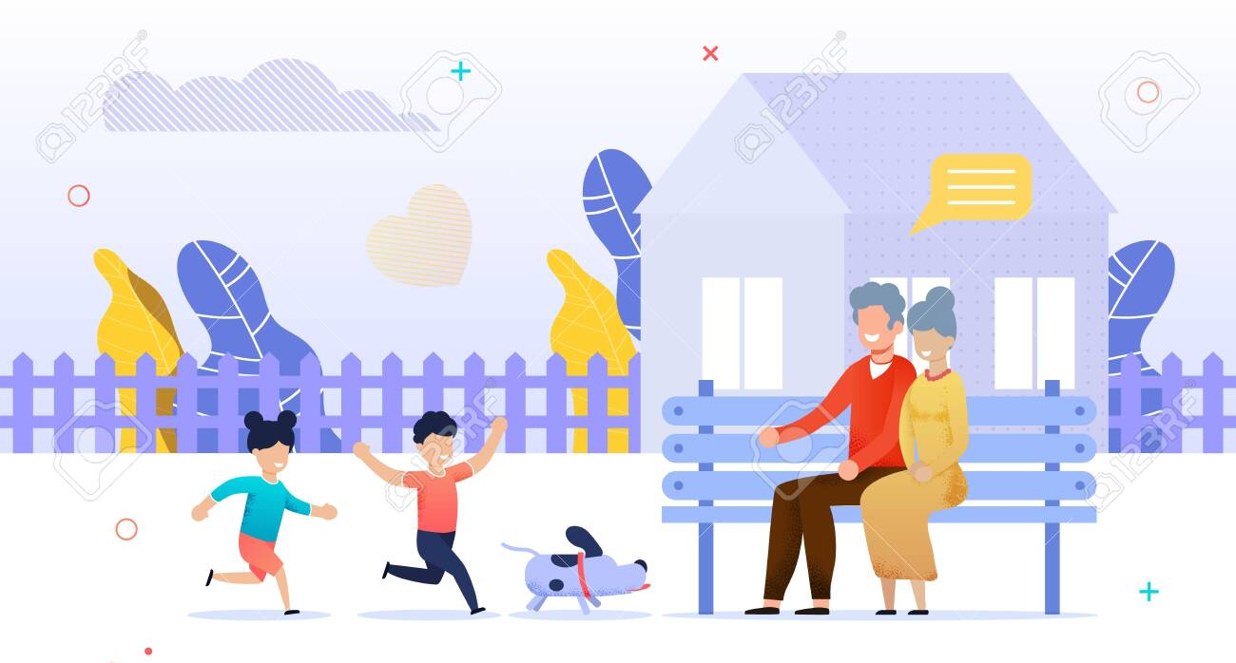
Where are they? Are they in the kitchen?
No, they aren’t. They are in the yard.

