Slide 1
Unit 1 Lesson 3
Put the Mirror on the Wall
START

Slide 2
In this lesson, you will learn :
1. How to identify household items.
2. How to identify location.

Slide 3
What is it?
It is a nice lamp.

Slide 4
Where is the lamp?
The lamp is on the table.

Slide 5
What is it?
It is a beautiful vase.

Slide 6
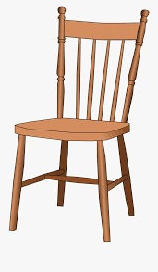
Where is the vase?
The vase is on the chair.

Slide 7
What is it?
It is a great toaster.

Slide 8
Where should we put the toaster?
______________________________

Slide 9
What is it?
It is a heavy microwave.

Slide 10
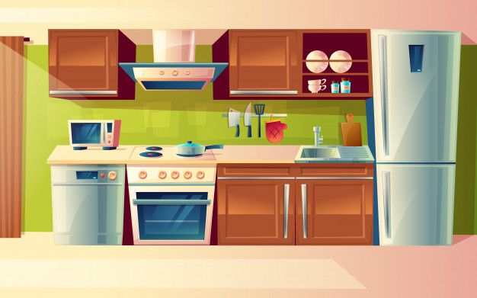
Where is the microwave?
The microwave is in the kitchen.

Slide 11
What is it?
It is a pretty sofa.

Slide 12
Where is the sofa?
The sofa is in the living room.

Slide 13
What is it?
It is a pretty clock.

Slide 14
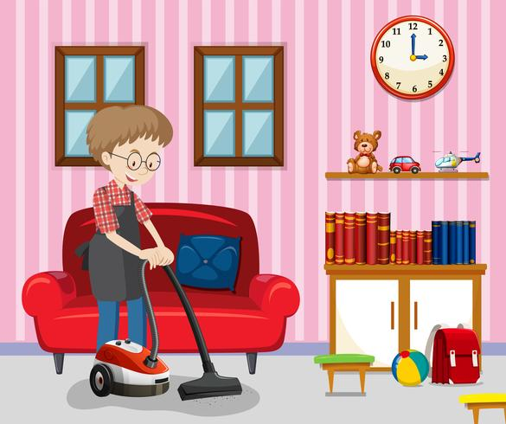
Where is the clock?
The clock is on the wall.

Slide 15
Preposition of Place (Keterangan tempat)
behind
in front of

Slide 16
Preposition of Place (Keterangan tempat)
above
under

Slide 17
Preposition of Place (Keterangan tempat)
on
in

Slide 18
Preposition of Place (Keterangan tempat)
next to
beside
between
near

Slide 19
Adjective (Kata Sifat) is used to describe a noun.
beautiful
(cantik/indah)
pretty
(cantik)
nice
(bagus)
light
(ringan)
heavy
(berat)
clean
(bersih)
soft
(lembut)
dirty
(kotor)

Slide 20
Let’s sing a song!
Put the Mirror on the Wall
Put the mirror on the wall.
On the wall, on the wall in the bedroom.
La! La-la-la!
La! La-la-la!
Put it on the wall in the bedroom.
Put the fan on the table.
On the table, on the table in the living room.
La! La-la-la!
La! La-la-la!
Put it on the table in the living room.

Slide 21
SENTENCE PATTERN
This is a _______ _______.
Put it in / on the ______________.
These are _______ _______.
Put them in / on the ______________.

Slide 23
EXAMPLE
Lio : This is a nice table.
Mom : Put it in the dining room.
Farel : This is a soft towel.
Dad : Put it in the bathroom.

Slide 24
Greta : These are clean plates.
Grandma : Put them next to the box.
Dani : These are beautiful flowers.
Grandpa : Put them on the table.

Slide 25
3
2
6
1
4
5

Slide 26
Put
them
Put
it

Slide 27
HOMEWORK (from EC Summary page 9-10)
Look at the pictures and find the objects !

Slide 28
1. Where is the ball?
The ball is under the table.
2. Where is the cake?
__________________________________________.
3. Where is the books?
__________________________________________.
4. Where is the fish?
___________________________________________.
5. Where is the boy?
___________________________________________.
6. Where is the hat?
___________________________________________.
7. Where is the flower?
___________________________________________.
8. Where is the boy?
___________________________________________.
9. Where is the frame?
___________________________________________.

