Slide 1

Second Meeting
Unit 1 Lesson 3
Put the Mirror on the Wall
START

Slide 2
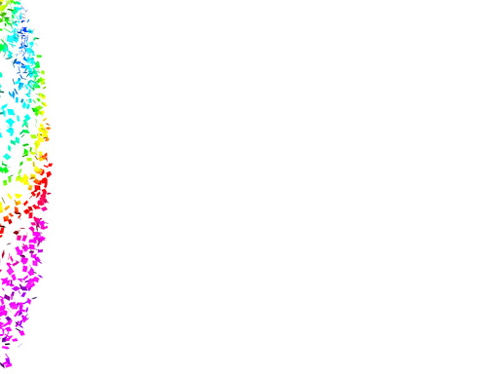
In this lesson, you will learn :
1. Review homework.
2. How to identify household items.
3. How to identify location.

Slide 3
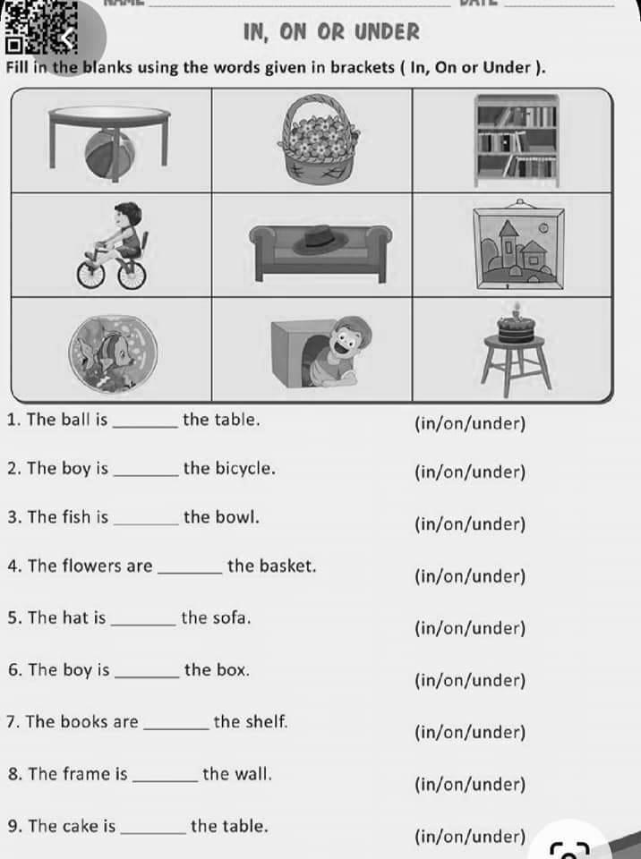
Homework
1. Where is the ball?
The ball is under the table.
2. Where is the cake?
The cake is on the chair.
3. Where are the books?
The books are in the bookcase.

Slide 4
4. Where is the fish?
The fish is in the aquarium.
5. Where is the boy?
The boy is in the box.
6. Where is the hat?
The hat is on the sofa.

Slide 5

7. Where is the flower?
The flower is in the basket.
8. Where is the boy?
The boy is on the bike.
9. Where is the frame?
The frame is on the wall.

Slide 6

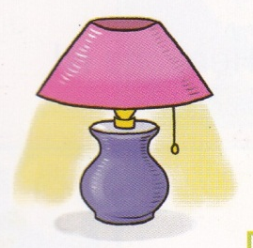



Household Items
It’s a nice lamp.
It’s a beautiful vase.
It’s a great toaster.
It’s a heavy microwave.

Slide 7
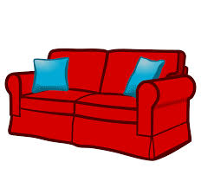

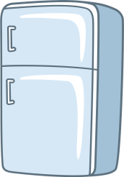

It’s a pretty sofa.
It’s a nice clock.
It’s a heavy refrigerator.
It’s a pretty picture.

Slide 8
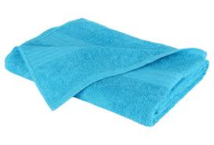
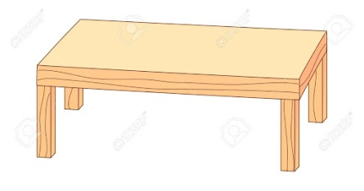
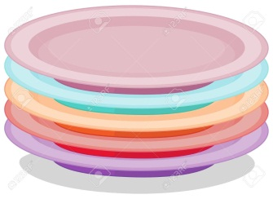

It’s a soft towel.
It’s a nice table.
These are clean plates.
These are beautiful flowers.

Slide 9
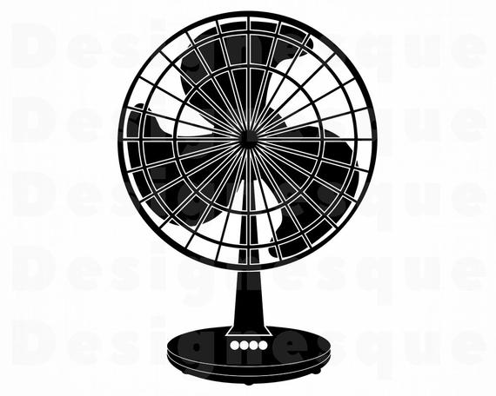

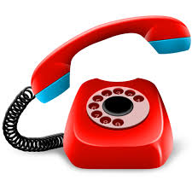
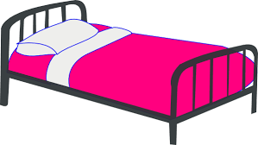
It’s a clean fan.
This is a nice mirror.
This is a pretty telephone.
It’s a cute bed.

Slide 10

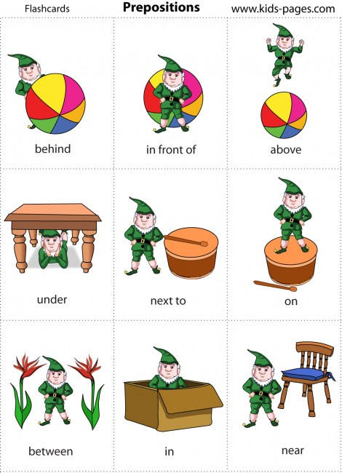
Location
Preposition of Place (Keterangan tempat)
behind
in front of

Slide 11
Preposition of Place (Keterangan tempat)
above
under

Slide 12
Preposition of Place (Keterangan tempat)
on
in

Slide 13
Preposition of Place (Keterangan tempat)
next to
beside
between
near

Slide 14
Adjective (Kata Sifat) is used to describe a noun.
beautiful
(cantik/indah)
pretty
(cantik)
nice
(bagus)
light
(ringan)
heavy
(berat)
clean
(bersih)
soft
(lembut)
dirty
(kotor)

Slide 15


Let’s sing a song!
Put the Mirror on the Wall
Put the mirror on the wall.
On the wall, on the wall in the bedroom.
La! La-la-la!
La! La-la-la!
Put it on the wall in the bedroom.
Put the fan on the table.
On the table, on the table in the living room.
La! La-la-la!
La! La-la-la!
Put it on the table in the living room.

Slide 16
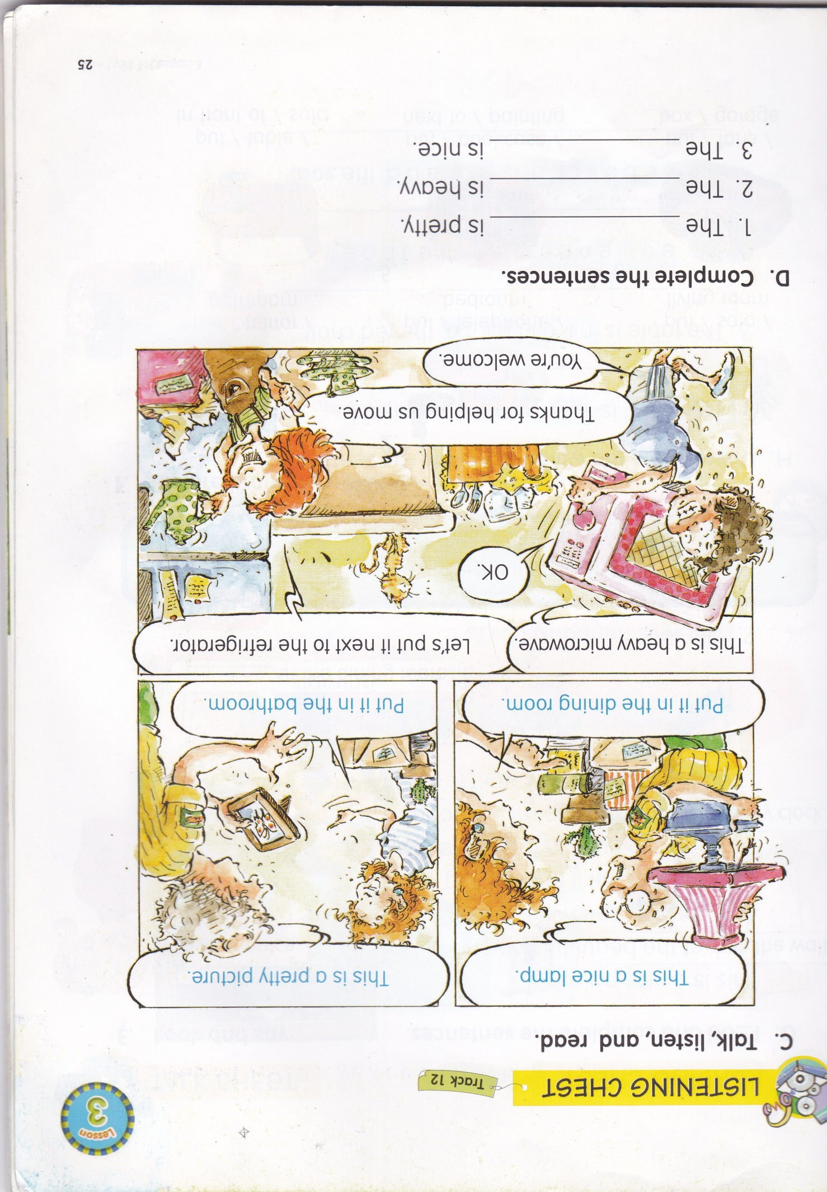

picture
microwave
lamp

Slide 17
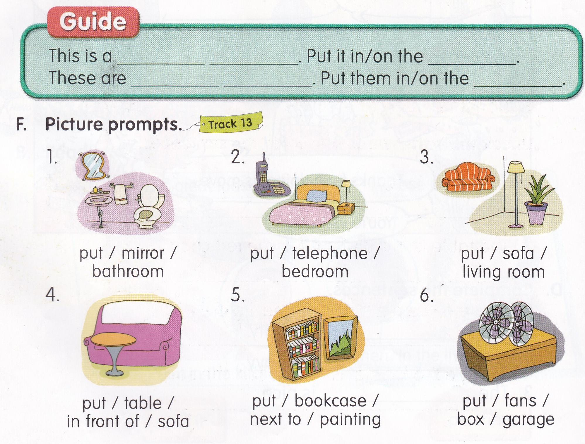

Slide 18
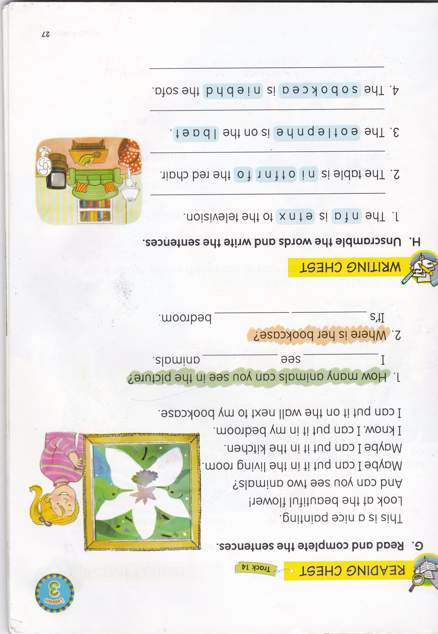
can
two
in
her

Slide 19

Unscramble the sentences
to / next / the / Put / . / bed / lamp / the
Put the lamp next to the bed.
fan / . / the / on / table / Put / the
Put the fan on the table.

Slide 20
The fan is next to the television.
The table is in front of the red chair.
The telephone is on the table.
The bookcase is behind the sofa.

Slide 21


