Slide 1
Who Is He?
Unit 2 Lesson 1

Slide 2
GRAMMAR FOCUS
Information question with Who

Slide 3
LESSON OBJECTIVE
In this lesson you will learn how to identify some occupations.

Slide 4
What is she doing?
She is teaching.

Slide 5
Who is she?
She is a teacher.

Slide 6
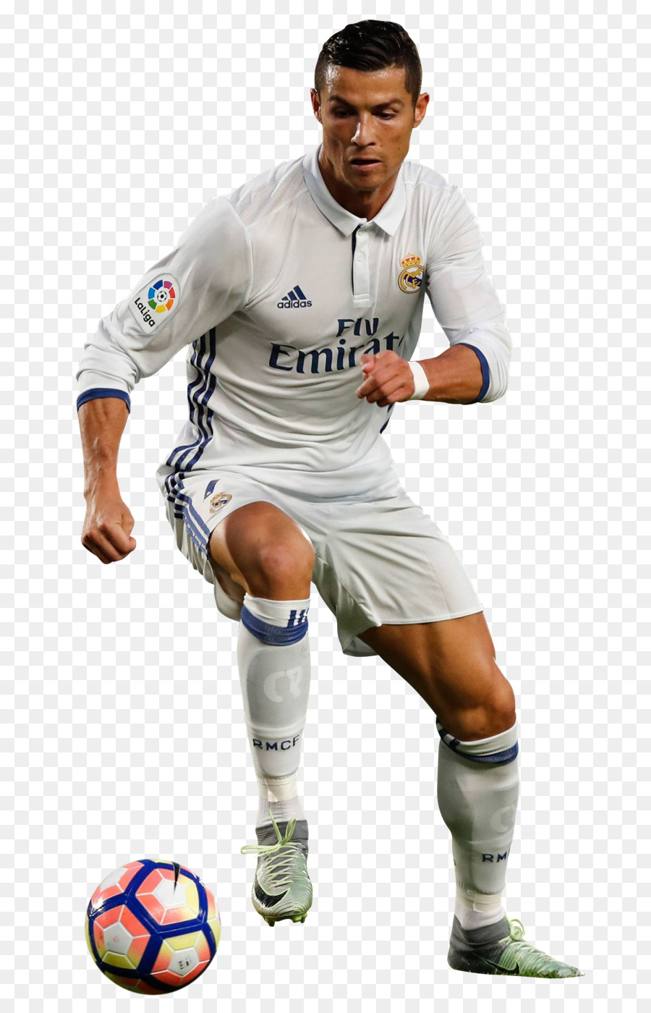
What is he doing?
He is playing soccer.

Slide 7
Who is he?
He is a soccer player.
His name is
Christiano Ronaldo.

Slide 8
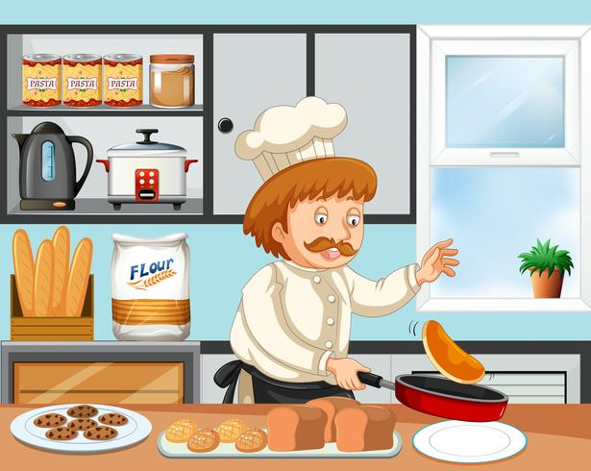
What is he doing?
He is cooking.

Slide 9
Who’s he?
He’s a cook.
He’s a chef.

Slide 10
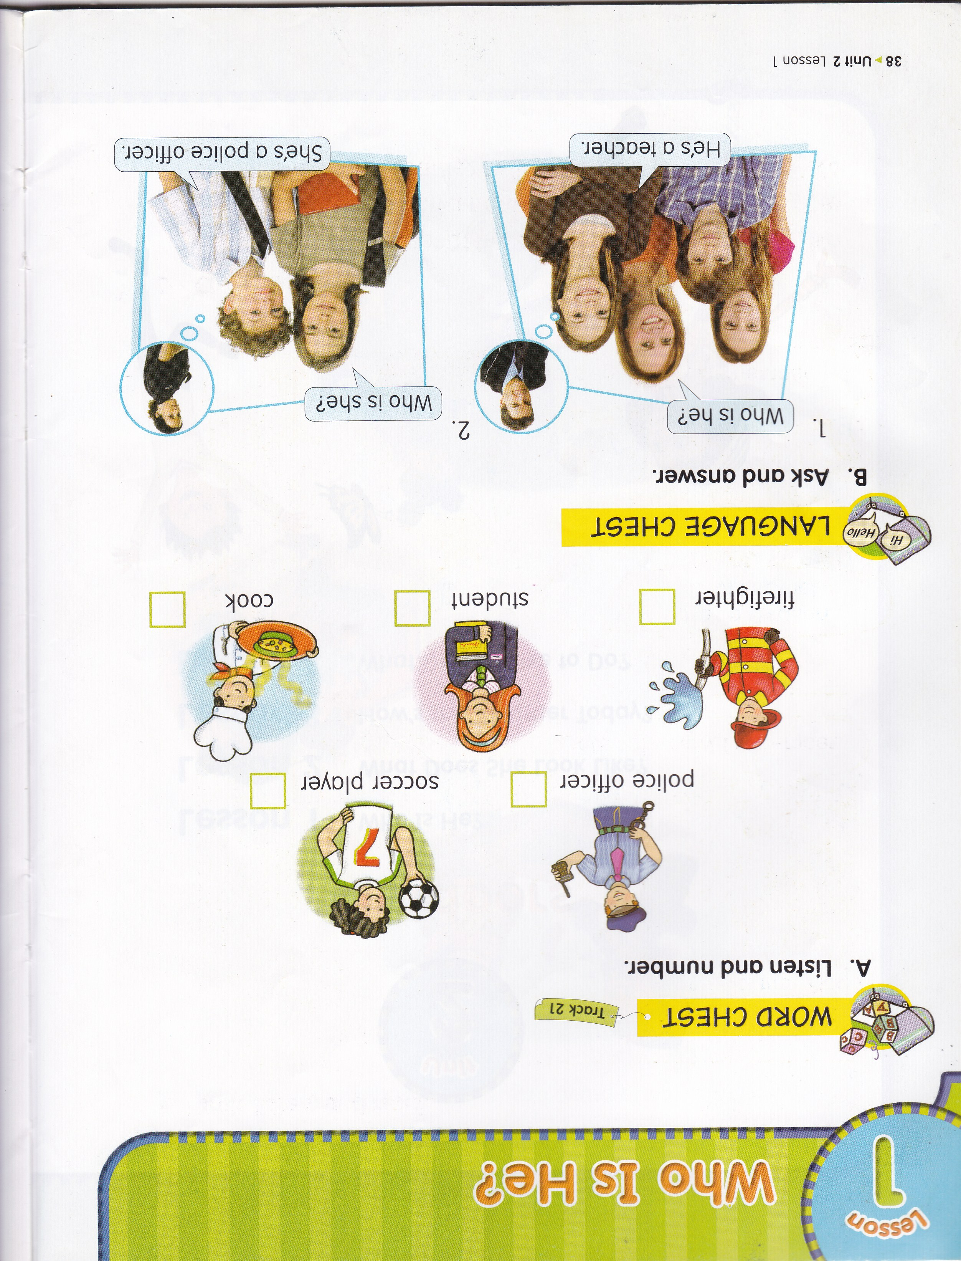
3
4
1
2
5

Slide 11
Let’s sing a song!
Who Are They?
Doctor, cook, and teacher!
Dentist and mail carrier!
Do you or I or anyone know who they are?
I think he is a dentist.
I think she is a teacher.
Tra – la – la – la …
Who is he? Who is she?
He is a shopkeeper, and she is a doctor.

Slide 12
SENTENCE PATTERNS
Who is he? He’s a __________.
Who is she? She’s a _________.

Slide 13
ASK AND ANSWER
Ella : Who is he?
Nino : He’s a teacher.
Dave : Who is she?
Kelly : She’s a dentist.

Slide 14
Adi : Who is he?
Dewi : He’s a criminal.
Davina : Who is she?
Amelia : She’s a dancer.

Slide 16
Who
is
She’s
Who
is
He’s

Slide 19
mail carrier
She is a soccer player.
They are tennis players.
He is a baseball player.

Slide 20
EC SUMMARY Unit 2 Lesson 1 Page 16 - 17
HOMEWORK

