Slide 1
Who Is He?
2nd Meeting
Unit 2 Lesson 1

Slide 2
GRAMMAR FOCUS
Information question with Who

Slide 3
LESSON OBJECTIVE
In this lesson you will learn how to identify some occupations.

Slide 4
SENTENCE PATTERNS
Who is he? He’s a __________.
Who is she? She’s a _________.

Slide 5
HOMEWORK
she
She
student
he
He
firefighter
he
He
police officer
she
She
dancer

Slide 6
dangerous
strong
brave
kind
criminal
farmer
dentist
soccer player
coach
doctor
firefighter
police afficer
cook
mail carrier
teacher

Slide 7
Who is she?
She is a teacher.
She is a librarian.
She is a student.

Slide 8
Who is she?
She is a dancer.
She is a doctor
She is a dentist.

Slide 9
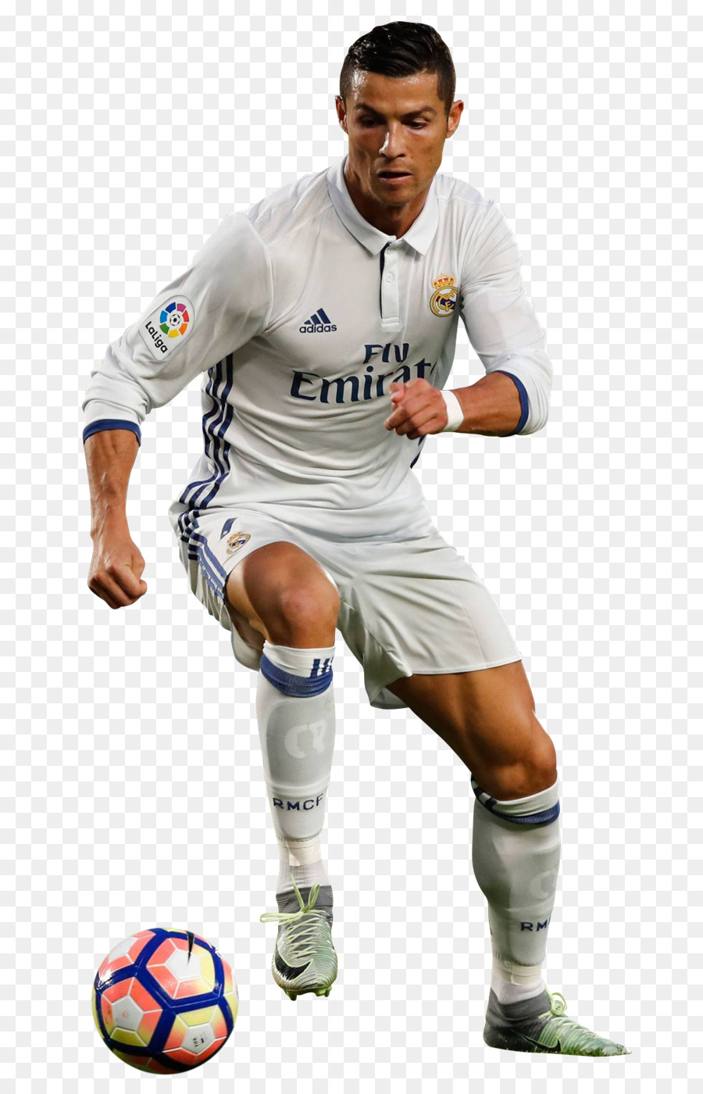
Who is he?
He is a soccer player.
He is a cook.
He is a police officer.

Slide 10
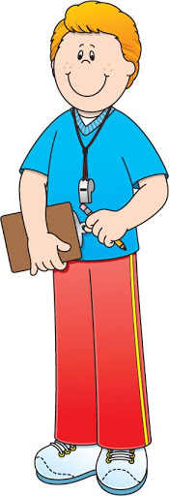
Who is he?
He is a firefighter.
He is a coach.
He is a mail carrier.

Slide 11
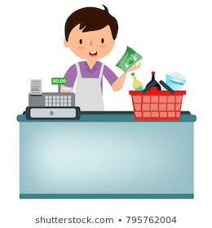
Who is he?
He is a farmer.
He is a shopkeeper.

Slide 12
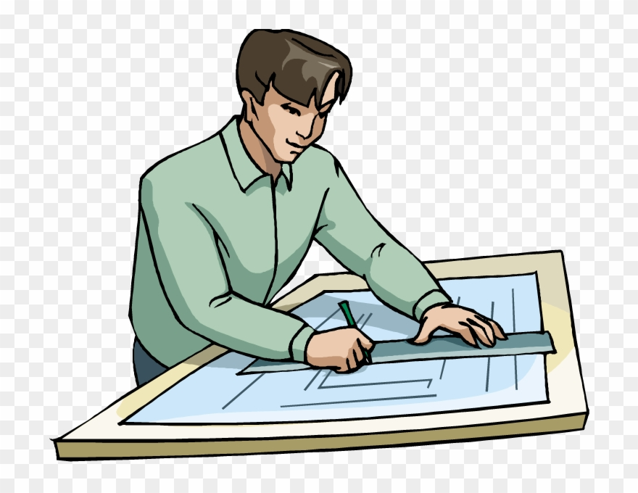
Who is he?
He is an architect.
He is a criminal.

Slide 13
Let’s sing a song!
Who Are They?
Doctor, cook, and teacher!
Dentist and mail carrier!
Do you or I or anyone know who they are?
I think he is a dentist.
I think she is a teacher.
Tra – la – la – la …
Who is he? Who is she?
He is a shopkeeper, and she is a doctor.

Slide 14
EXERCISE
She is a tennis coach.
He is a mail carrier.
She is a teacher.
He is a librarian.
He is our family doctor.

Slide 15
1. A (librarian / mail carrier / babysitter) delivers mail.
2. A (firefighter / police officer / cook) puts out fires.
3. A (doctor / dentist / shopkeeper) helps sick people.
4. A (principal / police officer / librarian) catches criminals.
5. A (babysitter / coach / firefighter) takes care of children.

Slide 16
doctors.
She is a librarian.
He is a mail carrier.

Slide 17
babysitter
that
you
know
is
she
nice
do
course
teacher
A : Do you _______ that man?
B : Of _________!
A : Who _______ he?
B : He’s our _________, Mr Wilson.
know
course
is
teacher
you
that
A : Do _____ know _____ girl?
B : Yes, I ______.
A : Who is ______ ?
B : She’s my _____________, Linda.
do
she
babysitter

Slide 18
a shopkeeper.
Who is she?
Who is he?
He is a baseball player.

