Slide 1
English Learning Video
for 3rd Grade

Slide 2
Unit 2 Lesson 2
What Does She Look Like?

Slide 3
In this video we are going to learn how to describe someone or something using Adjectives.

Slide 4
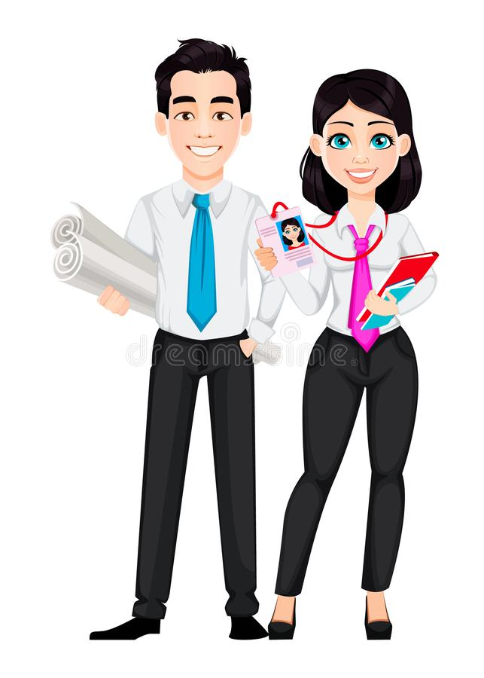
handsome
pretty
He is handsome.
She is pretty.

Slide 5
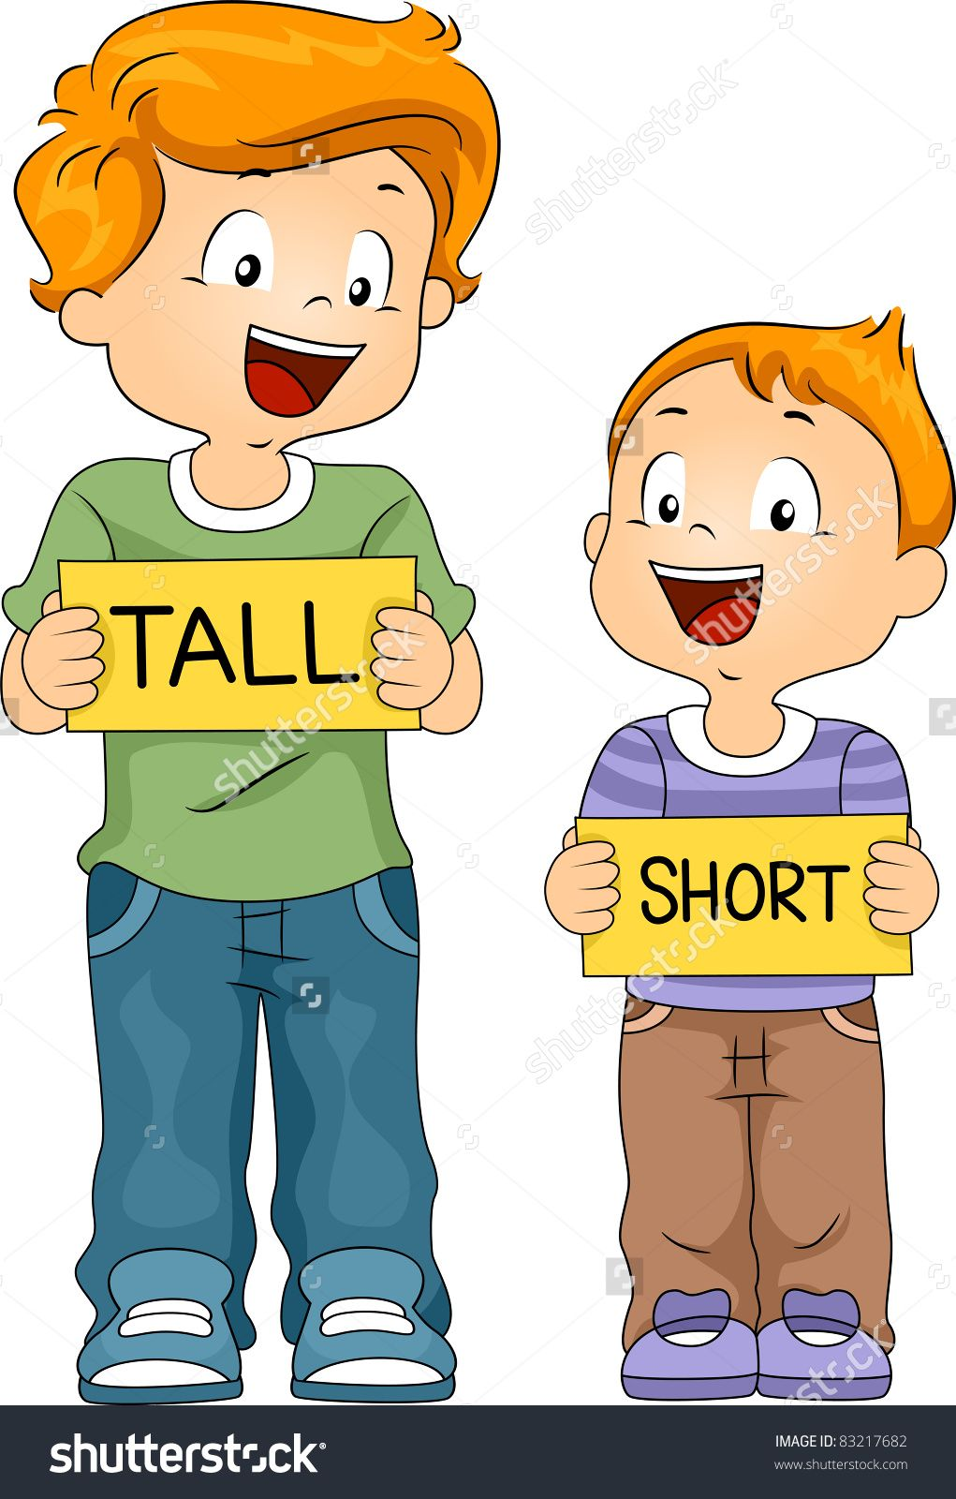
tall
short
He is tall.
He is short.

Slide 6
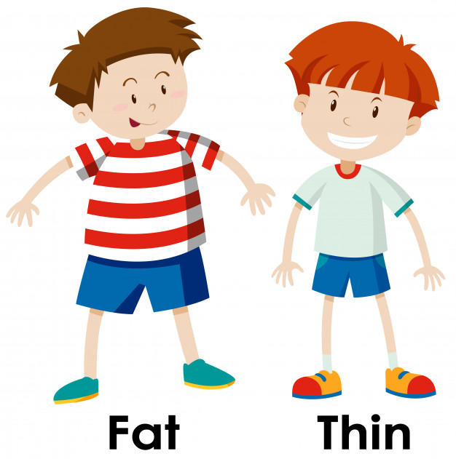
thin
fat
He is fat.
He is thin.

Slide 7
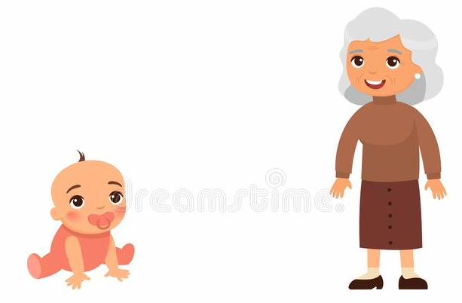
young
old
She is young.
She is old.

Slide 8
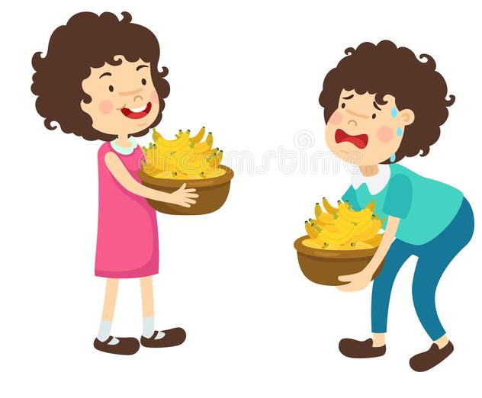
strong
weak
She is strong.
She is weak.

Slide 9
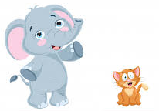
big
small
The elephant is big.
The cat is small.

Slide 10
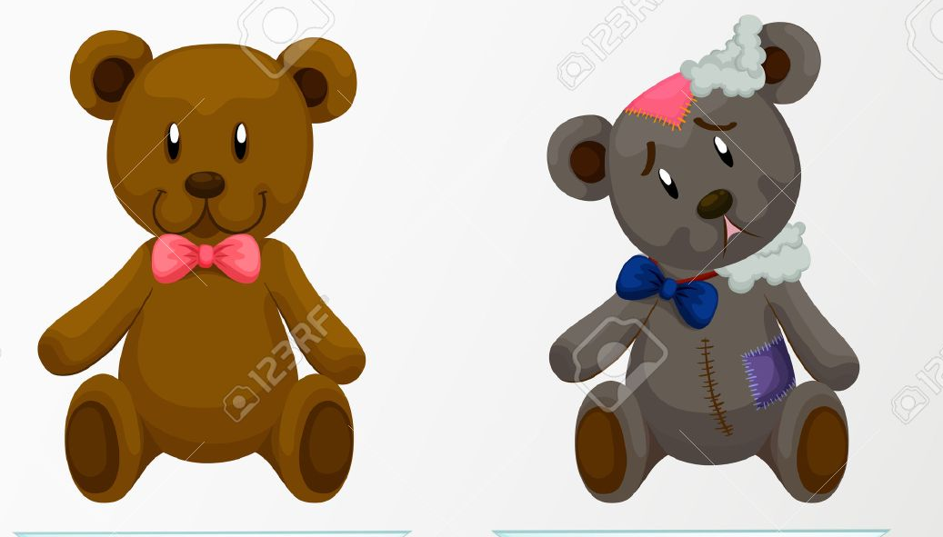
cute
ugly
The teddy bear is cute.
The teddy bear is ugly

Slide 11
Blond hair
Dark hair
He has blond hair.
He has dark hair.

Slide 12
4
1
3
2
5

Slide 13
What does he/she/it look like?
He’s / She’s / It’s ______ and _______.
What do you/ they/ we/I look like?
I’m/ you’re/ they’re/ we’re______ and _______.

Slide 14
Is she/ he/ it _______?
Yes, she/he/it is.
No, she isn’t.
No, he isn’t.
No, it isn’t.

Slide 15
do
does
he
I
you
she
we
it
they

Slide 16
What does she look like?
She’s pretty.

Slide 17
Is she blond?
No, she isn’t.

Slide 18
Is he handsome?
Yes, he is.

Slide 20
tall and handsome
A : What does he look like?
B : He’s tall and handsome.

Slide 21
big and strong
A : What does the dog look like?
B : It’s big and strong.

Slide 22
Complete the sentences!
young
cute
1. The baby is ________ and ________.
old
thin
2. The books are ______ and _______.
short
pretty
3. The girl is ________ and _______.

Slide 23
Let’s sing a song!
Short and Cute
Short and cute, short and cute!
What does your mother look like?
Short and cute, short and cute!
My mother is short and cute.
Big and strong, big and strong!
What does your father look like?
Big and strong, big and strong!
My father is big and strong.
Tall and thin, tall and tin!
What does your brother look like?
Tall and thin, tall and thin!
My brother is tall and tin.

