Slide 1


I USUALLY WEAR WARM CLOTHES WHEN IT’S COLD
Unit 1
Lesson 4

Slide 2
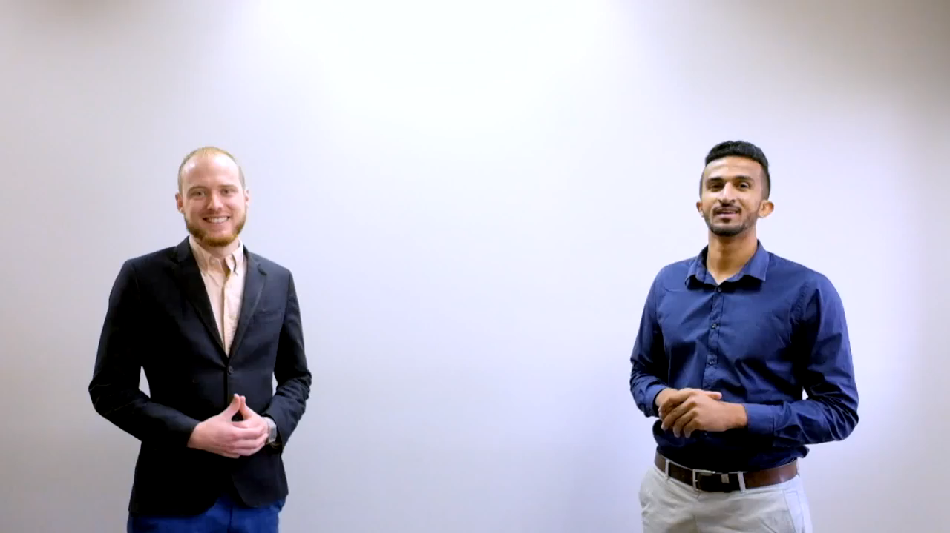

Slide 3
Adverb of Frequency

Slide 4
1. Adverb of Definite Frequency
Example:
I visit the supermarket twice a week.
I go to work three times a week.
Fatimah visits her friend every Friday
Every morning I brush my teeth.

Slide 5
1. Adverb of Indefinite Frequency
Example:
I frequently visit the supermarket.
I often go to work
I Sometimes play football after school.

Slide 6
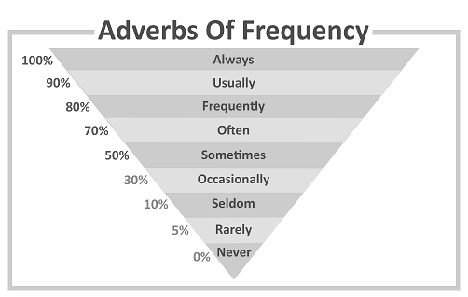

Slide 7
Rules for Position of indefinite frequency.
Subject + Adverb + Main Verb Adverb is placed before the main verb.
Example:
I always visit my bestfriend
Not
I visit always my best friend.

Slide 8
Rules for Position of indefinite frequency.
2. Subject + to be + Adverb Adverb is placed after to be.
Example:
I am never late for school
Not
I am late never for school

Slide 9
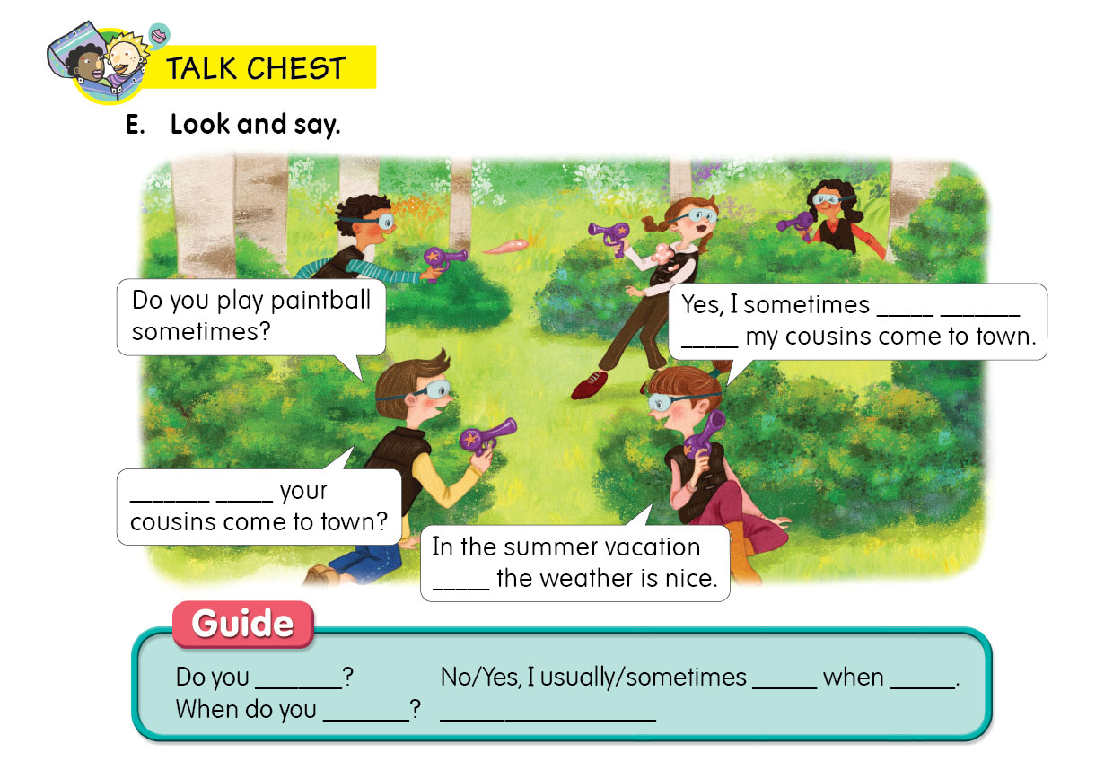
play
paintball
when
When
do
when

Slide 10
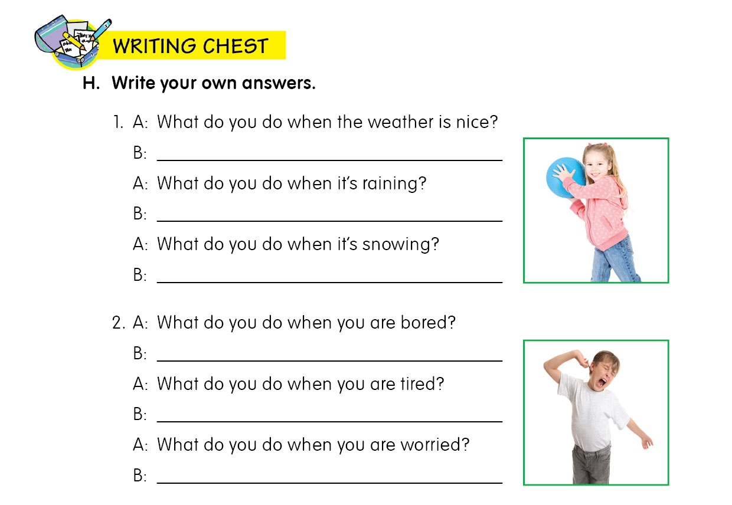
I play outside with my friends.
I stay home and watch TV.
I make a snowman.
I play video games.
I take a nap.
I talk to my parents.

Slide 11
Examples
My friends … punctual.
Never are
Are never
Are punctual never
My dad … until six o’clock.
Works usually
Work usually
Usually works.

Slide 12
Examples
She doesn’t … finish work early because she is often busy.
never
usually
always
It ... Snows where I live, so I never make a snowman.
sometimes
never
Always
We visit our grandparents three or four times ...
The month
month
A month

Slide 13
Thank you ☺

