Slide 1
She was happy because she passed the test
Unit 2
Lesson 2

Slide 2
In this lesson, we will learn about:
Talking about
things
happened
to other people
Cause and effect

Slide 3
Work in Group
What is cause and effect?
Make 3 examples and
determine the cause and the effect!

Slide 4
What is Cause and Effect?

Slide 5
Cause and Effect
The reason that something happens
or why something happens.
The consequences of an action or what happened.
So
Because

Slide 6
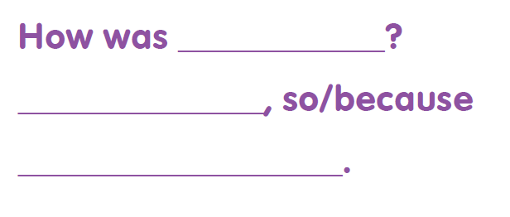

Slide 7
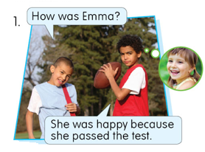
Cause
Effect
Because she passed the test.
She was happy.
What’s happening?
Why she was happy?

Slide 8
Structure of cause and effect
Because + Cause
So + Effect

Slide 9
Cause
Effect
Because she passed the test.
She was happy.

Slide 10
Determine the cause and effect in the following sentence
1. We didn’t have school on Monday because We had 8 inches of snow.
Cause:
We had 8 inches of snow.
We didn’t have school on Monday
Effect:
2. Alyssa was very tired Friday night so she went to bed early.
Cause:
Alyssa was very tired Friday night
She went to bed early
Effect:

Slide 11
He slipped on the ice so he was embarrassed.

Slide 12
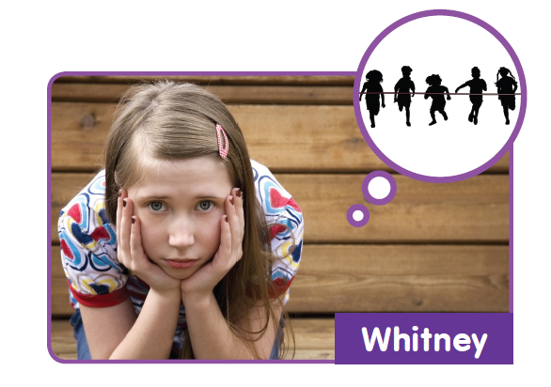
She was disappointed because she lost the race.

Slide 13
1. She was confused because she didn’t understand the teacher.
She _________________________, so _______________
2. He ripped his jeans because he was in a hurry.
He _______________, so ___________________
3. She was happy because she met her friend.
She _______________, so __________________
4. He was tired because he went to bed late.
He _________________, so _________________
didn‛t understand the teacher
she was confused.
was in a hurry
he ripped his jeans.
met her friend
she was happy.
went to bed late
he was tired.

Slide 14
1. He was lazy ... he did not study well.
a. so
b. because
2. I could not talk to him ... he was busy.
a. because
b. so
3. He was ill ... he did not attend school for a week.
a. so
b. because

Slide 15
He was embarrassed because he ripped his shirt.
How was Gina?
She did her homework wrong so she was frustrated.
How was John?
He spilled milk all over the counter because he was tired.

Slide 16
THANKS!

