Slide 1

Unit 2
Lesson 3
The Nile Is the Longest River in the World

Slide 2
What can you see?

Slide 3
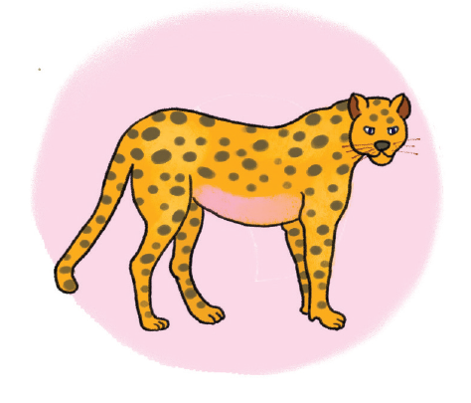
What can you see?

Slide 4
In this lesson, you will learn :
Talk about record – holding animals/ things,
Interesting facts about these animals/ things using superlative adjectives.
Exclamations.

Slide 5
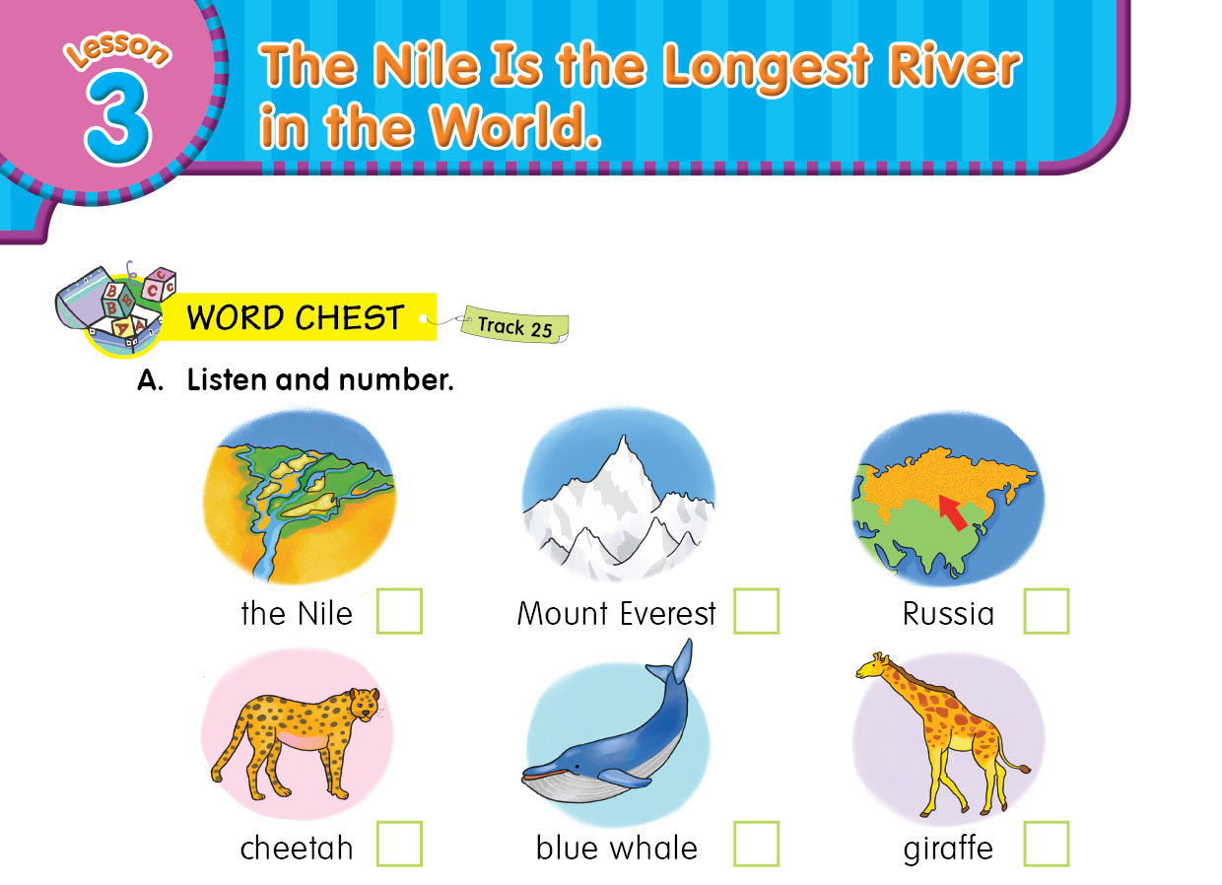

4
6
1
2
3
5

Slide 6



a river in Egypt
a mountain in the Himalayas.
the world’s largest country

Slide 7
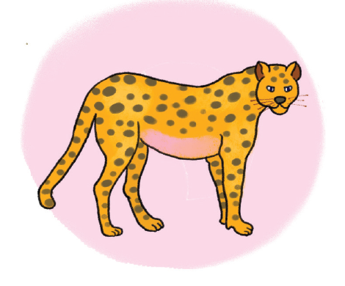

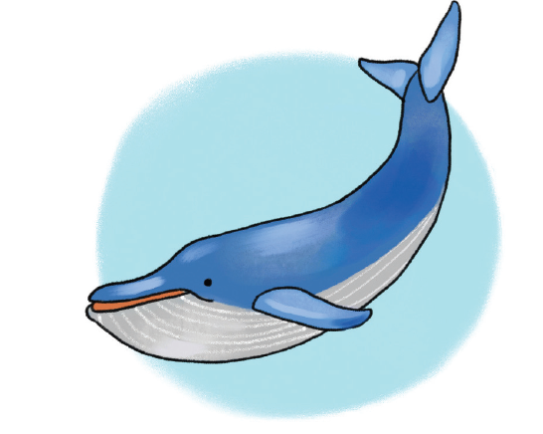

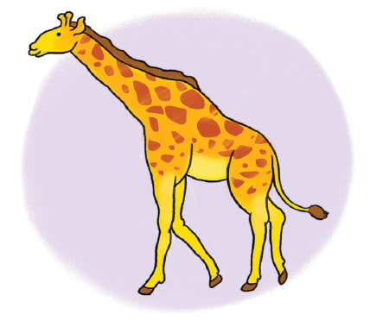

a wild cat.
a large sea animal.
an animal with a very long neck.

Slide 8
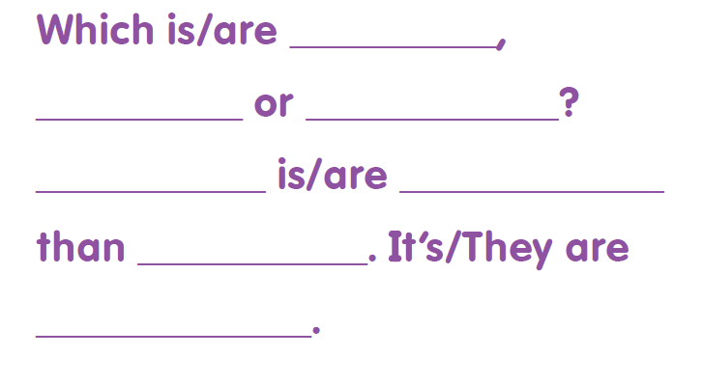

Slide 9
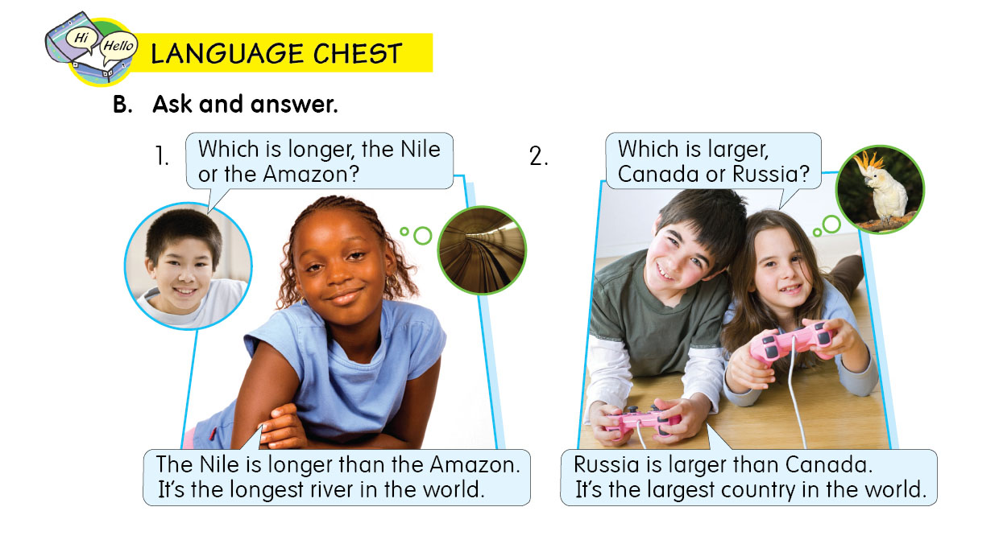

Slide 10
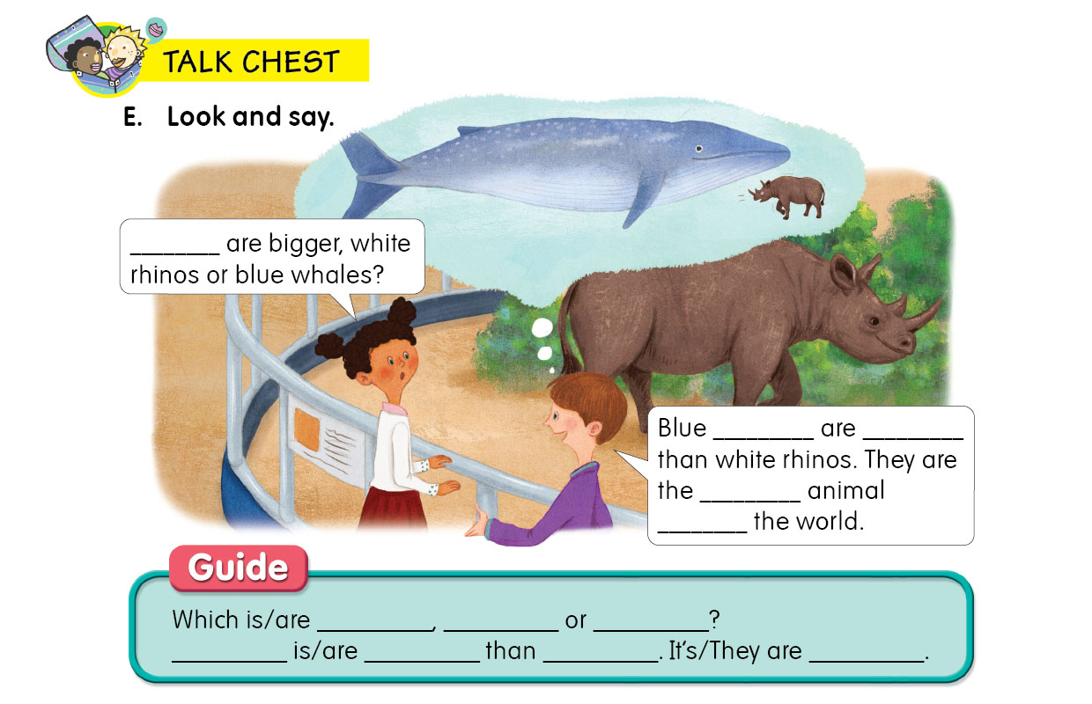
Which
whale
bigger
biggest
in

Slide 11
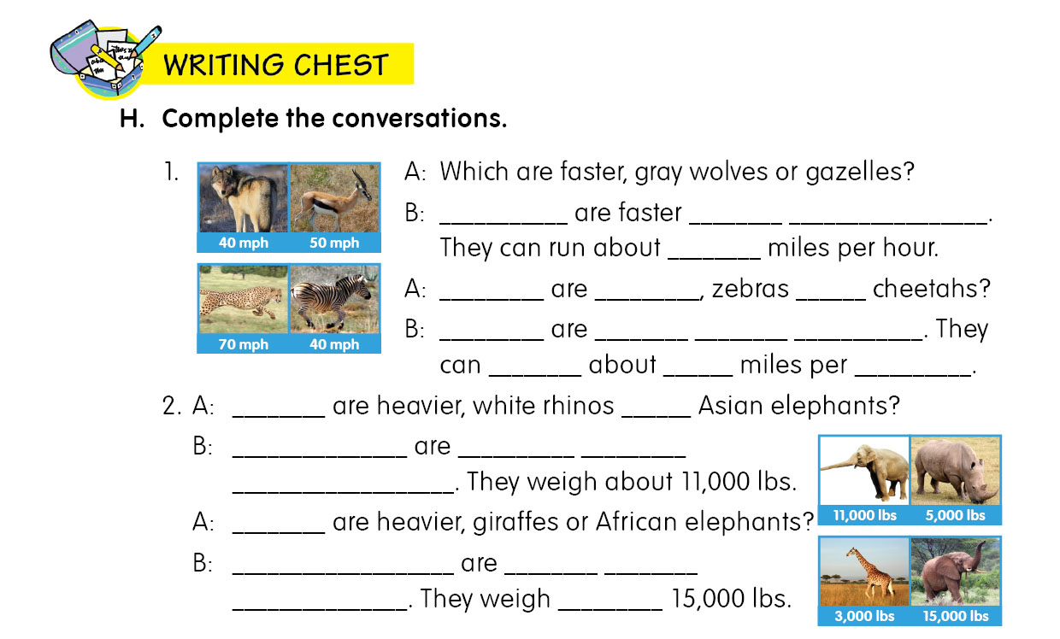
Gazelles
than
gray wolves
50
Which
faster
or
Cheetahs
faster
than
zebras
run
70
hour
Which
or
Asian elephants
heavier
than
white rhinos
Which
than
African elephants
heavier
giraffes
about

Slide 12
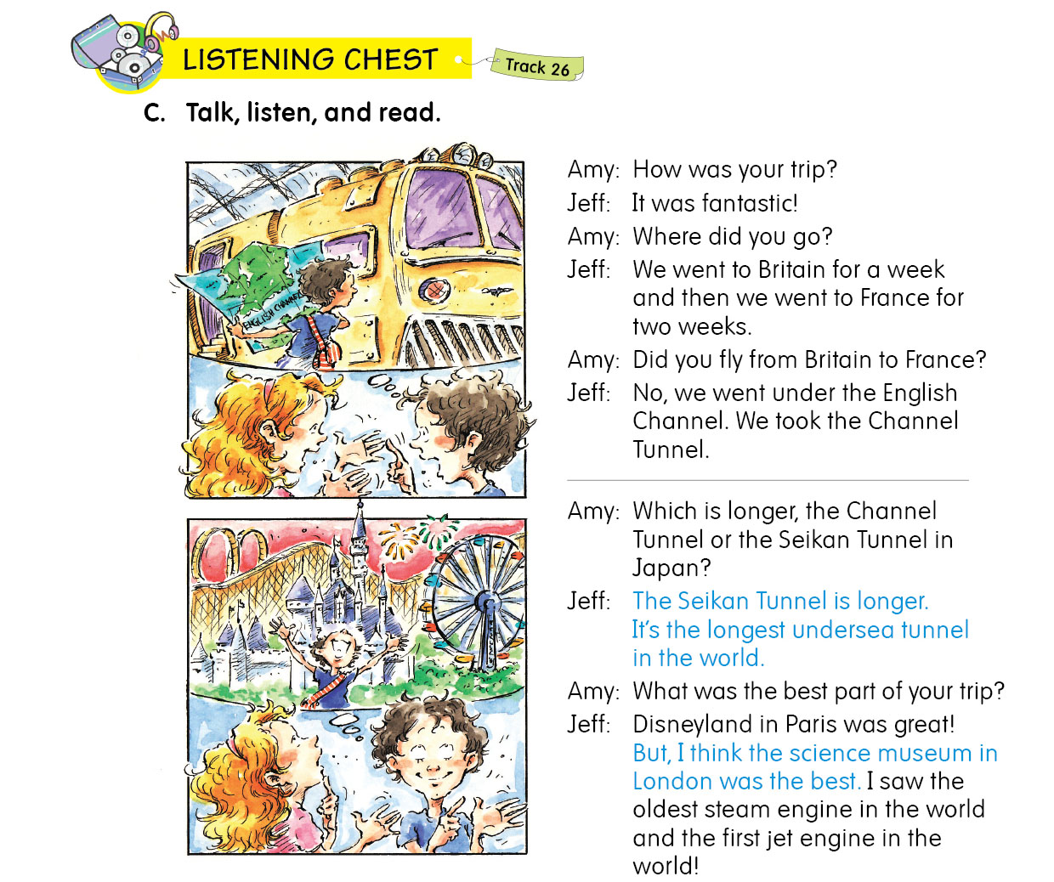

Slide 13
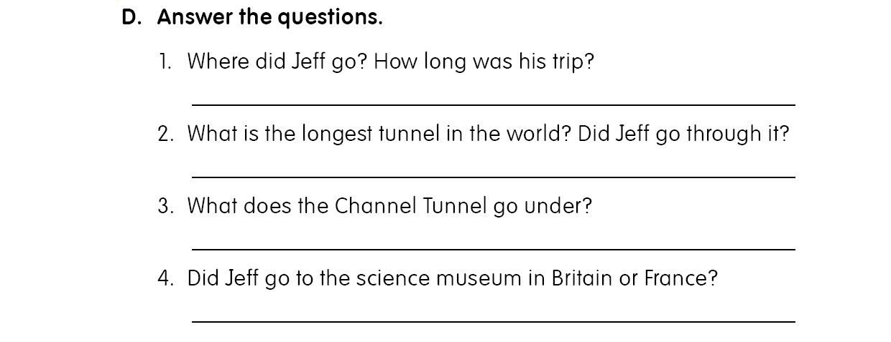
He went to Britain and France. It was three weeks long.
The Seikan Tunnel is the longest undersea tunnel in the world. Jeff didn’t go through it.
The channel Tunnel goes under the English Channel.
He went to the Science Museum in Britain.

Slide 14
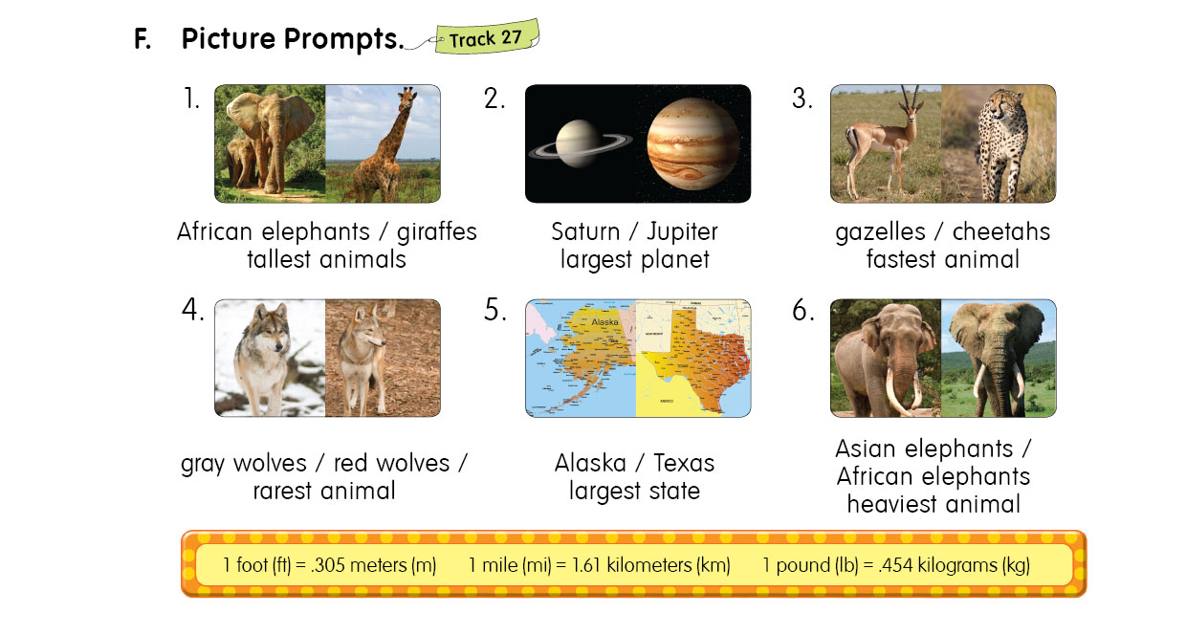

Slide 15
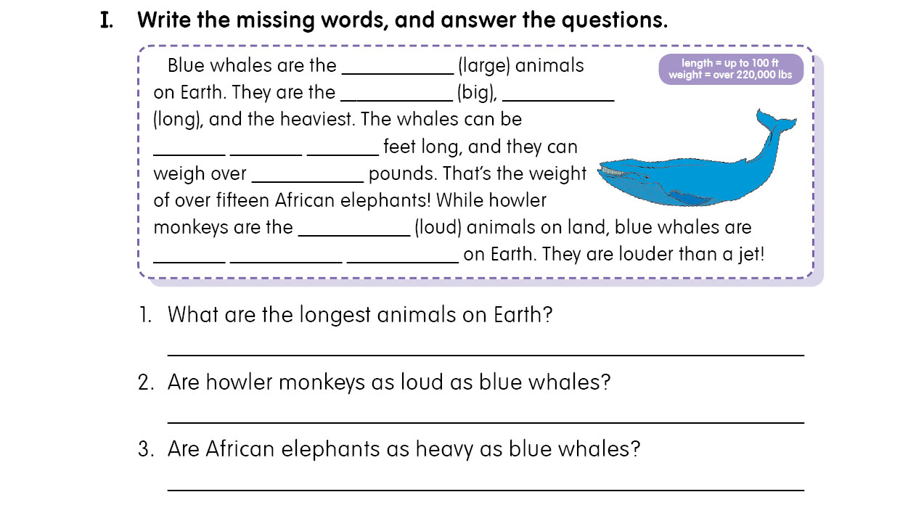
largest
biggest
longest
up
to
100
220,000
loudest
the
loudest
animals
Blue whales are the longest animals on Earth.
No, howler monkeys are not as loud as blue whales.
No, African elephants are not as heavy as blue whales.

Slide 16




Slide 17
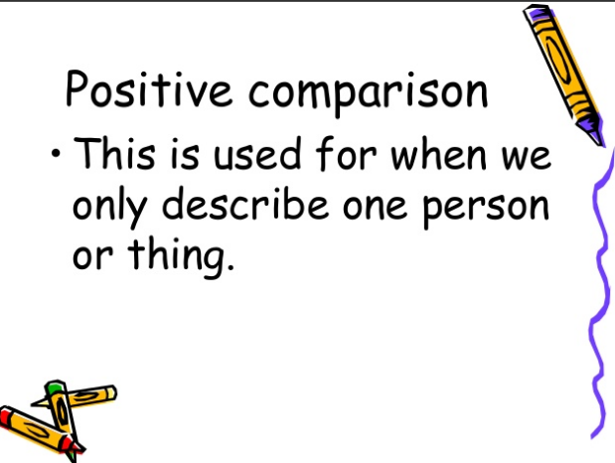

Slide 18
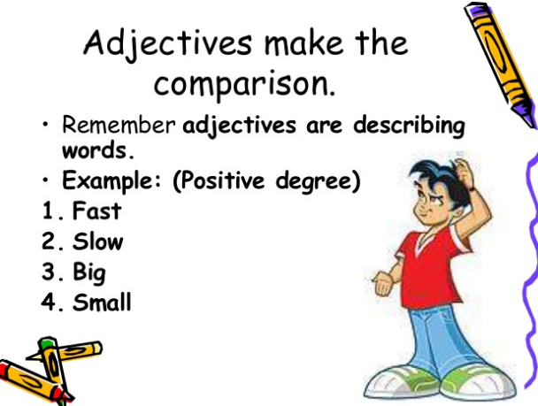

Slide 19
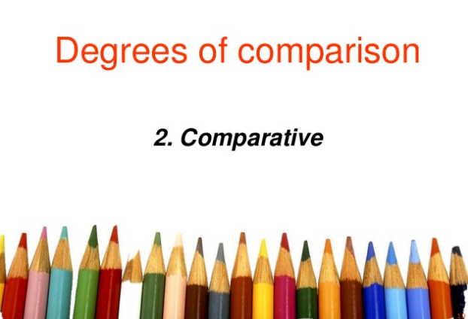

Slide 20
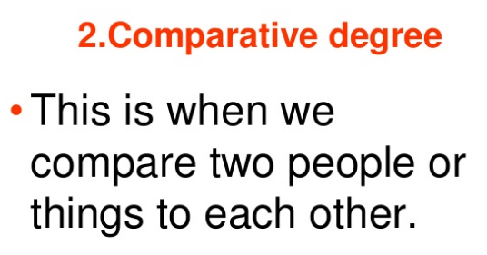

Slide 21
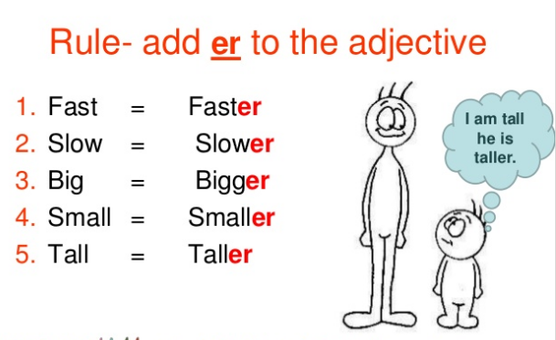

Slide 22
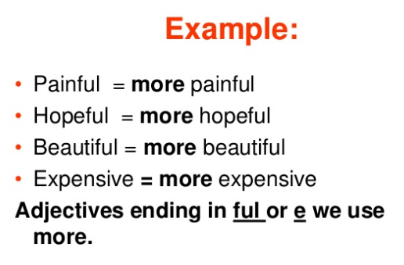

Slide 23
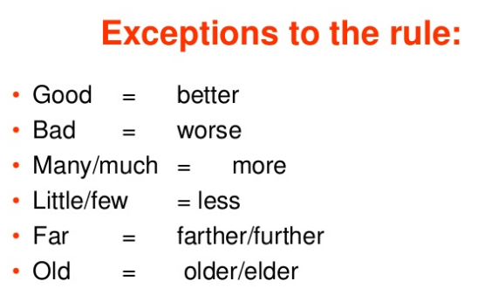


Slide 24
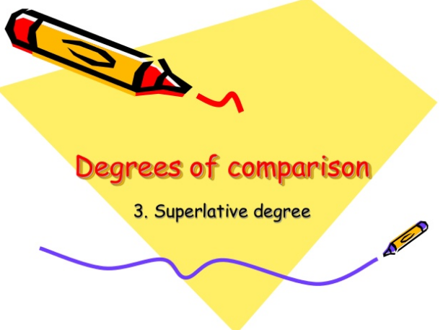

Slide 25
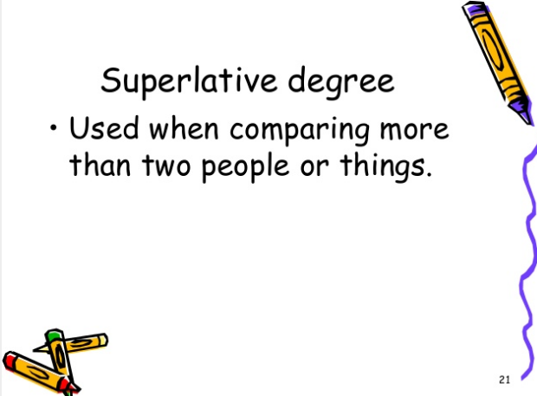

Slide 26
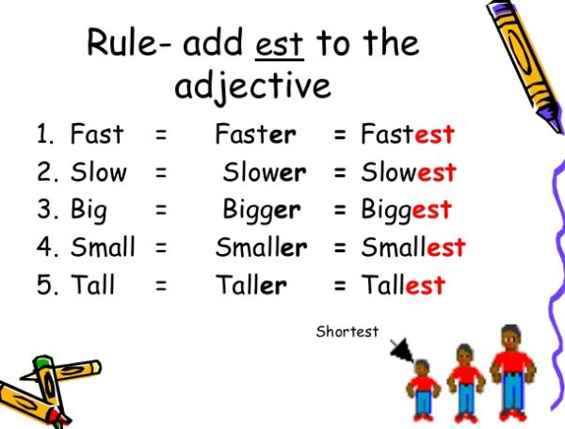

Slide 27
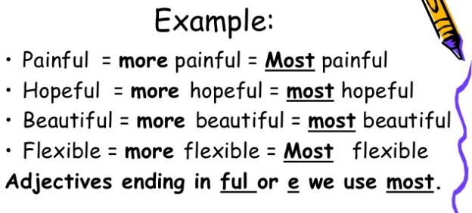

Slide 28
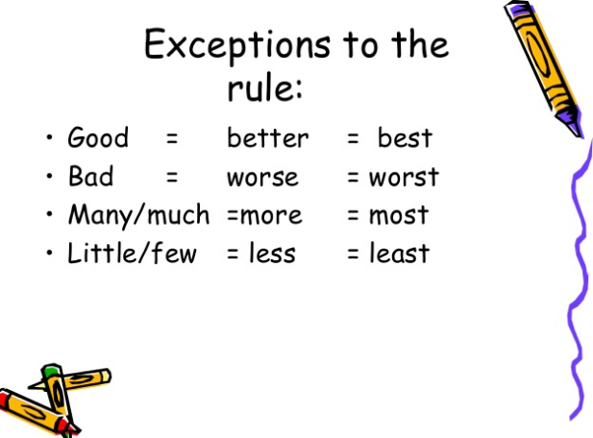

Slide 29
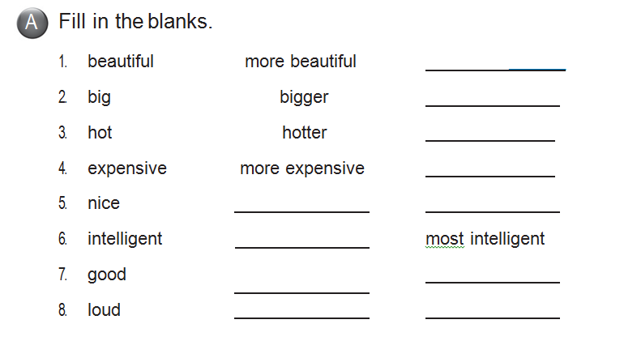
most beautiful
biggest
hottest
most expensive
nicer
nicest
more intelligent
better
best
louder
loudest

Slide 30

Thanks

